Slide 1
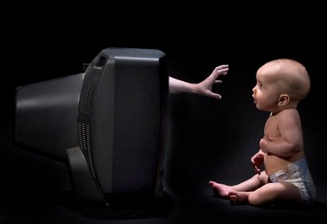
The Dark Side of Socialization
Guiding Question: Is the media a POSITIVE agent of socialization or a NEGATIVE?

Slide 2
Opening Question:
Is there a “standard of beauty” in our society?

Slide 3
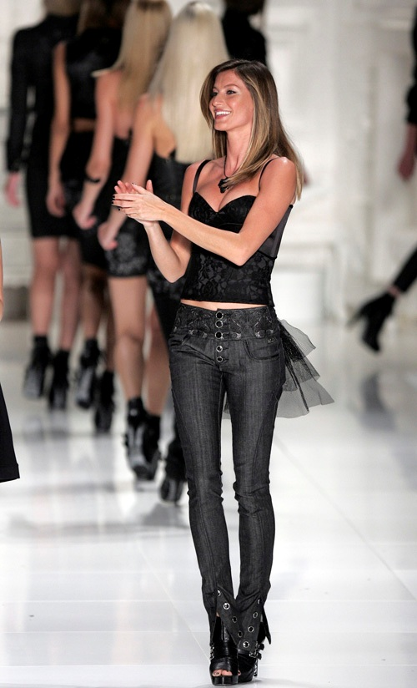
Gisele-Bundchen:
This is the current image of “female beauty”

Slide 4
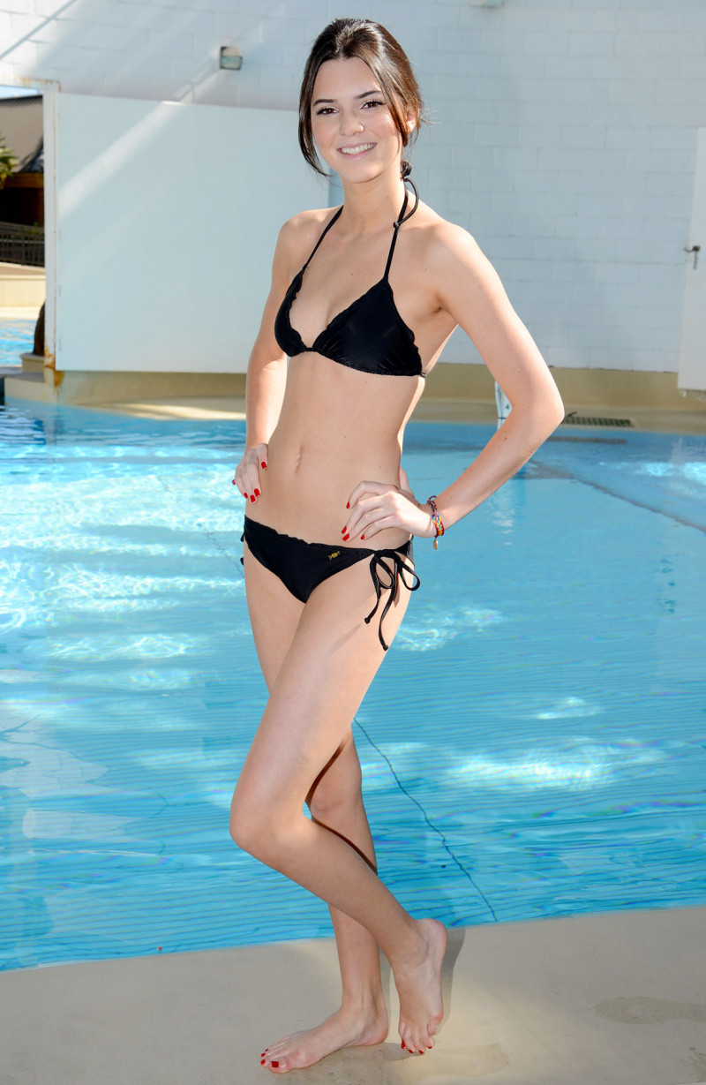
Kendall Jenner: As of 2016

Slide 5
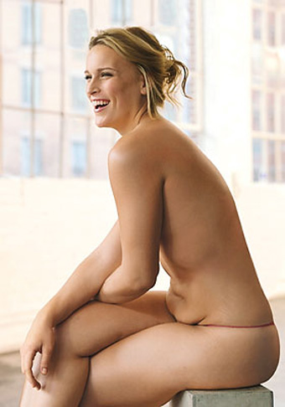
Glamour
Notes:
Controversy?

Slide 6
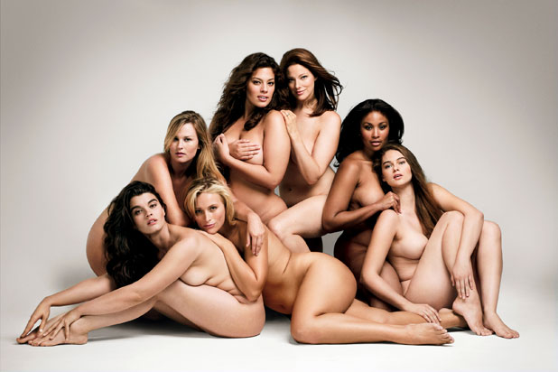
Dove Campaign

Slide 7
Most common American dress size: Size-14
...Designer labels stop at Size-10 or 12
“Plus size models” aren’t all that “plus”... They are Sizes-6+
Dove: Campaign for Real Beauty
Glamour: Committed to shoving a wide range of body types, celebration of so called “imperfections”, support of designers who share this celebration

Slide 8
How are men socialized by the media?
Masculinity in Disney Films
Masculinity & Alcohol

