Slide 1
Postmodernism
The study of Modernity: What is the world like TODAY?

Slide 2
Definition:
Postmodernism blends multiple sociological theories to describe the world as it is today.
Most scholars refer to the world’s “periods of modern history” in the following way:
1485-1500 - Early Modern Period: (War of Roses, Renaissance)
1760-1840 – Modern Period: (Industrial Revolution)
1900 and Beyond – Postmodern or “New Modern” Period

Slide 3
What do postmodernists say about the world?
Michael Foucault (1991) says that the world today is far more violent than most people realize. People don’t acknowledge all of the forms of “violence” in which one group exerts its control over another.
Foucault is using the term “violence” in a different way than we normally do…he is talking about the various ways in which individuals and groups control one another.
Examples: Gossip, Laws, Protests, Riots, Economic needs

Slide 4
What do postmodernists say about…
Reality – “The Gulf War did not happen!” (Jean Baudrillard, 1981, 2000).
    What he meant was that the media shaped the event so heavily that in so doing reality was replaced by “signs” or representations.
    Social Class – “We embody our social structure” (Pierre Bourdieu, 1979, 1991).
    What he meant was that by living in our distinct social class we inherit our forms of social, cultural, and symbolic capital. We perpetuate our own class system.
    Gender/Sexuality – Both are social constructions and are merely just performances based on what we “think” we know about who we are.

Slide 5
What do postmodernists say about…
“The Truth” – Jacques Derrida says there is no such thing as objective truth, but instead proposes bias is inescapable and will always exist on some level.
Life - Fredric JAMESON – says that individuals living in the Postmodern world are merely just “copy and pasting” their lives away. Due to the way our societies are set up and structured from birth to death we are no longer living for ourselves or in creative ways, but we are instead constantly copying (learning) from the existing system and pasting (perpetuating, reinforcing) it throughout the course of our lives.

Slide 6
What do postmodernists say about…
Technology – Manuel Castells describes the modern world as a “network society.”
Think about how a computer works.
1. There is a circuit board (the world)
2. On the board there are nodes, which are electronic signal generators and receivers (Individuals)
3. These nodes are connected through the “network” of information sharing (People are connected in society through institutions, culture, technology, etc)

Slide 7
Who is the most famous living postmodernist?
Slavoj ZIZEK: Žižek is well-known for using examples from popular culture, particularly cinema, to explain the complex theories of intellectuals. He has gained considerable popularity with his original approach. His work has contributed a lot to postmodern theory, especially his work concerning the nature of reality. A few of his key works include The Plague of Fantasies (1997) and Looking Awry: An introduction to Jacques Lacan through popular culture (1991).
Video: Ideology – A system of ideas or ideals
Examples: “The American Dream,”My religion is the right one,” or “my culture is better than yours!.”

Slide 8
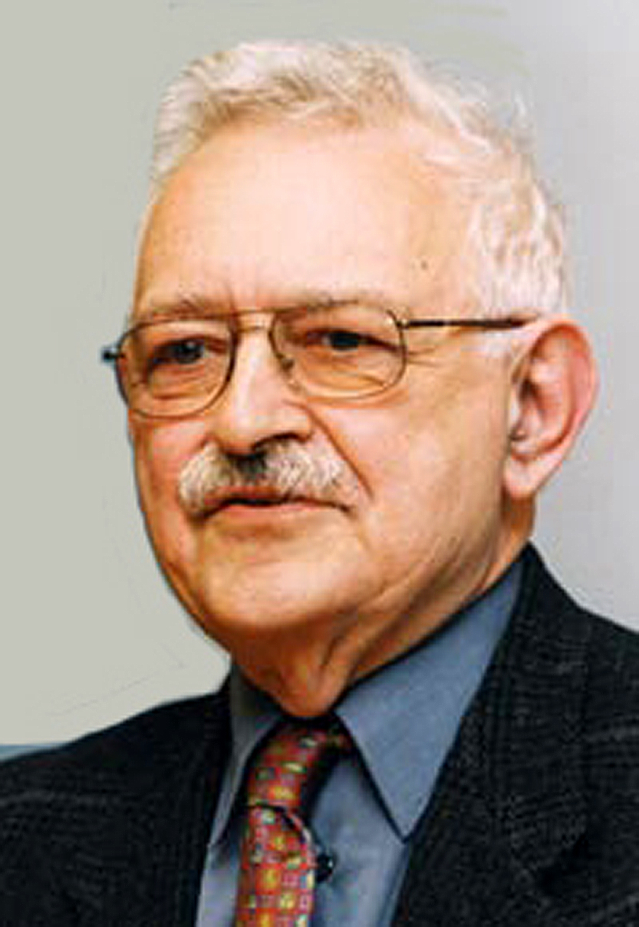
And finally…
The only one you actually *need* to know about…
Immanuel Wallerstein & World Systems Theory (1974).

Slide 9
What is World Systems Theory?
W.S.T. takes a traditional Marxist analysis and applies it on a global scale (Macro theory).
Recall that Karl Marx said that individuals exploit one another (Bourgeoisie & Proletariat) within the system of modern capitalism
Immanuel Wallerstein applies that idea to the global stage…instead of focusing on the exploitation of individuals (micro theory) he focuses on the exploitation of entire nations (macro theory).

Slide 10
Wallerstein’s Argument
Wallerstein argues that the only way the current global system can exist is through a system of exploitation.
Wealthier nations, usually the ones who became industrialized first, were able to monopolize the world economy.
Wealthier nations maintain their power and wealth by exploiting poorer nations.
Imagine a pyramid…

Slide 11
W.S.T.
There are THREE types of nation-states:
1. Core Nations – The nations with the most power that must exploit both other types in order to sustain itself.
2. Semi-periphery Nations – Exploited by the core, but also exploit the periphery.
3. Periphery Nations – Nations with the lowest levels of cultural, political, and economic power. They are subject to international trade laws and organizations which undermine their economic interests. As a result they have a low standard of living.

Slide 12
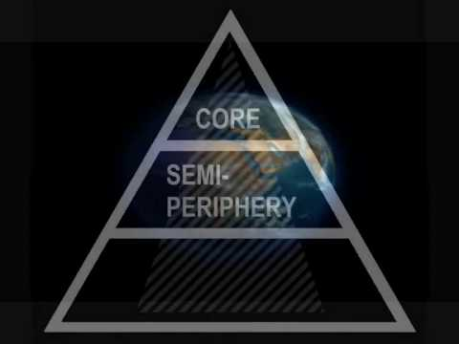

Slide 13
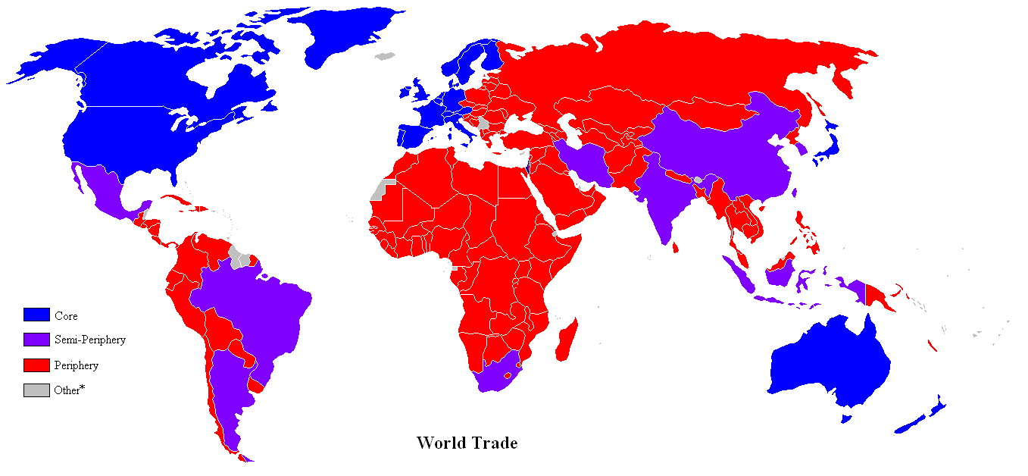

Slide 14
Final question:
If we are to assume that Wallerstein’s theory is true, then HOW does it actually occur? How do core nations exploit the peripheral nations?
In other words… how goes the global system work?
Let’s find out…

