Slide 1
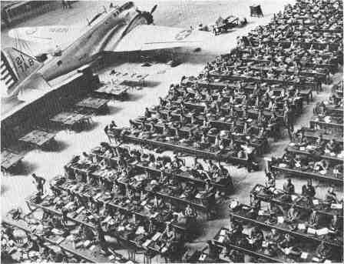
Module 20.3 [Part II]:
Mobilizing for Defense
Chapter 25 – Section 1

Slide 2
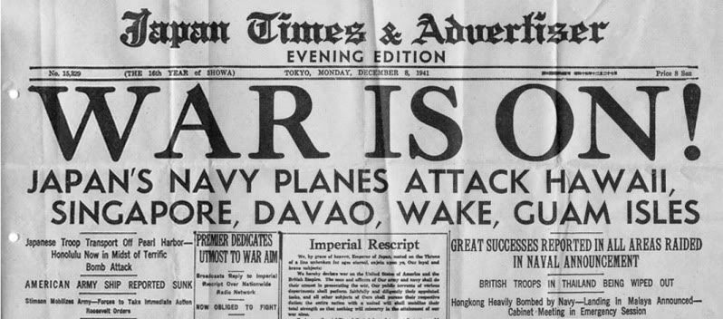
The day after Pearl Harbor…
Japan Times boasted that the United States had been reduced to a “third-rate power” and was “trembling in her shoes.”
Hitler says: “What is America but beauty queens, millionaires, stupid records, and Hollywood?”
….He was about to find out

Slide 3

However…
Americans were not trembling with fear… but with anger under the battle cry of “Remember Pearl Harbor!”
With popular support on his side… FDR expands the military
5 million volunteer for service… still not enough

Slide 4

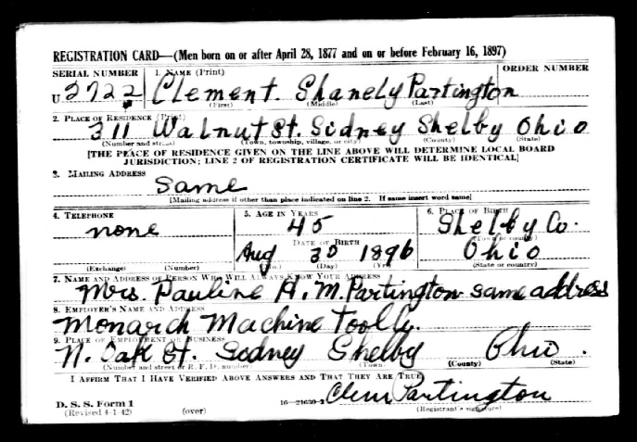
The Selective Service System expanded the draft and eventually provided an additional 10 million troops for the war effort
Women were now allowed to serve as “Auxillary” corps as nurses, ambulance drivers, radio operators, electricians, and pilots
…nearly every duty NOT involving direct combat.

Slide 5
U.S. Needs an Industrial Hero
FDR asks Bernard Baruch to lead the US’s industrial war effort at home – he says NO!
-----------------------------------------------------------------------
FDR: “If not you, then who can handle such a job? Who are the top three industrial production men in the United States right now?”
Baruch: “First, Bill Knudsen. Second, Bill Knudsen. Third, Bill Knudsen.”

Slide 6
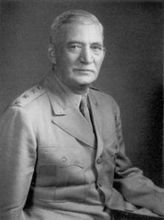
William Knudsen
-Danish immigrant (from Denmark) who came to America for opportunity
-Started out as a simple photographer, then opened his own bicycle shop and learned all he could about machines and production
-Impressed Henry Ford when he met him and got a job at Ford. Eventually worked his way up to foreman and then overseer of all production.
Agreed to start working at Ford for FREE!

Slide 7

At Ford Motors…
Knudsen perfected Ford’s “assembly line” practice by designing new factories FOR the machines and process needed for production
Became Ford’s highest salaried employee and increased its production and sales enormously
Left after a falling out with Henry Ford

Slide 8
General Motors
Knudsen became VP of General Motors
Took GM to the #1 spot in automobile industry
When FDR asked him to come help with the war effort, he left an enormous GM salary to come help out for FREE.
Eventually did receive compensation

Slide 9
Why it matters:
Knudsen’s perfected assembly line model would become the blueprint for transforming the US’s war production effort at home.
New factories would be set up in rural areas all throughout the US:
We will talk about one in particular in Dixon, IL …
THE GREEN RIVER ORDNANCE PLANT

