Slide 1

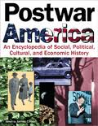
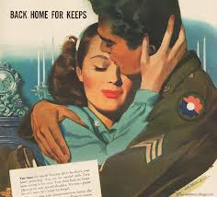
22.1: The Postwar Boom
The United States Economy After WWII

Slide 2
UNIT GOAL:
TO ANALYZE AMERICAN CULTURE OF THE 1950s USING *PSAs AS EVIDENCE
*PSA = Public Service Announcement

Slide 3

After WWII…
Most Americans were looking to put the nightmares of the war behind them and start their lives again. Many people felt that their lives had been “put on hold” by the war and there was a strong desire and push for “normalcy.”

Slide 4
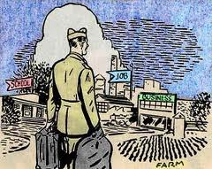
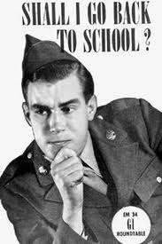
Helping veterans
There had been a strong pattern throughout American (and world) history of soldiers going off to war and coming back with readjustment problems.
This not only had a huge impact on the soldiers’ lives but on society in general.

Slide 5

The G.I. Bill of Rights was a law passed in 1944 that helped veterans by giving them:
Unemployment pay while they transitioned back into the civilian world
Money for college
Low interest home and business loans

Slide 6
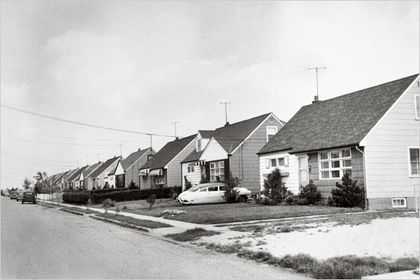
Rising Divorce Rate:
Changes in Cultural Beliefs: Men were supposed to be the breadwinners and head of household while women were supposed to be the caretakers. New social pushes for equality for women caused some social tension.
Tension created by changes in men and women’s social roles contributed to a rising divorce rate.

Slide 7
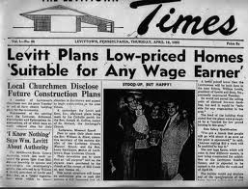
Readjusting the Economy
The end of the war caused the government to cancel $35 billion in war contracts.
1 million+ defense workers found themselves quickly laid off.
Those workers competed with returning veterans for jobs – and unemployment rose to 6% (BLS.Gov).
Unemployment would continue to rise well into the mid 1980s (BLS.Gov).

Slide 8
1950’s Boom: As a result, many economists began to predict a postwar depression…but they were wrong.
The American economy would be enormously successful due to Americans’:
1. Widespread savings and frugalness during the war
2. Pent-up consumerist desire to buy things as a result of wartime rationing
3. Widespread investments in war bonds during the war paying off in the decades to come
4. Strong foreign markets as a result of war ravaged Europe & Asia

Slide 9
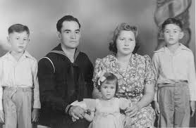
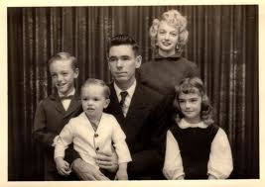
Truman’s Bout with Social Issues
Although the economy would end becoming quite successful, people were very unsure right after the war
Truman had to deal with many labor strikes…workers were dealing with high prices due to inflation and low wages due to a huge influx of workers
Truman responded by threatening to draft all of the strikers into the military…and the Unions gave in

Slide 10
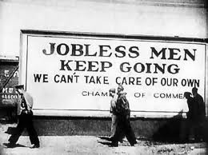
Truman’s Bout with Social Issues CONT’D
The Republican Party gained control of “the House” for the first time since 1928 and they started to make political life very difficult for him
Truman put himself on the line in support of civil rights and this hurt him politically.
“I am asking for equality of opportunity for all human beings,” he said, “…and if that ends up in my failure to be reelected that failure will be in a good cause.”

Slide 11
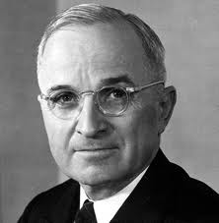
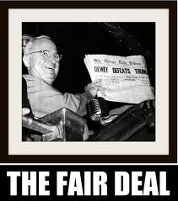
Truman Wins Re-Election in 1948
A new coalition between Republicans and “Dixiecrats” (southern Democrats against the Civil Rights movement) would hinder his ability to get things done.
Truman’s new program: Fair Deal – an expansion of social programs similar to FDR’s New Deal
. He was defeated on almost all proposals. Truman’s approval rating sank to an all-time low of 23%.

Slide 12
The Republicans Take Over
President Eisenhower won the election in 1952.
His Vice President, Richard M. Nixon faced allegations of fraud and profiting illegally from financers. Nixon gave an emotional speech on television now famously known as the “Checkers Speech” – denying those allegations.
“Middle Road” – Refers to Eisenhower being fiscally conservative but liberal on social issues

Slide 13
New Republicanism: Eisenhower’s Successes
Brown v. Board of Education of Topeka
Financing the interstate highway system
Balancing the budget
Cutting taxes
Raising the minimum wage
Extending social security and unemployment benefits
Increasing funding for public housing

Slide 14
Election of 1956
As a result, Eisenhower’s popularity soared and he won re-election in 1956.
Republicans winning the House and the Presidency was a clear signal that the American people were ready for change.

