Slide 1
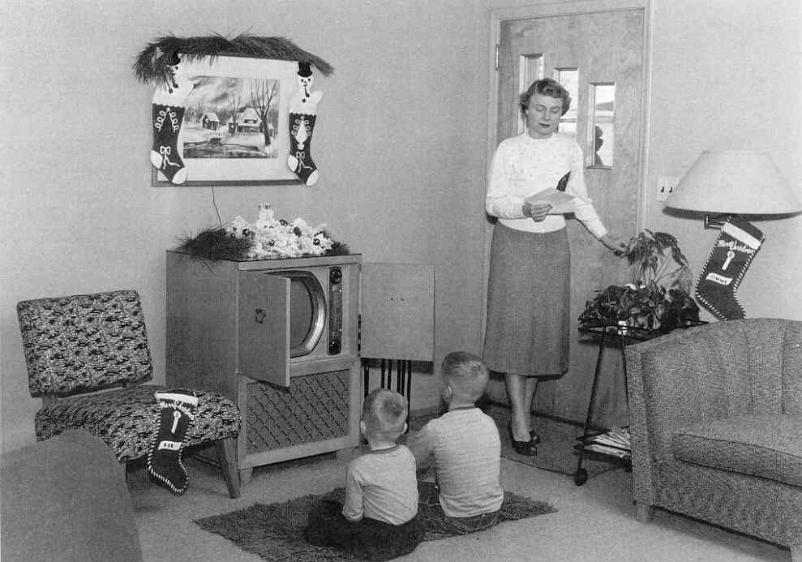
1950s Culture & The American Dream
Lessons 2-4

Slide 2
Bell Ringer Question:
What does the “American Dream” mean to you? In other words, what do you think the ultimate goals for Americans are?

Slide 3
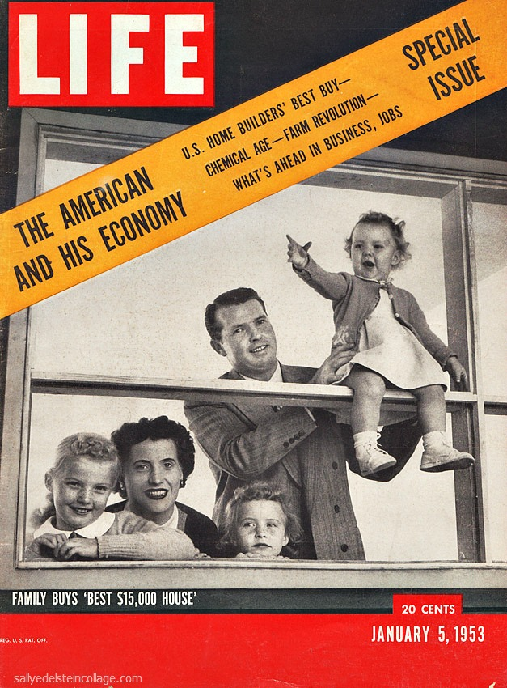
During WWII the economy soared because of high levels of employment and individual saving and investment.
After the war, Many worried that the US might be headed toward another recession…

Slide 4
Things that saved the US Economy
High saving turned into high consumption of goods
The GI Bill helped returning soldiers buy new houses, start businesses, and go to college.
The government continued to set prices on certain key goods (Ex: Oil)
The Fair Deal: Truman’s extension of the New Deal which raised the minimum wage and expanded social security coverage.

Slide 5
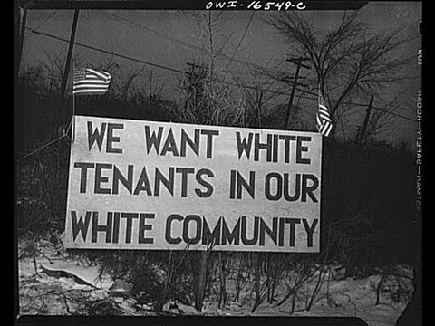
The “Other America”
Racial & economic inequality continued, which especially bothered returning minority soldiers
“White flight” – Those who would afford to moved away from the cities and into quickly growing suburbs. Those who couldn’t afford to move, mostly African-Americans, stayed behind.
                …what effect did this have?

Slide 6


Slide 7
White Flight cont’d
This resulted in much higher populations of non-whites living in poverty and working in lower-earning blue-collar jobs.
Cyclical Poverty – This is highly important today because it explains the cycle of poverty that occurs and income inequality is such a persistent problem today.

Slide 8
Poverty leads to Activism
In 1962 – 25% of Americans live in poverty (elderly, single women with children, minorities)
The rampant inequality and social tension of the 1950s set the stage for the Civil Rights Era of the 1960s.

Slide 9
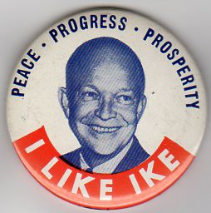
Republicans seize an opportunity
Americans had grown dissatisfied with the Democratic party over some key issues (the brief economic downturn, the firing of MacArthur, fears of “communism”, etc)
Republicans managed to take control of Congress & eventually in 1952, the Presidency...

Slide 10
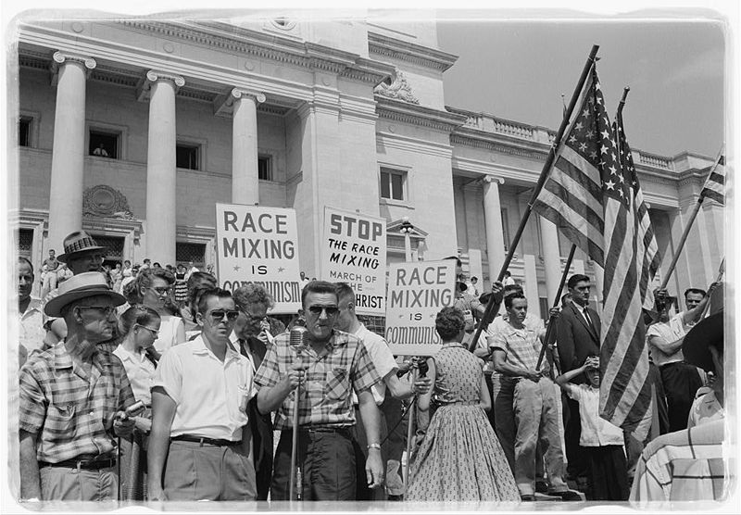
Politics of the 1950s
The Republicans (Eisenhower-Nixon) would win the election in 1952 by 55% of the vote and would also capture Congress.
The “Middle Road” for Republicans – To be conservative when it comes to economics but socially progressive. Eisenhower did not do very much for Civil Rights but he did not stand in the way of progress (Brown v. Board).

Slide 11

The “American Dream” of the 1950s
Despite the brief economic downturn, the 1950s were a period of great economic success and prosperity for the American people.
The “American Dream” for many included owning your own home, having an income-earning father, a home-maker mother, and well-behaved children all while enjoying the luxuries of life.

Slide 12

During the 1950s most Americans began working in white-collar jobs (non-industrial, service-related) that paid higher wages than blue-collar (industrial, labor jobs).
Franchises developed during the 1950s, which were businesses that operated at multiple locations or sold the license to a particular business model to individuals in exchange for a fee and royalties.

Slide 13
Social Changes
Social Conformity –Adhering to a group’s standards
Businesses did not want individuals who were too independent, creative, or anti-authoritarian.
They sought to hire conformists.
The cultural affect of this was to lower American individualism.
“Do what you have to do to be successful, just get in line, just do what you’re told,” et cetera

Slide 14
Social Changes cont’d
Women’s Roles – The role of a woman are a home-maker and mother was glorified by magazines, movies, and TV Programs cementing rigid gender roles in America.
Leisure Activities in the 1950s: Television, Reading, Fishing, Bowling, Hunting, Boating, spectator sports became even more popular.

Slide 15
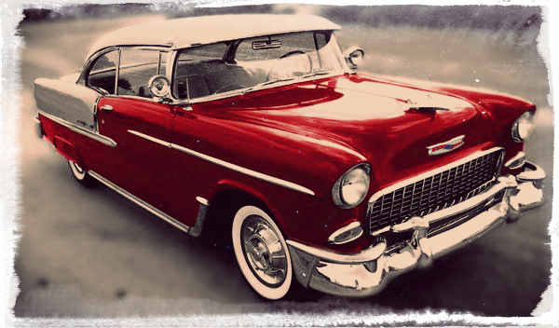
Travel
Automania – Suburban living made owning an automobile a necessity. This led companies to create a wide array of car designs and consumers became highly interested in particular brands, models, and styles.
The Interstate Highway System – Developed after Eisenhower signed a law appropriating funds for the construction of a national highway system. This would eventually lead to the decline of the prominent railroad industry.

Slide 16
New Business Model
Planned Obsolescence – Companies purposely design products to become outdated and insufficient after a period of time, which creates a new in the consumer to buy a new product in order to keep up with trends and social “needs” Companies also allowed widespread use of credit just as they did in the 1920s.

Slide 17
Formation of the “Middle Class”
Consumer Culture – The economic success during late 1940s and 1950s created a new social class in America – the “Middle Class.”
60% of Americans fit into this class, which emphasized a comfortable lifestyle and consumer luxuries.

Slide 18
Next class:
We will be examining 1950s PSA’s in order to evaluate 1950s culture and the “American Dream.”
Specifically, we will discuss social class, gender roles, and other aspects of 1950s culture.

