Slide 1
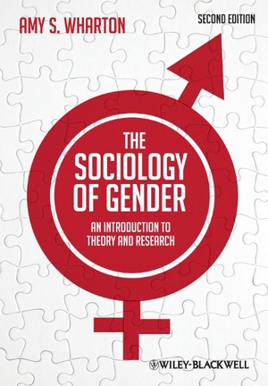

Slide 2
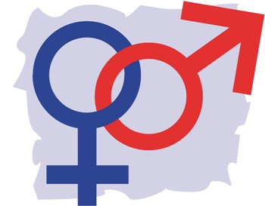
Opening questions:
What kinds of things are considered masculine?
What kinds of things are considered feminine?

Slide 3
First some terms…
Biological Sex – the physiological anatomy (internal and external sex organs) one is born with such as female, male, or intersex.
Gender – the way in which society determine and manage biological sex categories. Gender is either self-assigned or assigned by others. Gender is NOT a biological category but is instead a social category.
People conflate these two terms or think of them as synonyms – they are not.

Slide 4
Video:
The Social Paradox of Gender
https://www.youtube.com/watch?v=xBoKJrygPVQ

Slide 5
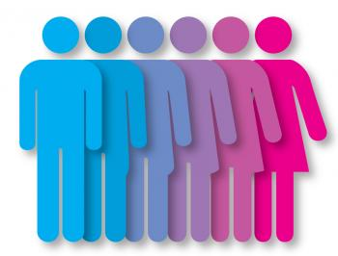
What happens when sex and gender do not align?
Cis-gender describes people whose biological sex they were born into matches their personal gender identity. (Prefix cis means “on the same side”)
Transgender describes people whose biological sex does not match their gender identity. (Prefix trans means “two things that lie on opposite sides”)
(0.3% of US population)
Intersexuality describes variations on sex definitions related to ambiguous genitalia. In other words, people are born with a combination of organs from both biological sexes. (Different estimates: 1 in 1,000 births / .02%)
Perspective: Same proportion of people with red hair, left handers

Slide 6
Public Opinion:
A psychological state is considered a mental disorder only if it causes significant distress or disability. Many transgender people do not experience their gender as distressing or disabling, which implies that identifying as transgender does not constitute a mental disorder (American Psychological Association).
Very recent brain scan studies suggest there is a structural (gray matter, white matter) component that might explain gender dysphoria (Bakker, 2018).
    Dr Bakker says, “Although more research is needed, we now have evidence that sexual differentiation of the brain differs in young people with GD, as they show functional brain characteristics that are typical of their desired gender.”
    Dr Bakker’s research will now investigate the role of hormones during puberty on brain development and transgender differences, to help guide and improve future diagnosis and therapy for GD adolescents.
    Dr Bakker comments, “We will then be better equipped to support these young people, instead of just sending them to a psychiatrist and hoping that their distress will disappear spontaneously.”

Slide 7
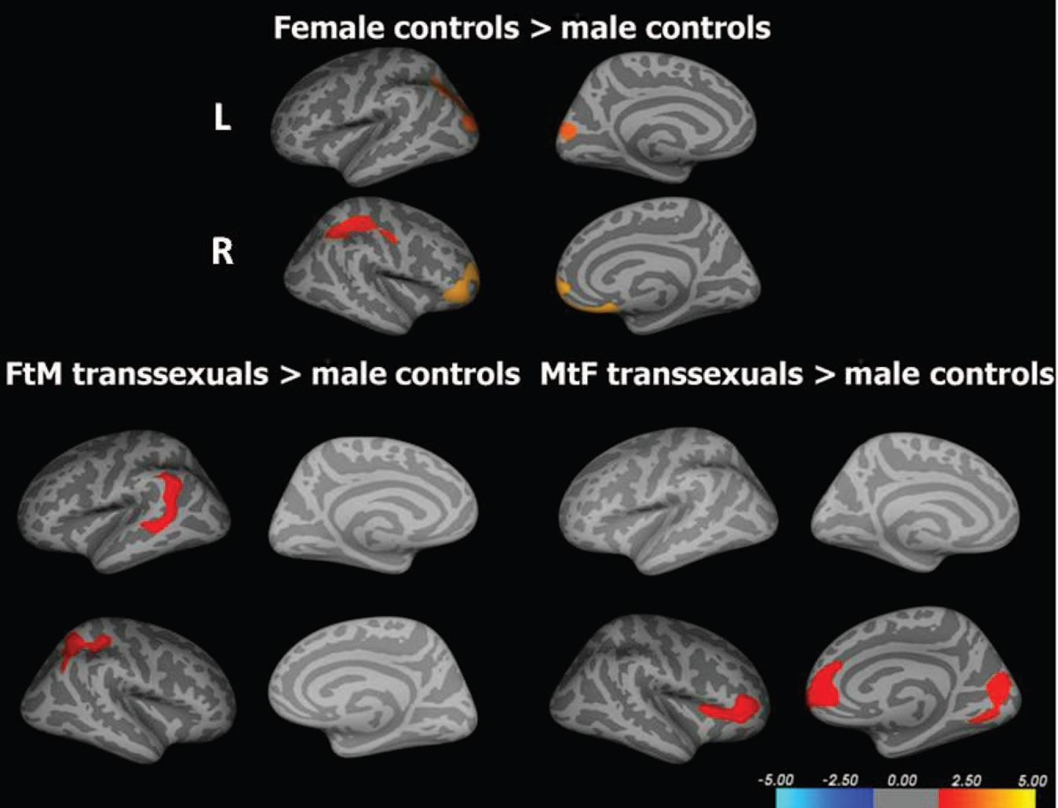

Slide 8
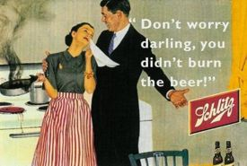
Sex Roles
Sex roles describe the tasks and functions perceived to be ideally suited to men versus women.
What types of jobs or “roles” in society are traditionally ascribed to men?
What types of jobs or “roles” in society are traditionally ascribed to women?

Slide 9
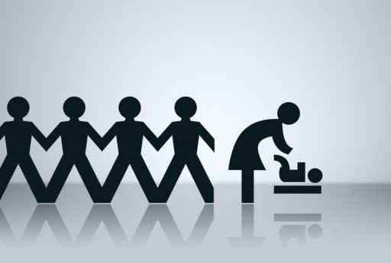
Research that contradicts gender norms:
Studies show that…
Men talk more than women (The Real World, 2014).
Men are more emotional than women (In Science, 2014).
Women are more aggressive negotiators in the business world (MIT, 2012)… but when men are aggressive they are seen as “leaders” and when women do it they are perceived as “bitchy.”
And much more.

Slide 10
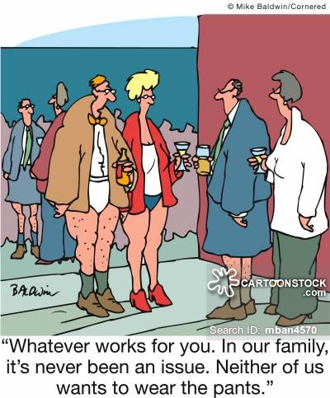
Why does it matter: Gender as a prison
“Masculinity as a prison”
“Femininity as a prison”
Knowledge is power: One you realize that “masculinity” and “femininity” are social constructions you no longer need to be limited by them. We should not pretend that these “norms” do not exist, but we do not need to be constrained by them.
But we should also be wary of them…such as the unfair treatment of women in the business world

Slide 11
