Slide 1

Module 23.4

Slide 2
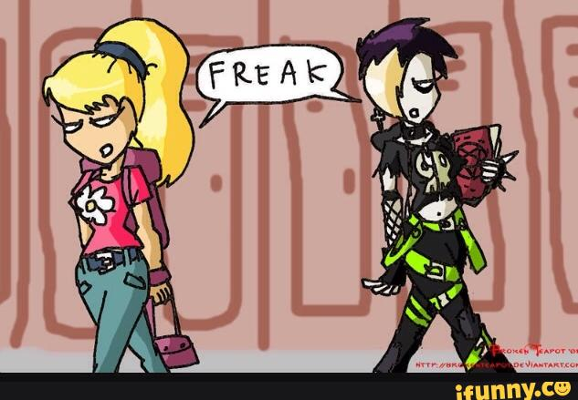
Culture – The beliefs, values, norms, and traditions within a society.
Counterculture - Groups in society that stand in indifference or opposition to mainstream culture.
In other words…any subculture whose values and norms differ strongly from mainstream culture.

Slide 4
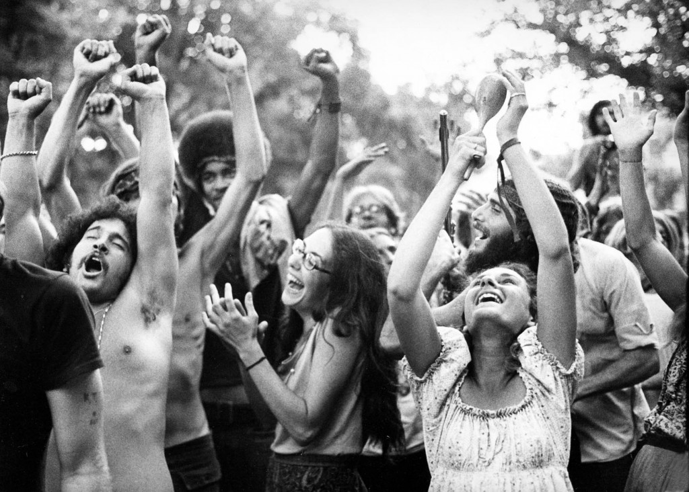
In the 1960s…
One type of counterculture that existed was…
Hippies – A group of mostly college-aged, white youths who wanted to live a life of peace, love, and freedom.

Slide 6
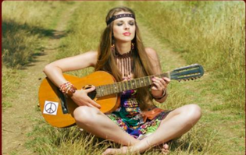
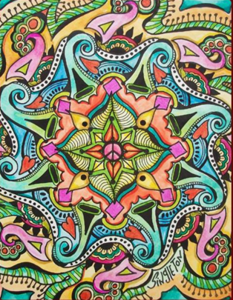
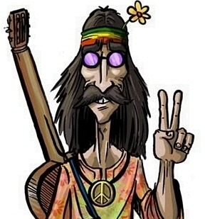
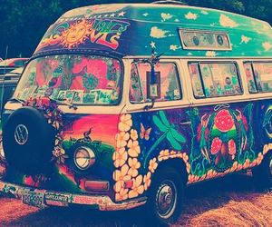
Many hippies wanted to live an alternate life-style… partly based on the ideas of communism and partly based on opposition to the problems they saw in America.

Slide 7
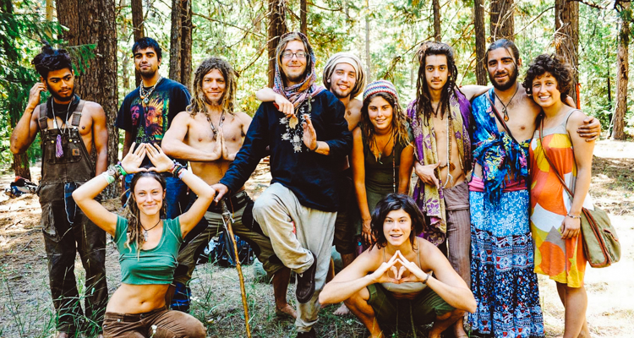
Who were the Hippies?
They shared some common beliefs with the “New Left”
They were against materialism and argued that American society had become “hollow”
Listened to rock music and folk music
Advocated for sexual freedom, anti-violence, and the right to use drugs.
Typically wore very colorful clothing that to mainstream society seemed “outrageous.”
Grew long hair because mainstream society saw long hair as “disrespectful”

Slide 8
The Death of a Movement
Hippie culture died off at the end of the sixties because although they agreed on “how to live,” they could not agree on “how to survive.”
“We fell apart over who would cook and wash dishes and pay the bills.” –Disillusioned Hippie
By 1970, thousands of hippies had lined up to collect welfare and food stamps – they had grown dependent on the very society they had once rejected.

Slide 9
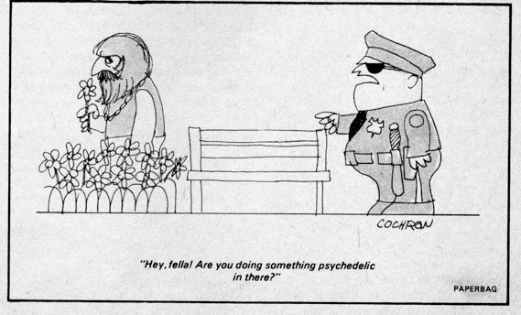

Slide 11
Other examples of counterculture:
Westboro Baptist Church
The Ku Klux Klan
“Beat Poets” of the 1950s
Rap & Hip Hop of the late 1980s and early 1990s
Goths
Punk Rock (REAL punk rock…not garbage like Green Day)
Gay Liberation / LBGT
“Techies” in the 1990s
Modern “Constitutional Militants”
Polyamory

