Slide 1
The New Frontier & The Great Society
Module 23– Section 2

Slide 2
By the end of this lesson…
Know the difference between “The New Frontier” and “The Great Society”

Slide 3
Kennedy’s “New Frontier”
New Frontier – Refers to Kennedy’s plans for progress through science and space exploration as well as Civil Rights.
Kennedy argued that although America was great, it could become even better through progress.
Opposition: A coalition between Republicans and Southern Democrats blocked funding for most of Kennedy’s programs – just like they had with Truman’s “Fair Deal”

Slide 4
Kennedy’s choice
This left Kennedy with a choice to make. He could either…
1. Use his executive powers to bypass Congress and push through the programs he wanted.
Or
2. Play it politically safe and not fight over highly controversial topics.
Kennedy played it safe by only making changes in areas where he could convince congress such as the economy and building up of the military.

Slide 5
“New Frontier” plans
Two of the programs that passed:
The Peace Corps – Volunteers who traveled to developing countries to assist them as teachers, agricultural advisors, doctors and nurses. The program was supposed to promote positive relations between these countries and the US and stop them from turning to communism.
Race to the Moon (1962) – Secured funding for the space race… this causes rapid funding for a lot of scientific programs and research.

Slide 6
Race to the Moon!
The Soviets had beaten the US into space with the first satellite as well as the first human in space.
Kennedy was determined to get to the moon first to prove that the US was not falling behind.
Seven years later in 1969, Neil Armstrong was the first man to walk on the moon!

Slide 7
DEATH OF JFK
1963: People loved JFK, however he lost some popularity due to his Civil Rights fight. (still prejudice and racism)
NOVEMBER 22, 1963 DALLAS TEXAS
JFK went to Texas to work on his relationship with the states democrats. They were more conservative and he was more liberal.
JFK was with his wife in the back of a car when he was shot in head. He was taken to the hospital but couldn’t be saved.

Slide 8
Who Killed JFK?
Lee Harvey Oswald: 24 years old, ex-Marine, had a checkered past. Castro supported, lived in the Soviet Union for a short time. Communist Conspiracy
Jack Ruby: shot and killed Oswald as he was being moved from one jail to another.
Warren Commission (1963): Investigation of the assassination of JFK. Concluded that there was not a conspiracy and that Oswald acted alone.
**1979: Reinvestigation concludes Oswald had help (second gunmen? Organized conspiracy?)

Slide 9
Who Killed JFK? (Cont’d)
2004 CIA Historian’s Report: Chief Historian David Robarge concluded that the CIA had been complicit in a “benign cover-up”, instructing their officials to give only “passive and selective testimony that would not alter the direction of the Warren Commission’s findings.”
The CIA failed to disclose:
  Loose ties to Oswald
  CIA ties to Mafia / Castro assassination attempt
  "In the long term, the decision of John McCone and Agency leaders in 1964 not to disclose information about CIA's anti-Castro schemes might have done more to undermine the credibility of the commission than anything else that happened while it was conducting its investigation” (Shenon, 2015).

Slide 10
Lyndon Baines Johnson
One positive came from the tragedy of the assassination of JFK…
LBJ’s smooth transition as president showed Americans that the system was strong.
In contrast, the assassination of a dictator would cause widespread turmoil and often a civil war.

Slide 11
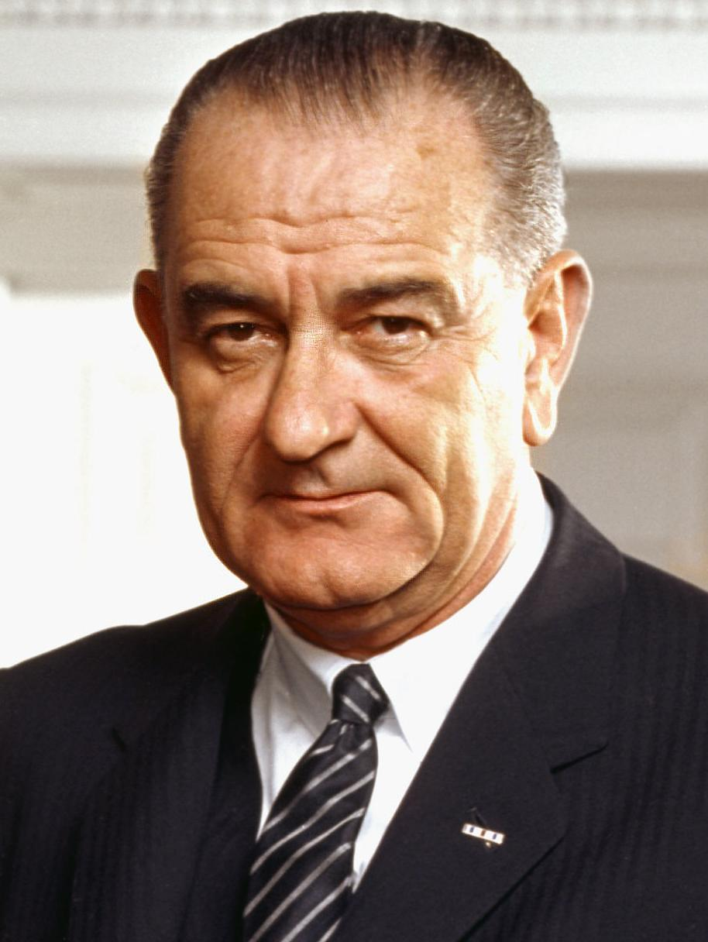
Lyndon Baines Johnson___
Long career in House of Rep. & Senate
Known for his skills as a politician and being very persuasive
Helped pass the Civil Rights Act of 1957 – which showed the federal government’s commitment to civil rights and the Brown v. Board decision.
However, the federal government would find itself having extreme difficulty enforcing this legislation.

Slide 12
The “Great Society”
Once LBJ was re-elected in 1964 he launched his own campaign for progress called the “Great Society.”
This plan was also a plan to make the United States even greater – it was an outright war on poverty and discrimination.
This was a step up in the government’s role in society though. Critics of LBJ argued that the government had no right righting social wrongs because that was not its purpose.

Slide 13
Great Society Programs
Economic Opportunity Act – Approved $1 billion for youth programs, anti-poverty measures, small-business loans, and job training for citizens.
Some of these still exist today: Job Corps & Head Start
LBJ’s programs were very successful because they cut the numbers of Americans living in poverty in half (11% to 5.5%). However, these programs were costly to fund and continued the tradition of decificit spending that would be a problem for decades.

Slide 14
Writing Assignment:
In 2-3 paragraphs compare/contrast the “New Frontier” with the “Great Society.”

Slide 15
Assignment:
Book Questions
-Pg 902: Terms #1-10, Main Ideas #1-7
-Pg 903: Standardized Test Practice #1-3

