Slide 1
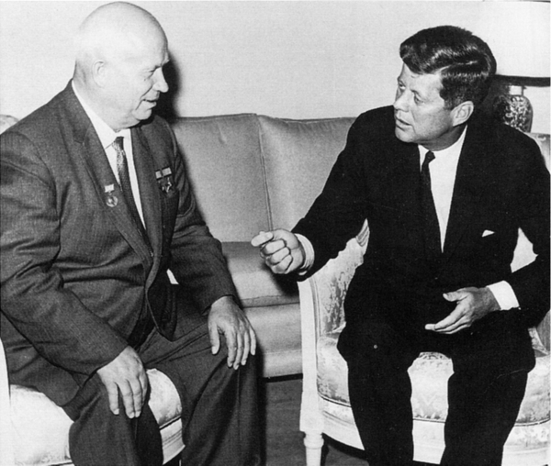
Kennedy and the Cold War
Module 23– Section 1
23.1

Slide 2
At the start of the 1960s…
Cold war tensions were very high at the time. It had looked like the 1960s would begin with friendly competition between the US and Soviets until the U-2 spy plane incident. The Soviet launch of Sputnik and their development of long-range missiles led many Americans to fear that the US was falling behind its rival. In the election of 1960, John F. Kennedy (D) would go up against Vice President Richard M. Nixon (R).

Slide 3
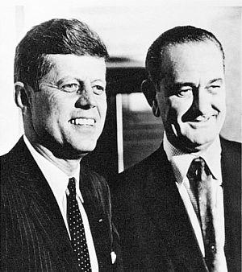
Watch/Listen:
Listen to both candidates opening statements. Who do you think did a better job?
Kennedy and Nixon Debate (1960)

Slide 4
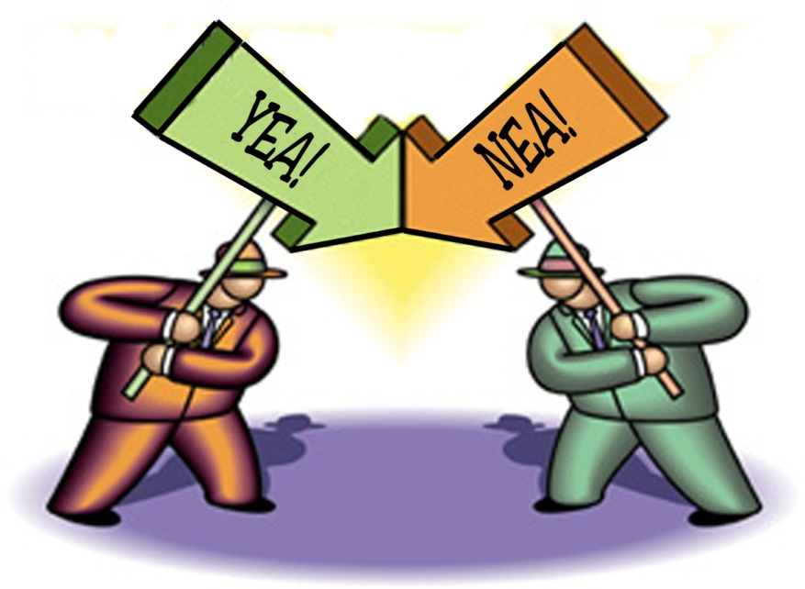

The First Televised Debate (1960):
JFK and Nixon squared off.
They were both eloquent speakers and highly knowledgeable.
On most issues the two were quite similar.
People who listened to the debate on the radio thought that Nixon won, but those who had watched on television thought that JFK won the debate.

Slide 5
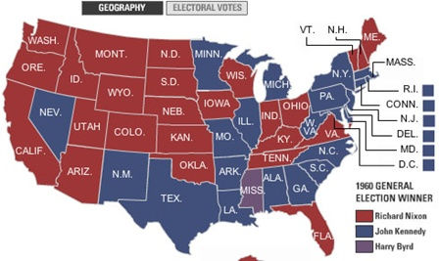
The 36th President
JFK won the election of 1961
He wanted to confront “communism” head on, but his leadership would be put to the test with several Cold War crises.

Slide 7
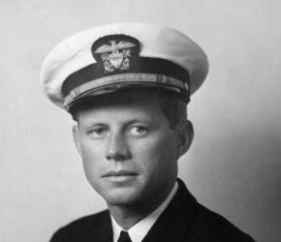
Kennedy’s Military Strategy
Kennedy wanted to strengthen the United States’ ability to fight a non-nuclear war because…
He argued that Eisenhower’s strategy to “respond to Soviet aggression with massive retaliation” would not work – it was mutually assured destruction.
This made the U.S. weaker in his eyes.

Slide 8
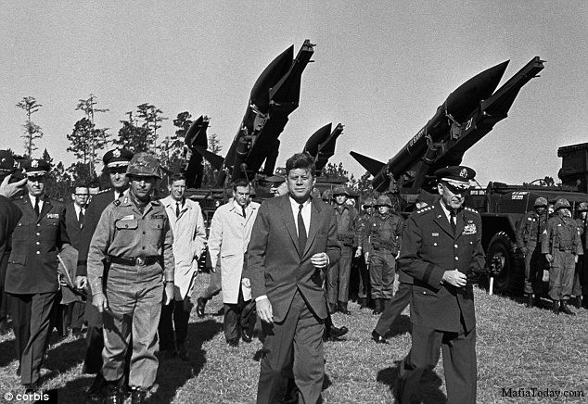
The Cuban Dilemma
Castro came to power by leading a successful revolution against Cuba’s former dictator. He then assumed dictator powers for himself.
Castro then seized and nationalized three oil refineries owned by the US/Britain
In response, Eisenhower placed an embargo on Cuba…meaning he cut off diplomatic and trade relations.

Slide 9

The Bay of Pigs
In March of 1960, Eisenhower approved a secret CIA mission to overthrow Castro
The Plan was to train Cuban exiles to invade Cuba while the U.S. assisted them with airstrikes
When JFK learned of this plan 9 days after his election, he did not like the plan. He decided to continue it anyway ($$ was spent).

Slide 10
The Bay of Pigs cont’d
The event was a disaster because:
1. CIA airstrike(s) failed to destroy the Cuban air force
2. Advanced strike group sent to distract the Cuban army never arrived
3. The CIA failed to properly assess the size of the Cuban army and the Soviet tanks and jets that assisted them

Slide 12
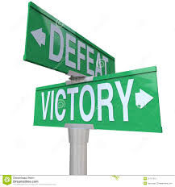
Defeat!
The Cuban media sensationalized the defeat of the “North American mercenaries”
This publicly shamed the US and Kennedy had to take the blame
In response, the Soviets increased arms shipments to Cuba

Slide 13
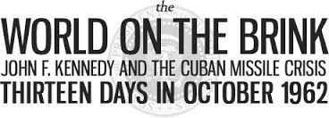
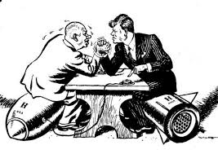
The Cuban Missile Crisis
US Planes photographed Soviet missile bases in Cuba shortly after the Bay of Pigs incident showing completed Soviet missile bases armed and ready to fire
The American public panicked – for six days the world watched as the threat of nuclear disaster on a global scale loomed.

Slide 14
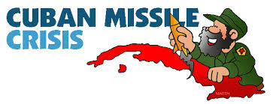
Cuban Missile Crisis cont’d
Kennedy ordered a massive force of 100,000 soldiers to assemble in Florida. They poised for an invasion of Cuba.
Kennedy and Krushchev began dialogue to resolve the crisis

Slide 15
Cuban Missile Crisis cont’d
Khrushchev offered to remove the missiles in Cuba as long as the US also removed their missile bases from Turkey
The agreement was made and nuclear disaster was averted – but both leaders would be heavily criticized at the time.

