Slide 1
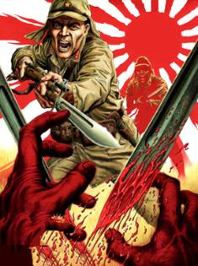
War in Europe, Africa, & Asia
Module 20, Lesson 5&6

Slide 2
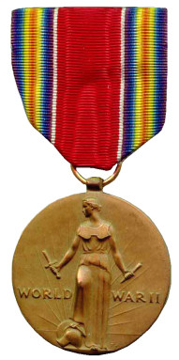
Campaigns:
Atlantic: Allied convoys vs German U-boats
Eastern Front: Russians vs Germans
North Africa: US/Brit vs Germany/Italy
Italy: US/Brits invade Italy
Western Front: US/Brits vs Germans
Pacific: US/Aus vs Japan

Slide 3
Battle of Stalingrad in 1942
The “Russian winter” had stopped German forces in their tracks in 1941.
-In summer of 1942 German forces began going on the offensive again hoping to capture Soviet oil fields
-The Luftwaffe began heavy bombing raids to pave the way for German land forces
-German land forces moved in…conquering the city of Stalingrad house by house…however it took them too long and winter again set in

Slide 4
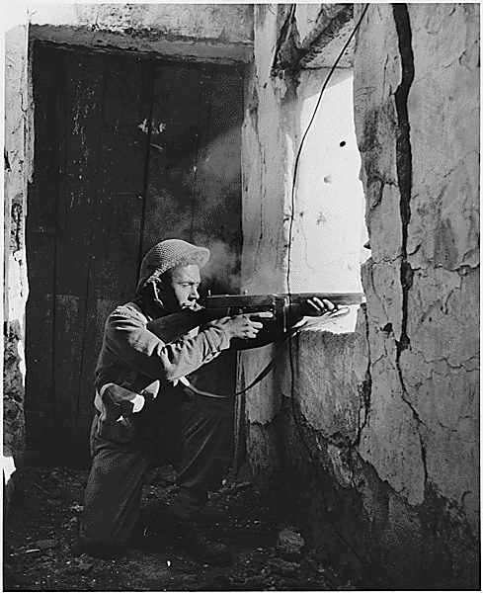
Stalin wants help
Joseph Stalin asks FDR/Churchill to open a “western front” and start pushing toward Germany because the Soviet Union had taken enormous losses thus far
FDR/Churchill instead chose to finish the Italian campaign. This will scar the relationship between the Stalin and FDR/Churchill

Slide 5
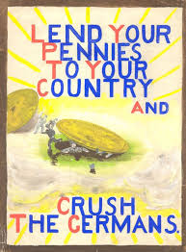
Stalingrad cont’d
Russian forces surrounded Stalingrad, trapping the German forces and Hitler ordered them not to retreat
-Eventually, the German forces surrender after months and months of brutal fighting and 1,100,000 soviet soldier deaths.
-Now the Soviet forces would advance on Germany

Slide 6
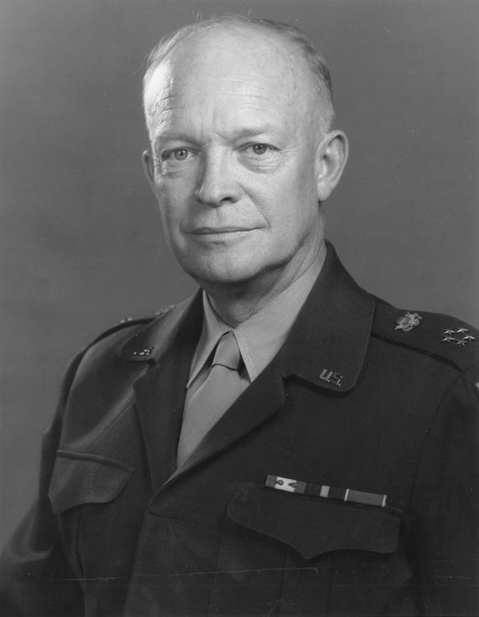
Dwight D. Eisenhower
Leads successful campaign in North Africa and Italy
In charge of “Operation Overlord” (D-Day): The campaign to liberate France… set in motion June 6th, 1944

Slide 7
D-Day: June 6th, 1944
Shortly after midnight, three divisions parachuted down behind German lines followed by early morning thousands of seaborne soldiers came in the largest land-sea-air operation in army history.
Despite enormous casualties, the Allied forces were able to gain ground and eventually liberate the French capital.

Slide 8
Film clips:
Band of Brothers: 101st Airborne (Army) parachute into France
Saving Private Ryan: Marines conduct amphibious assault on the beach of Normandy

Slide 9
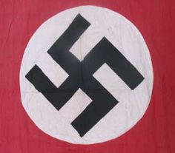
The Race is on
Soviets and US/British forces would now race for the glory of being the first one to take Germany
Allies capture first German town… Hitler respond with a desperate final assault (8 tank divisions).
After a month-long battle, German forces retreat

Slide 10
Meanwhile…
Soviet troops come across the first death camps where German “SS” were working feverishly to dispose of the “evidence”
The Soviets were horrified. Americans would eventually stumble across more death camps and be equally horrified
The Holocaust had been discovered

Slide 11
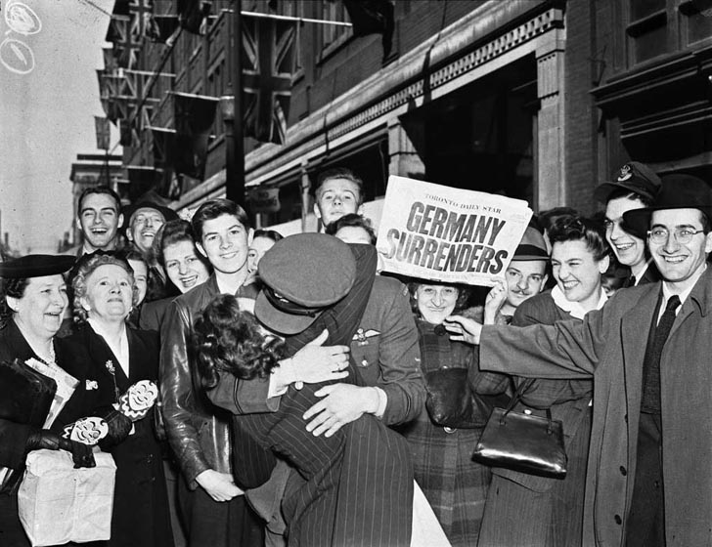
V-E Day
As Allied troops were closing in, Hitler shot himself and his wife took poison. Their bodies were burned.
On May 8th, 1945 the Allies celebrated V-E Day – the unconditional surrender of Germany and Victory in Europe.
Roosevelt died before V-E Day in 1945 and Vice President Harry Truman assumed office.

Slide 12
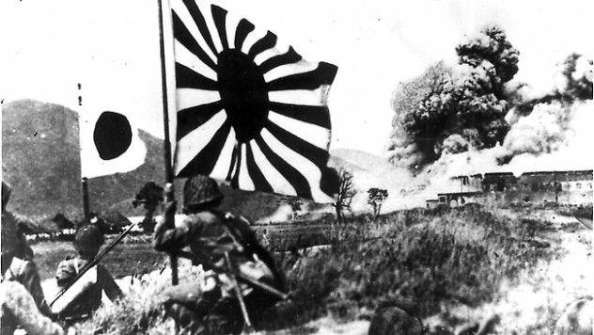
War in Japan
The Allies were hoping that victory in Europe would force Japan to surrender… but they would be disappointed.
Allied forces, led by General Douglas MacArthur are forced to flee the Philippines leaving behind many U.S. soldiers.

Slide 13
Key events:
Surprise air strike of Tokyo (hope)
Battle of Midway (Foothold)
Battle of Iwo Jima (Prepare for mainland assault)
Dropping of the atomic bombs in Nagasaki & Hiroshima

Slide 14
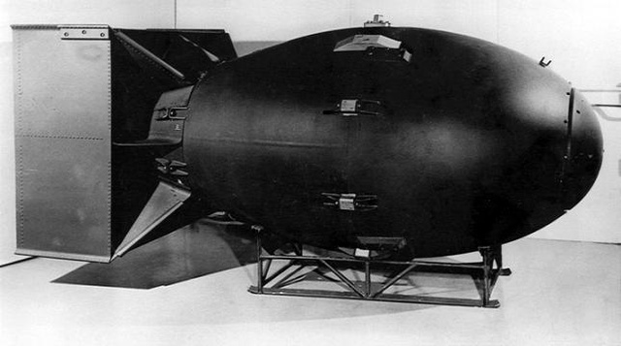
The Manhattan Project
This was the most enormous scientific undertaking of its time… employing 600,000 Americans working in absolute secrecy
Truman did not even know about the project until he became president). The project’s final result was the Atomic Bomb – a weapon of mass destruction.

Slide 15
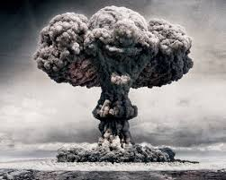
“Little Boy” & “Fat Man”
Two atomic bombs were dropped on Hiroshima and Nagasaki – so much destruction ensued that Japan’s emperor ordered the military to draw papers for formal surrender.
“I cannot bear to see my innocent people suffer any longer,” he told Japan’s leaders tearfully.”

Slide 16
Yalta Conference
Stalin, FDR, and Churchill met soon after Germany surrendered to discuss plans for Post-war Europe.
Stalin wanted to harshly punish Germany by dividing it into militarily occupied zones to prevent them from ever attacking his people again.
Churchill strongly disagreed, fearing the Stalin wanted to establish a communist regime there.

Slide 17
Yalta Conference cont’d
FDR mediated between the two and Churchill conceded to Stalin because they badly wanted Stalin to take part in a new peacekeeping organization – The United Nations. Compromise was reached.

Slide 18
Nuremberg War Trials
Germany was geographically divided into three zones, occupied by American, British, and Soviet troops.
In the German town of Nuremburg, German leaders and military officials were put on trial for “war crimes”

