Slide 1
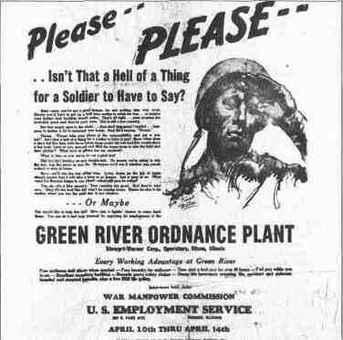
The Home Front
The Green River Ordnance Plant

Slide 2
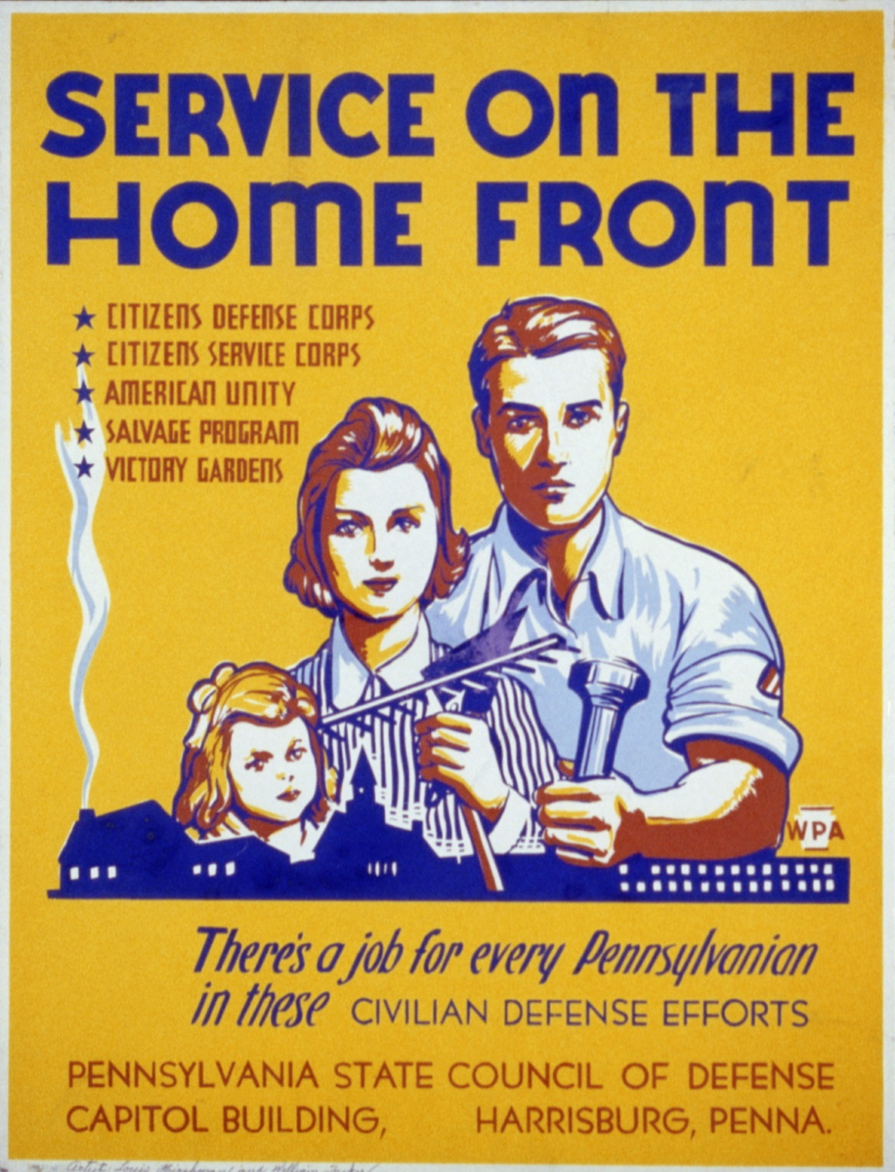
The Home front - All activities the civilian population engages in in support of their nation’s war effort abroad.

Slide 3
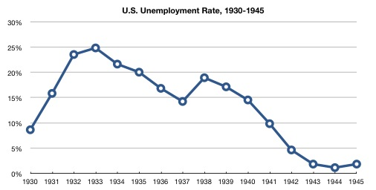
Overview of the Home Front:
Unemployment fell to 1.2 percent (meaning only 1.2% of the population did NOT have a job).
Average weekly pay rose 10%
US Government set price controls on certain goods

Slide 4
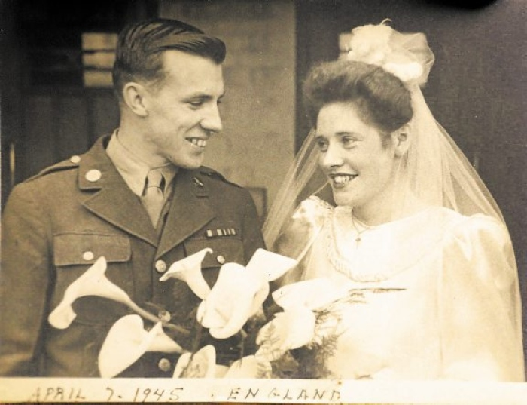

Overview of the Home Front:
Social Changes – Couples rush to marry, Families become comfortable leaving children with neighbors or day cares, returning soldiers turned into the “baby boom” generation
-GI Bill of Rights helped ease the transition of returning soldiers by giving them education benefits and assistance buying homes, farms, or starting businesses

Slide 5
The Green River Ordnance Plant
The GROP was a munitions plant in Dixon, IL during World War II. This means that they typically made explosives and ammunition.
The plant was constructed rapidly in 1942 and run by a private company called the Stewart-Warner Corporation – the government paid them a hefty contract to oversee the plant.
Ordnances are types of explosives.
Examples: Bazooka ammunition, artillery shells, battleship ammunition, rifle grenades, fuses, and rockets.

Slide 6
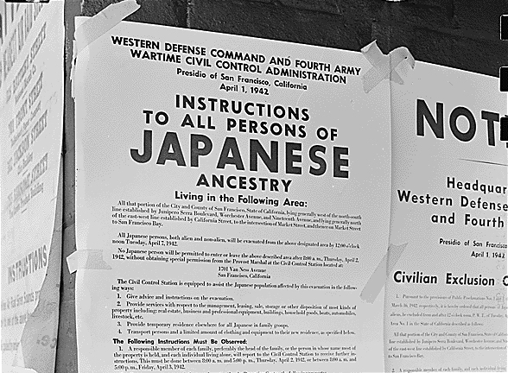
Internment of Japanese Americans:
People of Japanese ancestry were forcibly removed from California, Washington St, Oregon, and Arizona and sent to “relocation centers.”
-Many were mistreated and victims of discrimination
-In Chicago, Japanese Americans were treated much better due to their “contributions to the economy.” (NY Times example)
-In 1965, Congress finally compensated victims of Japanese Internment – but this was less than 10% of actual losses.

Slide 8
Document Search
Use the primary and secondary source documents to answer the questions on your worksheet. This is a test grade. ☺

Slide 9
Book Questions:
Ch 24 Pg. 764 (Def: #1-10, Main ideas #1-8)
Pg. 765 (#1-3)
Ch 25 Pg. 804 (#2-10, #8, #9, #10)
Pg. 805 (#1-3)
Study Guide due next class

