Slide 1
“A New Deal” Fights the Depression
Module 19.1

Slide 2
The Election of 1932…
Hoover (Republican) vs Franklin Delano Roosevelt [FDR] (Democrat)
People were ready for change because of the hard times of the Great Depression & anger toward Hoover’s lack of response to it

Slide 3
In his inaugural address, FDR famously said this to give the American people hope:
“The only thing we have to fear, is fear itself!’

Slide 4
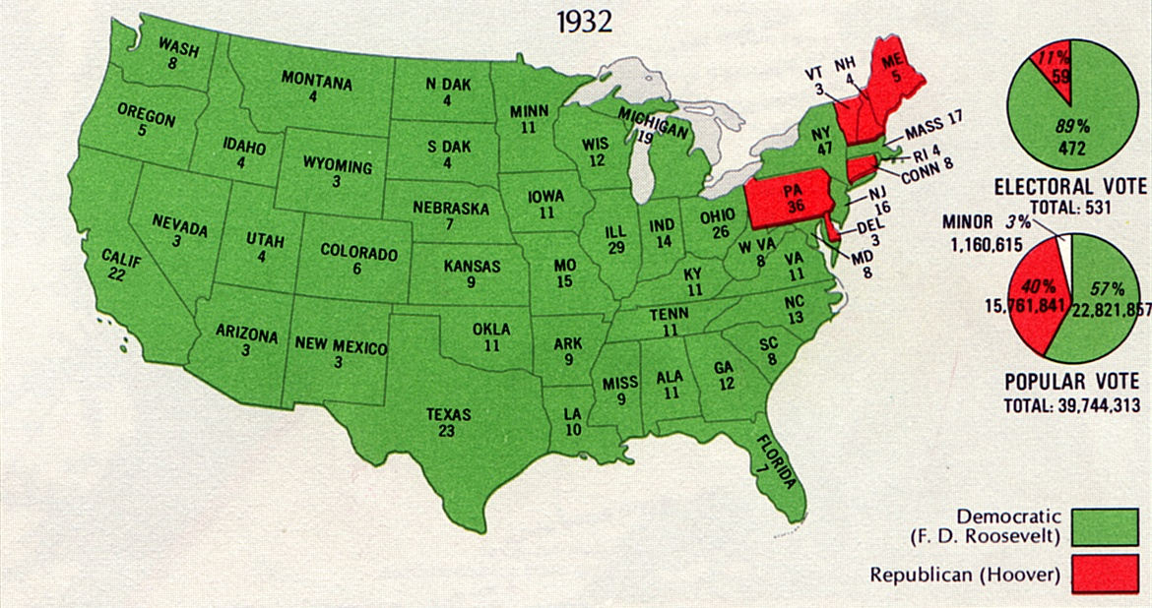

Slide 5
FDR wins!
FDR was a two-term governor from New York and a distant cousin to a former president -- Theodore Roosevelt.
He had also been a state senator and the Assistant Secretary of the Navy.
FDR wins by a landslide (23 million votes to 16 million).
The Democrats also won a majority of seats in the House (their greatest victory since before the Civil War).

Slide 6
The “New Deal”
FDR’s First Plan: He gathered a group of experts (professors, lawyers, economists) to begin devising a new set of economic and social policies.
This group of experts was called the “Brain Trust”

Slide 7
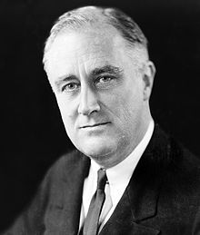
The New Deal – a phrase taken from Roosevelt’s campaign speeches in which he promised “a new deal for the American people” who were upset at the direction of the country.

Slide 8
The New Deal focused on three general goals:
1. Immediate relief for the needy
2. Long-term economic recovery
3. Financial reform (to safeguard the country from the problems that led to the G.D.)

Slide 9
The “Hundred Days”…
The Hundred Days refers to a period from March 9th to June 16th in 1933 in which Democrats worked feverishly to pass “New Deal” legislation, which significantly expanded the U.S. Governments role in the economy.

Slide 10
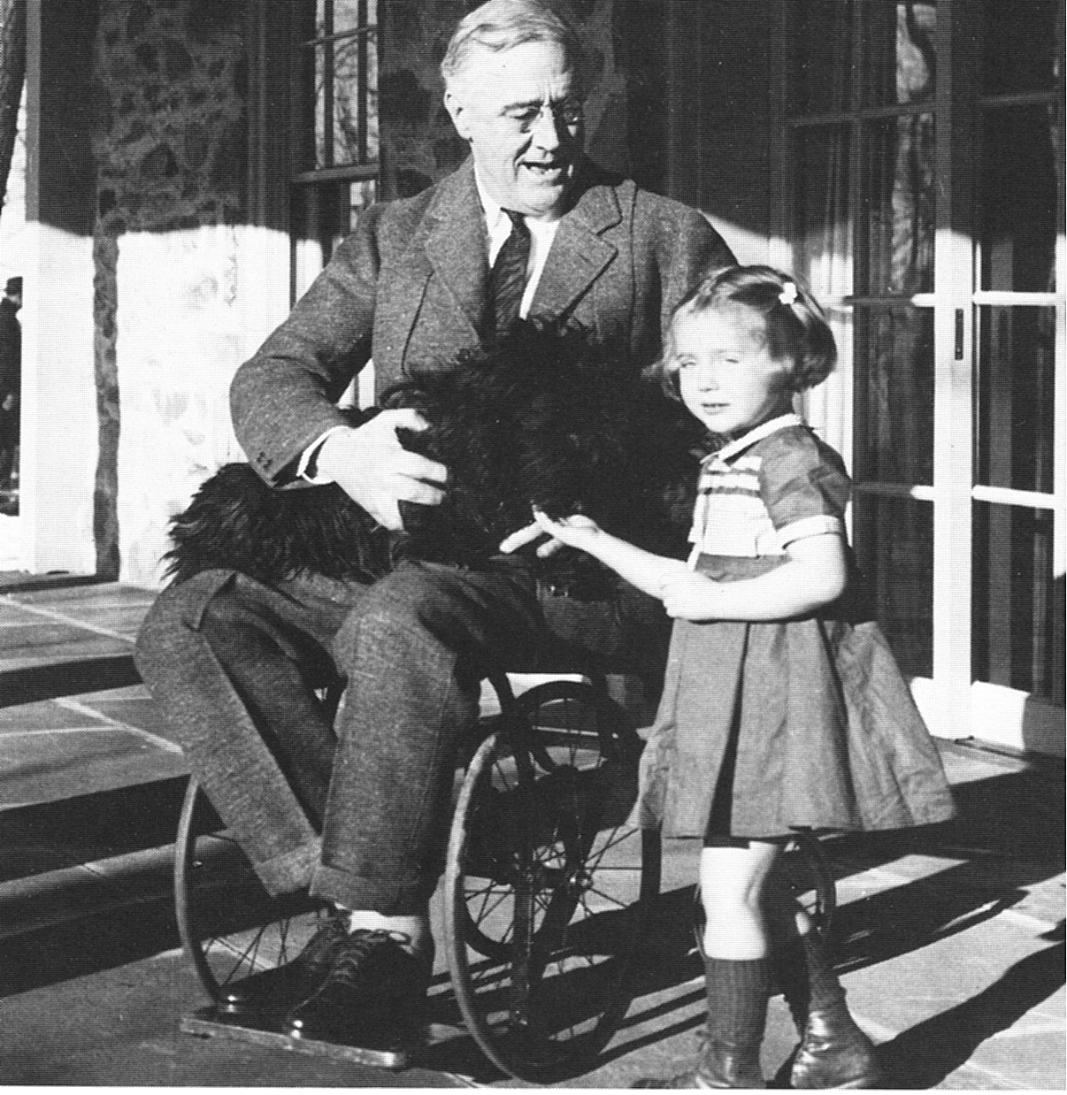
FDR was diagnosed with polio in 1921 and became partially paralyzed from the waist down.
Most historians believe that struggling with his illness shaped his
strong will and
determination.

Slide 11
FDR did not like to be seen or photographed in his wheelchair and made every effort to stand (with assistance) behind a podium.
He rarely discussed his disability because he feared people would react as many did at the time toward disability… with ignorance.
FDR was very popular throughout his career

Slide 12
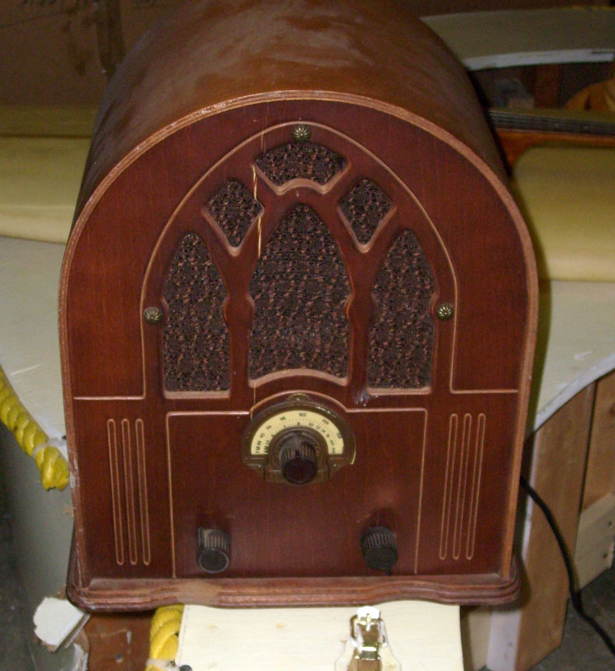
Fireside Chats
FDR was the first president to use live radio to communicate with the American people.
This made him even more popular because people felt that
he was a confident
leader who cared about
the American people.

Slide 13
Important Changes FDR made:
Established the Federal Deposit Insurance Corporation (FDIC) to restore faith in the banking system. ***
Federal Securities Act compelled corporations to provide complete and accurate information on all stock offerings and made them liable for misrepresentations (lying to investors and the public)
21st Amendment repealed prohibition and placed a tax on alcohol

Slide 14
Important Changes FDR made cont’d:
“Alphabet Agencies” – Various organizations and programs that helped people find work and provided money for individuals and businesses to grow.
KNOW THIS ONE: W.P.A. (Works Progress Administration) – Focused on employing young, male workers who helped build parks and trails.
The National Recovery Agency promoted industrial growth by establishing codes of fair practice for industries (price setting, standards and regulations).

Slide 15
Criticism of FDR:
Opponents of FDR thought that…
1. New programs cost too much money
2. FDR’s government was using “deficit spending” (spending more money than you have) in order to reboot the economy
FDR’s response to his critics was that deficit spending was a “necessary evil” and it would be a short term-strategy (Today: The debt ceiling)

