Slide 1
Hardship & Suffering during the Great Depression
Module 18.2

Slide 2
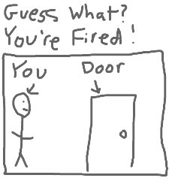
A Depressed Way of Living
In cities across the country people lost their jobs, were evicted from their homes, and ended up living in the streets.
Some slept in parks, or sewer pipes, wrapping themselves in newspapers to fend off the cold.
(Remember: “Hoover Blankets” & “Hoovervilles”)

Slide 3
Finding relief…
Soup Kitchens – If people were lucky, they made it into a soup kitchen for free soup and bread… but lines were long and sometimes people had to walk far only to be turned away or to stand in a line for hours.
Breadlines – A similar concept… people would stand in long lines and wait for a chance to get free bread.

Slide 4
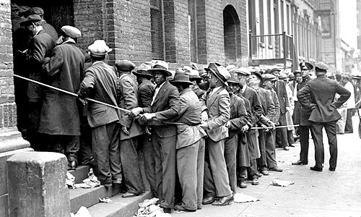

Slide 5
Racial Inequality continues
Conditions for African Americans and Latin Americans were especially difficult… they were victims of prejudice and violence
When they were able to get a job, they were paid lower wages and dealt with many forms of institutional racism.

Slide 6
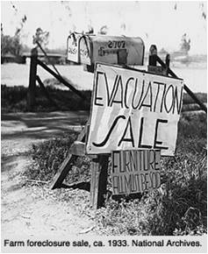
Farmers
Economically, farmers were hit the hardest during the depression. They were unable to sell their crops and many lost their farms when they were unable to pay their bills.
…however… the fact that some were able to grow their own food meant they had an easier time surviving.
During the Depression, farmers protested their hard times by burning their crops publicly. What affect might this have had??

Slide 7
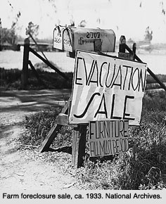

Slide 8
The Dust Bowl
Over-farming had made a lot of farmland unfit for growing crops.
As a result… large fields were left without grass or crops on top of the dirt.
Strong winds picked up the dust creating “dust storms.” This was especially bad in Kansas, Oklahoma, Texas, New Mexico, and Colorado.

Slide 9
General effects in society
Suicide rate increased
Three times as many people were admitted to mental asylums.
Cultural Effect: Years later… many people who were young during the depression professed a deep need to be financially stable during adulthood.

Slide 10
Video
https://www.youtube.com/watch?v=IQ_lizW5zSI
BEFORE watching activity: Based on your notes…come up with a plan to solve the problems of the Great Depression. Then we will watch a video to see what was actually done and what people who lived through it thought and felt.
Macro (big) Solutions: How will you fix the economy itself? Businesses? Jobs?
Micro (small) Solutions: How will you provide relief for individuals suffering during the Depression?

