Slide 1
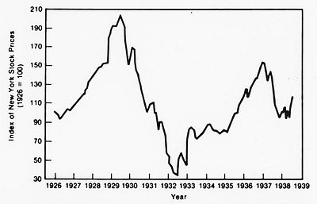
The Nation’s Sick Economy
“We in America are nearer to the final triumph over poverty than ever before!” –Herbert Hoover in 1928
Module 18.1

Slide 2
The Election of 1928…
Herbert Hoover vs Alfred Smith
Hoover won because he was able to point to years of prosperity under Republican leadership (Roaring 20s).
Hoover is beloved not only in the US… but also around the world…
Hoover and the Election of 1928: Landslide
Hoover & Poland
…Republicans were boasting that poverty would be eradicated during Hoover’s presidency.

Slide 3
Signs of trouble ahead?
Some economists warned of “weaknesses” in the U.S. economy (Superficial Prosperity).
What do you think the economists were worried about? (Ch. 20 & 21)?
So…what caused the Great Depression???

Slide 4
What caused the Depression?
Split up into groups. Each group will be responsible for reporting on a specific cause.
Group 1: “Industries in Trouble” (671)
Group 2: “Farmers need a lift” (671)
Group 3: “Consumers have less money to spend” & “Living on credit” (671-672).
Group 4: “Uneven distribution of income” (672).

Slide 5
Group Report (Copy down into your notes):

Slide 6
END PART I

Slide 7
What caused the Great Depression?
The availability and widespread use of credit
The unequal distribution of income and jobs
Tariffs and war debt policies that cut down the foreign market for American goods
An agricultural crisis
Widespread panic and attempts to withdraw money from banks
The Great Stock Market Crash of 1929

Slide 8
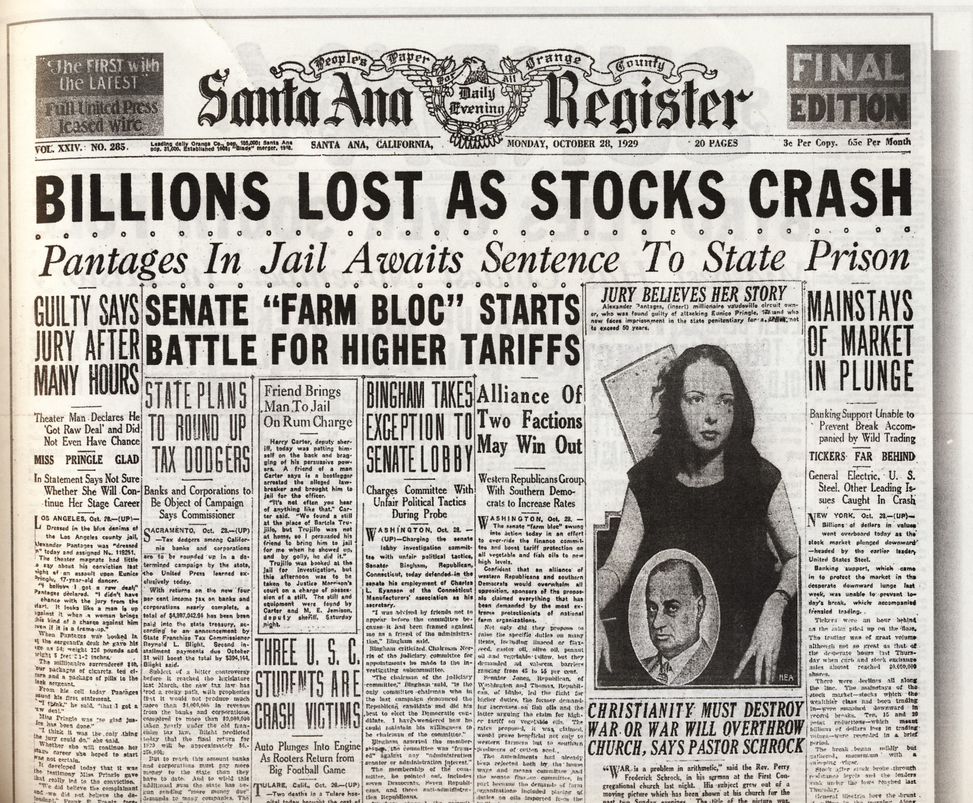
Black Tuesday: The Last Straw
On October 29th, 1929 investors began to quickly sell their stock and pull out their investments.
This caused panic… everyone tried to sell their stock at the same time causing the market to “crash”

Slide 9
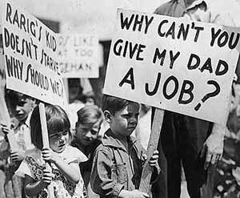
By November… investors had lost $30 billion… (an amount equal to the total amount the US spent during World War I).
The Great Depression – A period from 1929 to 1940 in which the U.S. economy (and much of Europe’s economy) plummeted and unemployment sky rocketed.

Slide 10
The Collapse of the Banking System
-Many people panicked and tried to pull all of their money out of banks. Too many people taking money out too quickly caused the banks to fail – and people lost everything.
-As a result of the depression and collapse of the U.S. stock and banking system, many people developed a strong mistrust for the banking system.

Slide 11
Americans Lose Trust in Banks
-It would take YEARS…and for some…an entire generation to regain trust in the banking system.
-This is why the government will “guarantee” your money up to a certain amount today. This is called the FDIC (Federal Deposit Insurance Corporation)

Slide 12
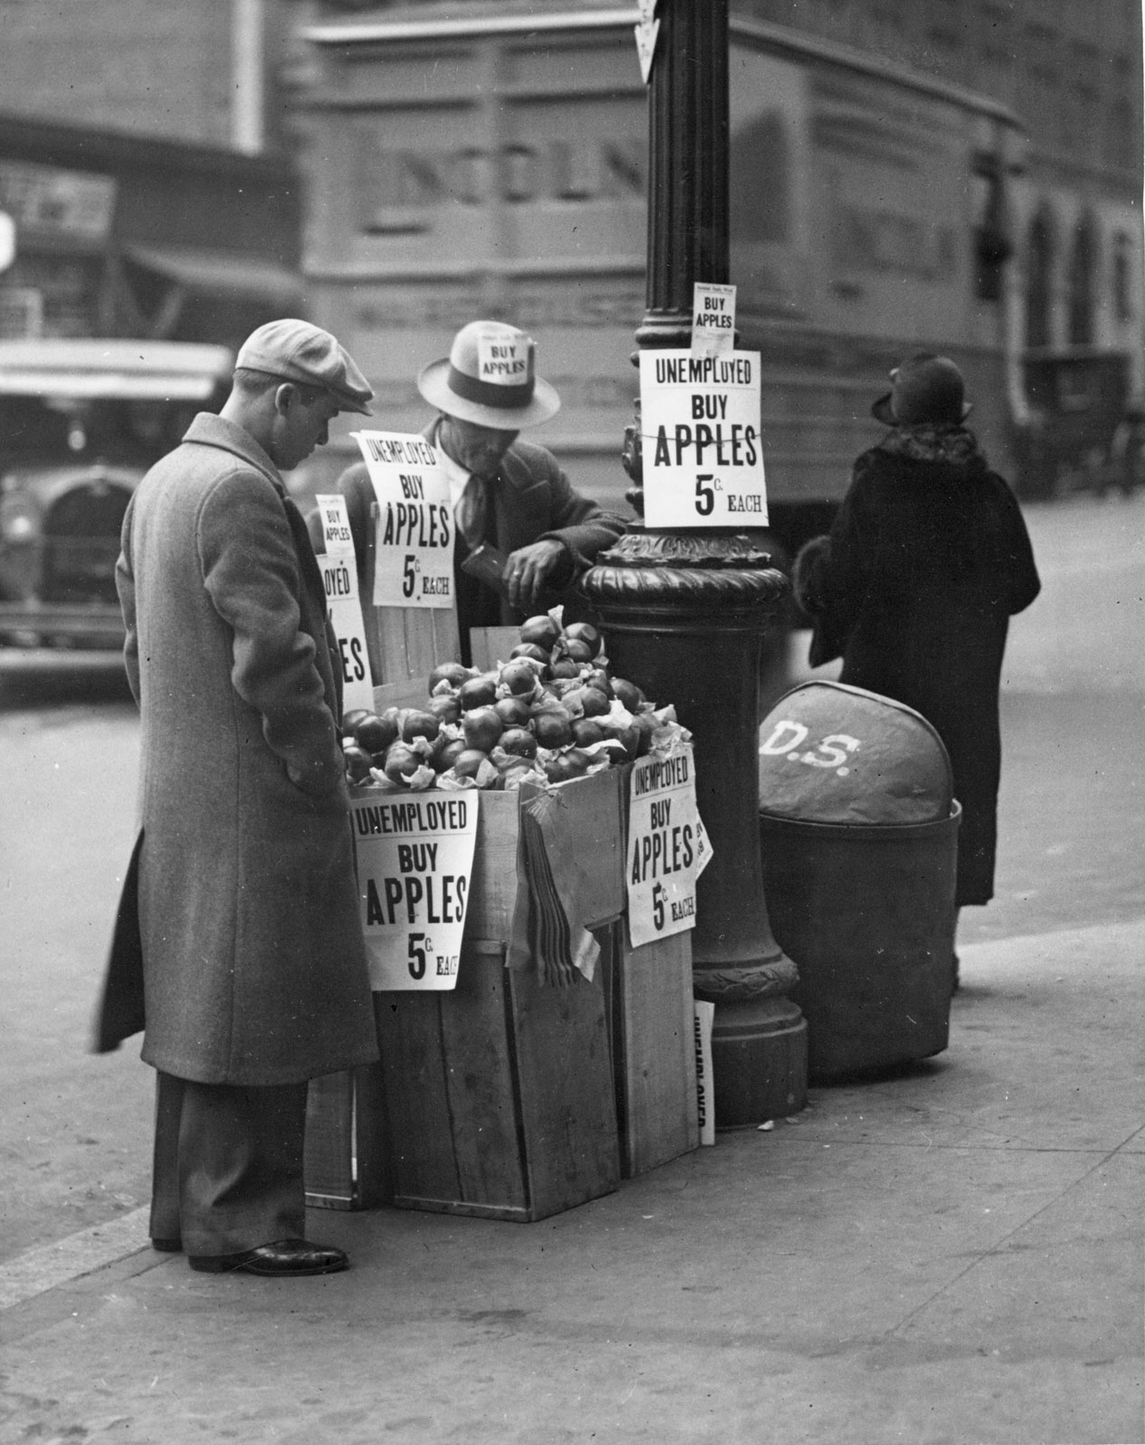
During the Depression…
People lived longer: Life expectancy actually went UP (6.2 years) during the Depression.
Why?: Advances in healthcare, different working conditions (less work = slow pace, less accidents) Source: University of Michigan Study in 2009
Cons: People must stretch their finances over longer life spans… this is a drain on the economy & affects people’s retirements

Slide 13
People lived longer cont’d…
This happened again 2001 & 2008… some call it “The Great Recession.” Life expectancy went up… the economy went down…
People had to work longer to support themselves in old age, which took jobs away from younger people
What is the difference between a depression and a recession?

Slide 14
The Hawley-Smoot Tariff – A law designed to protect American farmers and manufacturers by limiting importation of foreign goods.
…However…
This had the opposite effect: By reducing the flow of goods into the United States, the tariff prevented other countries from earning American currency to buy American goods. In other words… this tariff had negative effects on the economy by removing foreign markets from the U.S. economy.

Slide 15
Historical Misconceptions about the Great Depression
The Great Crash of 1929 did not cause the depression, it was merely the catalyst.
The Depression could have been prevented.
Occurred only in the United States
Only effected the wealthy

Slide 16
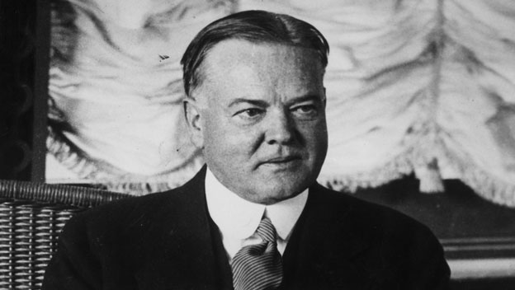
Who’s to blame?
People will always want someone to blame when something goes wrong. Sometimes it’s justified and sometimes it isn’t (scapegoat).
Hoover was blamed for the depression and the once beloved president became hated… so much so that the makeshift communities that the impoverished lived in during the depression became known as “Hoovervilles”

Slide 17
A Shantytown or “Hooverville”
Video: “Hoovervilles”, “Hoover Blankets”
Hobos: Wandering men who were either looking for work or were just trying to survive. Some had “given up.”
Many men abandoned their families during the depression out of the deep shame they felt for being unable to support them.

Slide 18
Activity:
Use your notes (and your book if needed) to summarize the events that led up to the Great Depression. You may….
-Go here on your phone:
http://www.hyperhistory.com/online_n2/connections_n2/great_depression.html
1. Start with the end of World War I
2. End with the Great Crash of 1929
Add in details about factors leading up to the crash such as: use of credit, bank failures, black Tuesday, etc

