Slide 1
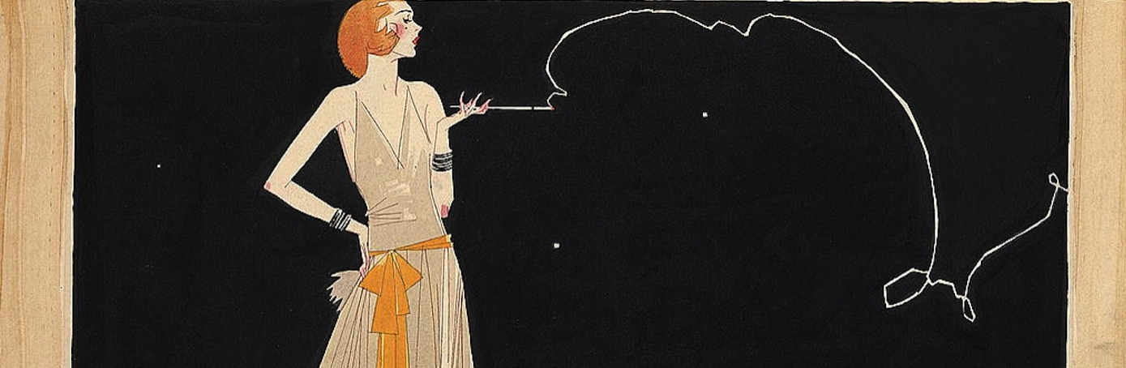
The Roaring Twenties: Changing Ways of Life & 1920s Women
MODULE 17.3
& 17.4

Slide 2
Review Questions
Explain why the prosperity of the Post-WWI decade (1918-1928) was “superficial.”
What were some of the postwar issues Americans dealt with from 1918-1928?

Slide 3
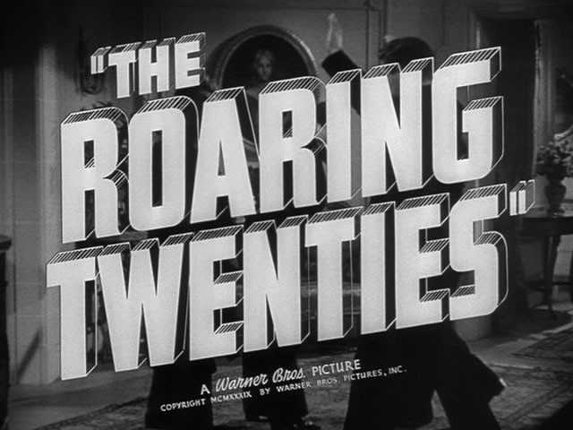
The Roaring 20’s
They are called the Roaring Twenties because the decade seemed to be a time of great prosperity and enjoyment.
The culture of success and celebration made its way into art, music, and motion pictures.

Slide 4

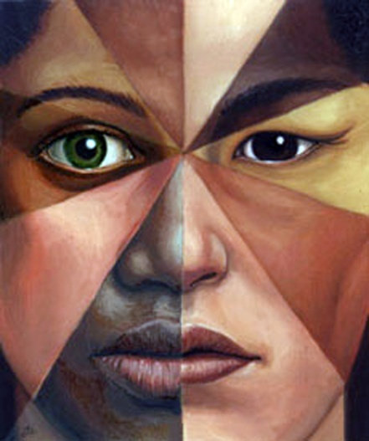
Cultural Conflict
After World War I, Americans experienced cultural conflicts and internal tensions due to rapid changes in culture.

Slide 5
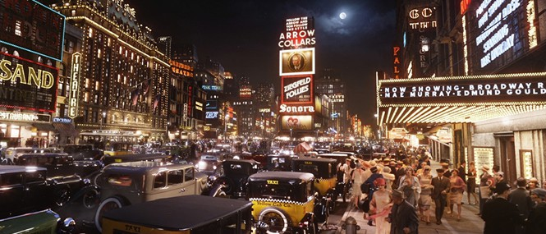
The American City
Big cities like New York & Chicago continued to rise in economic and social prominence and take over mainstream culture.
This led to tensions between “small town/rural traditional values” and “big city/urban values”

Slide 6
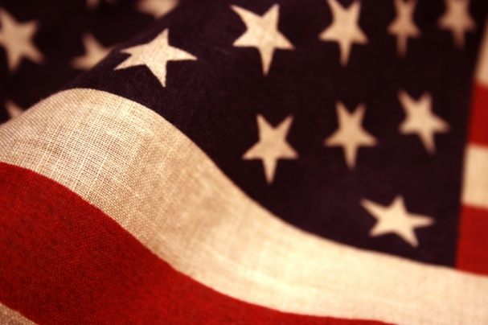
Values
Small town / rural values – revolves around a traditional lifestyle and protestant Christian ethics
Big-City / Urban values – revolves around progressivism, celebration of success, enjoying life after a terrible war… a PARTY atmosphere
People with these two mindsets viewed laws and issues of personal freedom very differently.

Slide 7
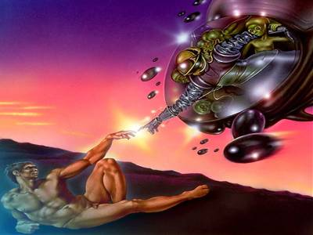
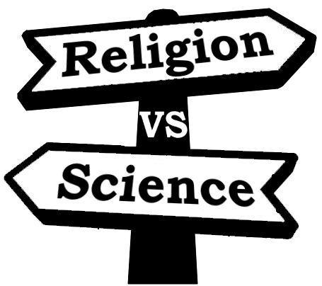
Science vs. Religion
Scopes Trial – A court case on whether or not evolution could be taught in schools. John Scopes was initially found guilty but the Tennessee Supreme Court eventually overturned the decision.
Fundamentalism - A literal, non-symbolic interpretation of religion.

Slide 8
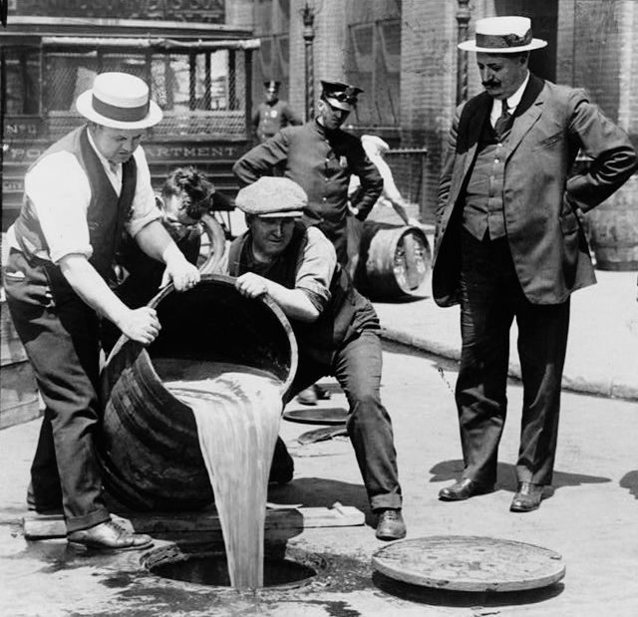
Prohibition (1920-1933) – Also known as the 18th amendment, made alcohol illegal.
It went into effect in 1920, and a “dry era” began in the United States. The manufacturing, sale, and transportation of alcohol became illegal.
**21st Amendment later repealed it

Slide 9
This satisfied those with “traditional values” because they felt that alcohol led to the moral decay of society (laziness, crime, domestic violence, etc).
This did NOT sit well with people who had “big city values” because they wanted to have fun and celebrate their success.

Slide 10
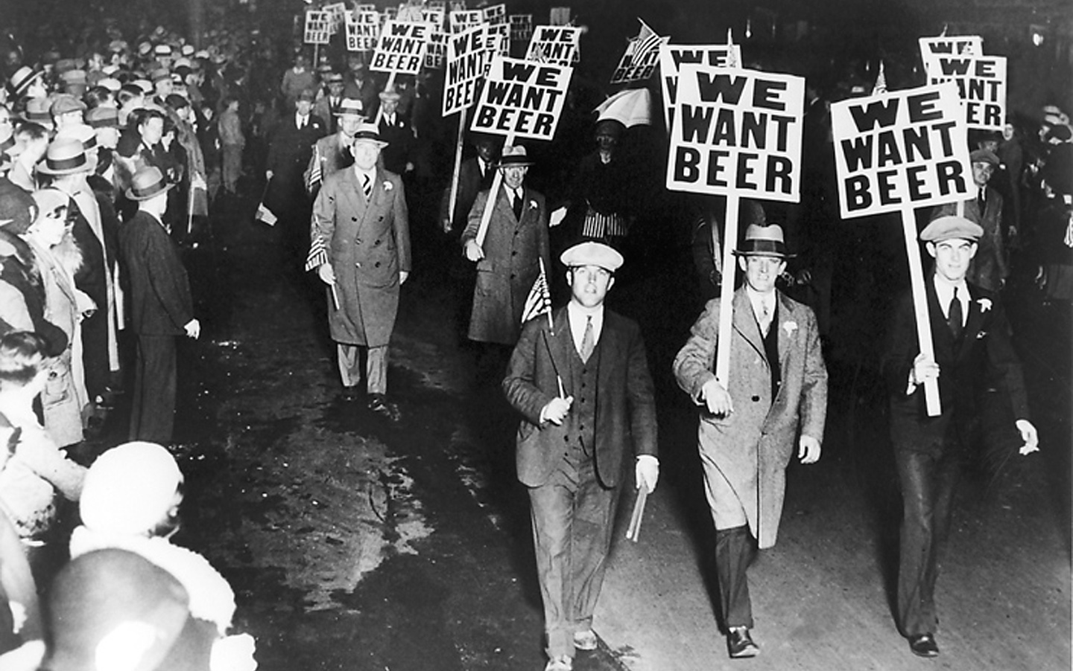
Many immigrant groups considered alcohol a regular part of social interaction and resented the government meddling in their affairs.

Slide 11
Those who wanted to obtain alcohol had to do so illegally, and they did so by going to nightclubs that were called Speakeasies.
Bootleggers were people who smuggled and distributed alcohol during prohibition. They got their name from the anecdotal practice of carrying liquor in the legs of boots.

Slide 12
**The affects of prohibition: An overall dissatisfaction and resentment toward the law and the bolstering of organized crime
21st Amendment – Repealed prohibition in 1933
(To Repeal – to remove a law or rule from effect)

Slide 13
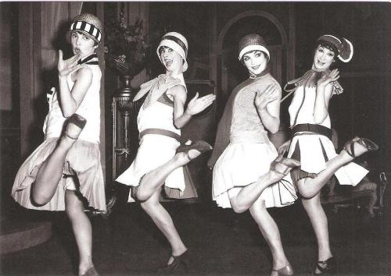
Cultural attitudes toward women began to change during this time too.
Flapper – A socially emancipated woman who embraced the new fashions and urban attitudes of the twenties.

Slide 14
During the 1920s the traditional mode of dating (official courtship with the intention to marry) began to be supplanted by a more casual form of dating.
**Studs versus Sluts - this is where the double-standard granting men more sexual freedom than women becomes engrained in our culture… although it did exist before this point.

Slide 15
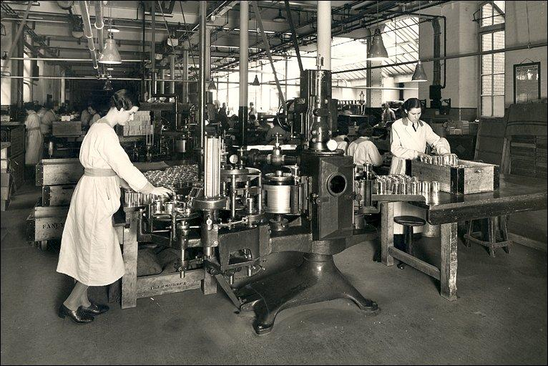
Women began to work outside the home in greater numbers and participated in the economy like never before.

Slide 16
1920s Creative Research Project
Start thinking about what topic(s) you might be interested in learning more about.
You will propose a “creative project” based on your topic. (Comic book? Short story? Music video? Song lyrics? Poem?)

Slide 17
Videos
The Great Gatsby (Speakeasy Scene)
  Where does it take place?
  How do the characters get in?
  What is going on there?
  Who is there?
HBO’s Speakeasy Tour

