Slide 1
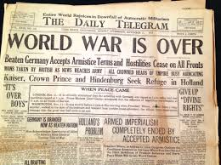
Postwar Issues
Module 17.2

Slide 2

Postwar
Americans had historically been an Isolationist country, wishing to keep to itself and not get dragged into Europe’s problems (a continent plagued by warfare throughout its history).
Many Americans became fearful of outsiders. A wave of nativism swept the nation.
Nativism - prejudice against foreign-born people
Isolationism – a policy of pulling away from involvement in world affairs.

Slide 3

The Red Scare
In Russia, a group of revolutionaries called the Bolsheviks overthrew the Czar and established a military dictatorship. They called themselves “communists” in an attempt to appeal to the common person in their society, drawing on the ideas of Karl Marx.

Slide 4
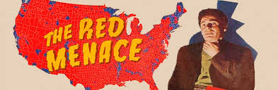
Communism in America?
In America, a communist party was established after the war, and when several bombs were mailed to government and business leaders, the American public began to grow fearful of the spread of communism.
This is important because the fear of communism played an enormous role in United States foreign policy until 1991 – and some would argue until the present date.

Slide 5
Example: Sacco & Vanzetti
Two Italian immigrants who were put on trial for murder.
Many historians say that they were unfairly tried due to their political beliefs

Slide 6
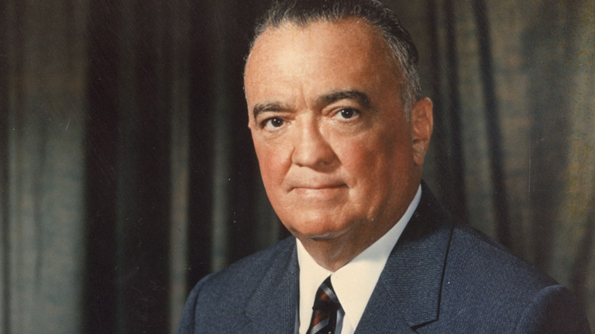
The Palmer Raids
In 1919, Attorney General Mitchell Palmer appointed J. Edgar Hoover to be in charge of hunting down suspected Communists, socialists, and anarchists.
They trampled people’s civil rights, invading private homes and offices and jailing suspects without allowing them legal counsel. Hundreds of foreign-born people were deported without trials.

Slide 7
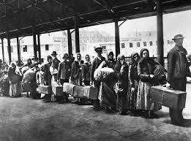
Responses to the fear of “Communism”
The Ku Klux Klan – Membership in the group soared as a result of the Red Scare and the Klan became politically dominant in many states.
“Keep America for the Americans” – A prevailing attitude that argued that because there was less of a need for low-skilled jobs in America, there was no longer a need for immigrants to come into the US and take them.

Slide 8
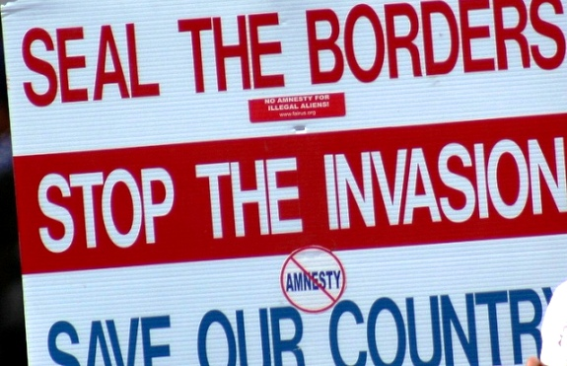
Fear of Immigrants
The Emergency Quota Act of 1921 – Established a maximum number of people who could enter the U.S. from each foreign country in order to protect domestic jobs and national security.

Slide 9
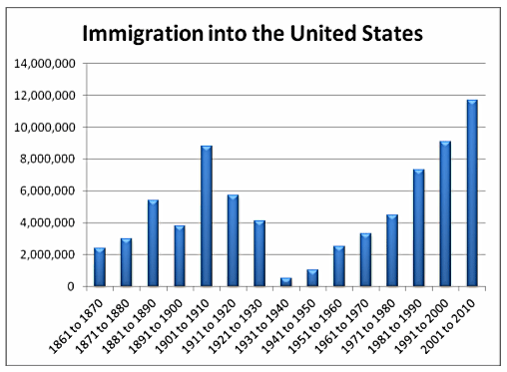

Slide 10
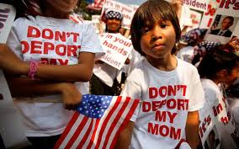

Connection to today
This debate goes on today. You may have heard discussion of “immigration reform”, “national security”, “the war on terror”, and other types of socio-political discussions.

Slide 11
Labor Unrest
“Progressives” had won many elections in the early 1900s by responding to labor unrest
1919: More than 3,000 strikes occurred (4 million workers) people were upset over:
1. Bad working conditions & Accidents
2. Low pay
3. Children working long hours
However…a new era of Big Business Republican Presidents began in the 1920s [Tug of War]

