Slide 1

The Business of America
MODULE 17.1

Slide 2
Part I: The Aftermath of WWI, The Harding Presidency

Slide 3
1918: The “Great War” Ends
The Allies (US, Britain, France) beat the Central Powers (Germany, Austria-Hungary, Ottoman Empire, Bulgaria)
Germany was forced to sign the Treaty of Versailles, which blamed them for the war and made them pay for all the damages.

Slide 4
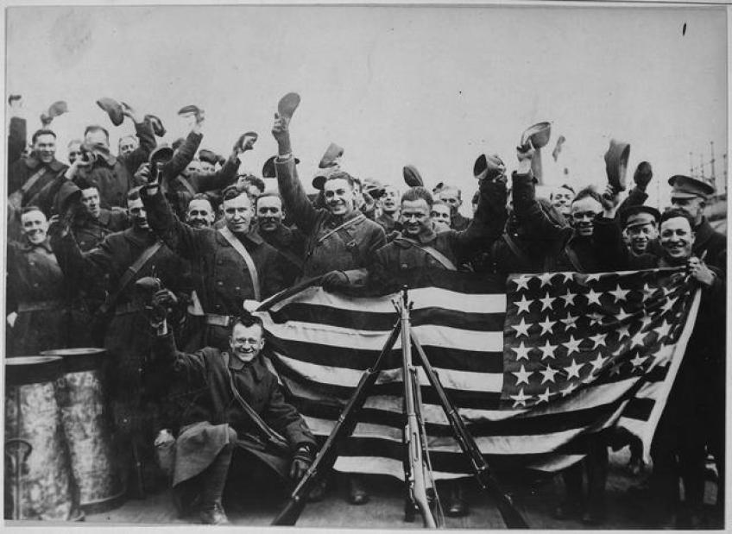
After the WWI: The “Great War”
Americans were sick and tired of…
War
The politics of the “Progressive Era” (1890-1920)
Americans were fearful of:
“Outsiders” (Immigrants, Communists)

Slide 5
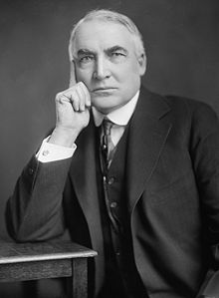
The Election of 1920
Warren G. Harding was able to win the Election of 1920 by promising Americans…
A return to “normalcy”
Peace
Economic Prosperity

Slide 6
France, Britain, & Germany after WWI
France & Great Britain borrowed $10 billion from the U.S. during WWI
Harding placed high tariffs (taxes) on imports, which made it hard for these two countries to pay back their debts.
Both countries put pressure on Germany to pay it’s war debt

Slide 7
The Dawes Plan
France invaded Germany when it was unable to pay the war debt
An American banker, Charles G. Dawes was sent in to negotiate.
He came up with what is now known as The Dawes Plan

Slide 8
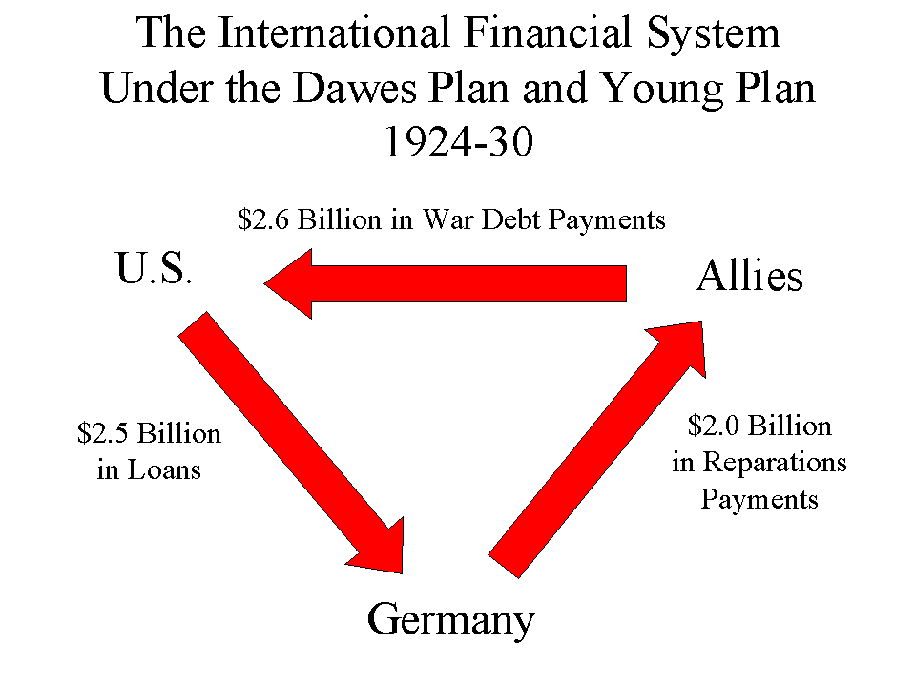

Slide 9
The Dawes Plan
Essentially, the U.S. actually arranged to be repaid with its own money.
This solution caused resentment all around the world:
  France & G.B. felt the Americans financially benefitted from the war, while Europeans paid for it with their lives and homelands.
  Germany felt they were being unfairly punished and that the reparations were impossible to repay
  Americans felt like they were preventing WWII

Slide 10
Part II: Harding’s Domestic Policies & Problems

Slide 11
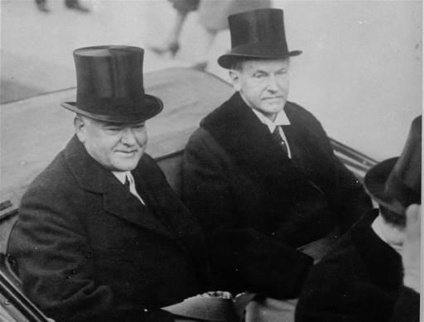
Pro Business Presidents
American Industries Flourish under presidents Warren G. Harding, Calvin Coolidge and Herbert Hoover.
All were Republican presidents who favored policies that:
Reduced taxes
Increased business profits
Expanded the use of credit.

Slide 12
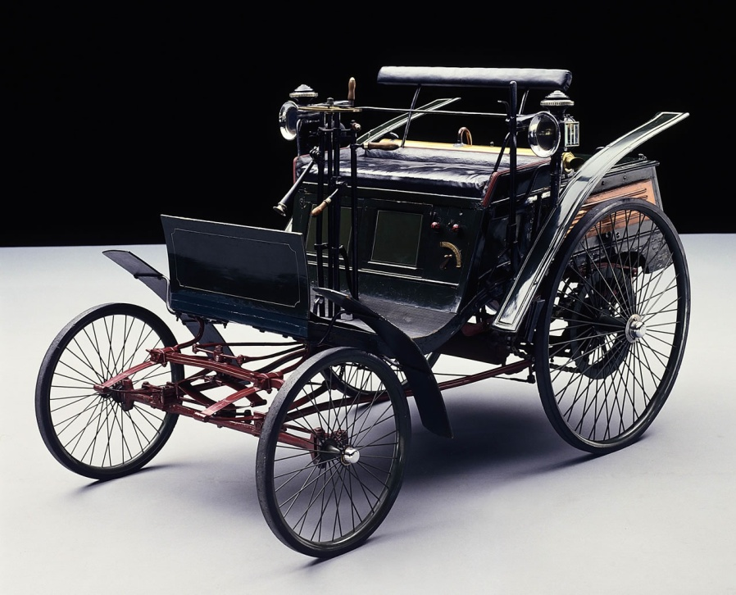
The Automobile: New Patterns in American Living
Garages / Smaller lawns
Gas stations, Oil industry
Roads
Repair shops
More!

Slide 13
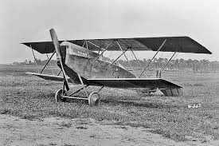
The Airplane
The technology to fly in airplanes was developed in 1907. The technology was used during the Great War.
Afterward, the development of the early airplane industry occurred rapidly, initially for the U.S. Post Office to carry mail.
Charles Lindbergh and Amelia Earhart became heroes and symbols of the advancing age for their transatlantic flights.

Slide 14
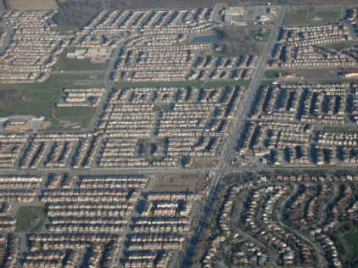
Urban Sprawl
The biggest change came in the distances that people could live from their jobs.
Cities began to “sprawl” (spread out) in all directions.
Many more cities developed, not just the big ones (Chicago, NYC, Philadelphia, Boston)
This is the beginning of suburban patterns of living

Slide 15
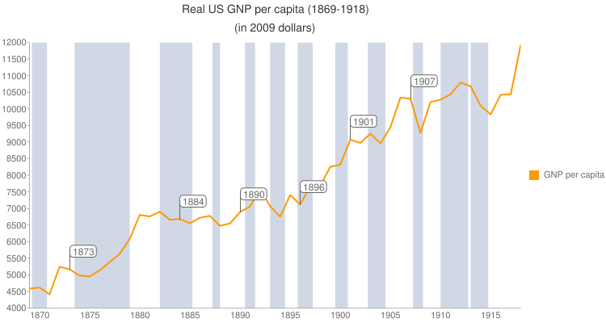
America’s Standard of Living Soars
Wages rose
People now owned luxuries such as refrigerators, washing machines, etc
Car ownership rose
Emergence of telephones
Can you imagine your life without these luxuries? This was the beginning of hyper-consumerism!

Slide 16

The rise of American Advertising
Advertising previously focused on informing people about goods and services. But now…
------------------------------------------------------------------------
Businesses hired psychologists and other professionals to figure out how to convince people to buy things.
The result was a change in the way Americans (and eventually, the rest of the world) consumed “stuff”.

Slide 17

Endless Prosperity?
The 1920s were called the “Roaring Twenties” because people thought everything was great after the war and that everyone was prospering.
Early in the 1920s the economy was prosperous (it was strong and grew quickly), but there were signs of trouble ahead…

Slide 18
Trouble Ahead?
People bought more stuff, saved less, and acquired large amounts of debt.
Things like cars, appliances, and clothes became status symbols (Veblen, 1899).

Slide 19

Types of Credit
Credit – Buying a good or service without actually paying for it up front. A “promise to pay later.”
Installment Plans – Buying things over an extended period using more than one payment. “Five easy payments of $19.99…” is still $100
Buying on Margin – Investing borrowed money with the hope of making money in the stock market.
…What happens when you lose??

Slide 20
Endless Prosperity?
Businesses kept growing larger: producing more goods as quickly as possible.
Technology allowed more production while also employing less people.
So…
[MORE stuff] + [less people to buy it] = ?????

Slide 21

The economy of the 1920s was superficial.
Superficial – Seemingly good on the surface, but deep down it is not.

