Slide 1
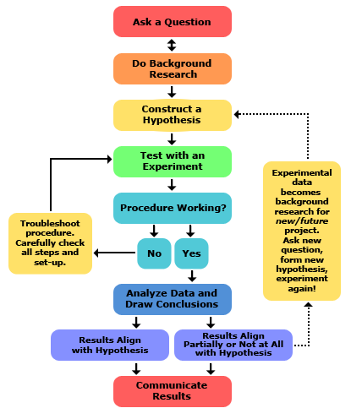

1.1 – Social Science Research Methods

Slide 2

The Scientific Method
We use the scientific method to ensure that research is done correctly. It allows:
1. Anyone, including other scientists, to check the work of the researcher
Scientific Method - A procedure for acquiring knowledge through observation and experimentation (7-step research model)

Slide 3

The way we conduct research is to collect and analyze data.
Data – facts and statistics collected together for reference or analysis
We use data as evidence to either support or reject hypotheses.

Slide 4

Two Types of Data:
Quantitative Data – Research that works with numerical data.
Qualitative Data - Research that works with non-numeric data such as interviews, photographs, and tape recordings.
    Scientists usually prefer quantitative data because it is much easier to make sense of.

Slide 5
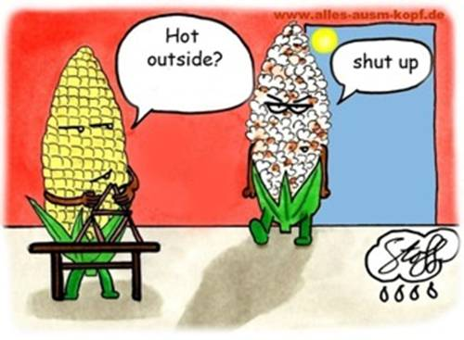
CAUSE AND EFFECT
Usually research is looking to explain WHY (Cause) something happens and to what degree (Effect).
Research explains cause and effect by isolating individual variables and explaining the relationship between them.
Variable – an element, feature, or factor of a larger concept that is measurable

Slide 6
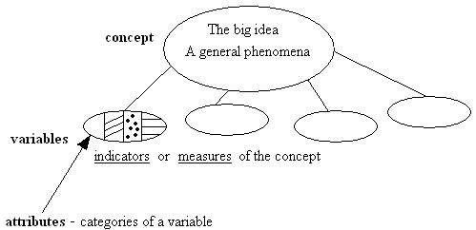

Slide 7
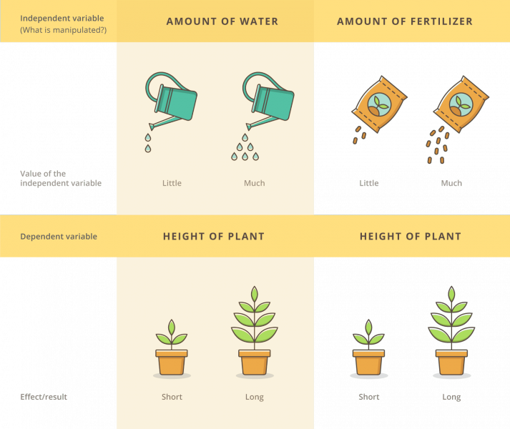
TWO TYPES OF VARIABLES:
Independent Variable (IV) – the variable that CAUSES the effect
Dependent Variable (DV) – the variable that is effected by the IV
Again, research tries to explain relationships between variables.

Slide 9
MEASURING VARIABLES:
Once you have determined what your variables are, you must operationalize them – which means to decide how you will measure them.
Examples:
Variable= Television viewing
Operational definition: Hours spent watching TV
Variable = Crime rate
Operational definition:
[CRIME RATE] = [Reported Crime] + [Unreported Crime]

Slide 10
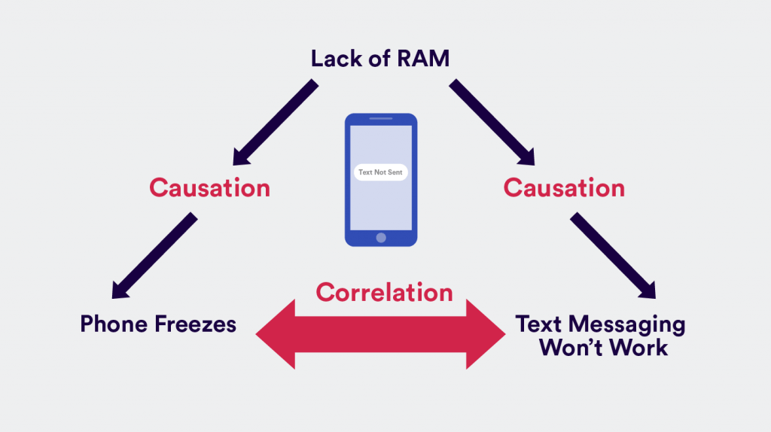
CORRELATION:
When research discovers the existence of a relationship between two variables, we say that there is a correlation.

Slide 11
Notable Features of Research:
The Topic/Question: The general concept or question being studied
The Hypothesis: A statement, narrow in scope and focus, that seeks to explain a phenomenon or answer the research question
N= The population (total number of participants or subjects)
Variables (Independent, Dependent)
Experimental Group, Control Group

Slide 12
LET’S PRACTICE (Advanced)
I will hang out a worksheet that we will use to practice working with variables.

Slide 13
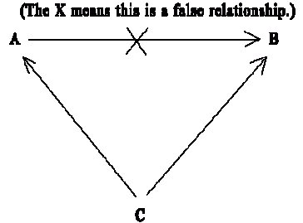
An important phrase / consideration:
Spurious Relationship – The existence of a relationship between two variables that is NOT causal (often explained by a missing variable)
“Correlation does not equal causation.”
IV does not cause DV / A does not cause B
Example: Ice Cream Sales & CRIME

Slide 14
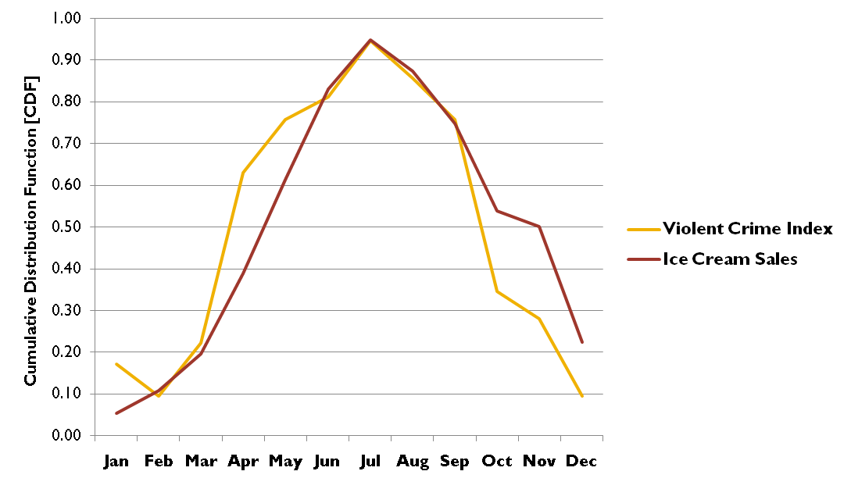

Slide 15
7-STEP Research Model
1. Identify a topic/problem and ask a general question (What are your variables?)
2. Do a literature review
A. Find out what research has already been done
B. Don’t repeat old research unless you can add value to it or challenge its findings
3. Form a hypothesis which seeks to explain the relationship between the two variables. Give operational definitions for variables.

Slide 16
7-STEP RESEARCH MODEL (cont’d)
4. Choose the research method that is most appropriate
5. Collect the data
6. Analyze the data (make sense of it)
7. Publish findings

Slide 17
SIX RESEARCH METHODS
1. Surveys – Questionnaires designed to be completed without the need for the researcher to be present. Usually made up of closed-ended questions.
2. Secondary Analysis – Analyzing data already collected by others
3. Document Analysis – Analyzing written records/sources (diaries, newspapers, police records, etc.)

Slide 18
4. Experiments – Testing a hypothesis in a controlled setting by utilizing two groups.
The control group receives no experimental treatment and serves as the baseline.
The experimental group receives the experimental treatment (dependent variable).
Afterwards, cause and effect are determined by comparing and contrasting the two groups and the effect of the dependent variable.

Slide 19
5. Observation – Observing people’s behavior in their natural environment without them knowing you are observing them and without playing any role in that environment.
    Example: Taking notes on people’s seating arrangements during lunch
6. Participant Observation – Observing people’s behavior in their natural environment while playing a role in the environment. Subjects might know they are being studied or they might not.
    Example: Joining a cult to study it

