Slide 1
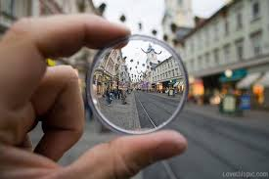
Three Sociological Perspectives
Viewing the world through a sociological lens

Slide 2
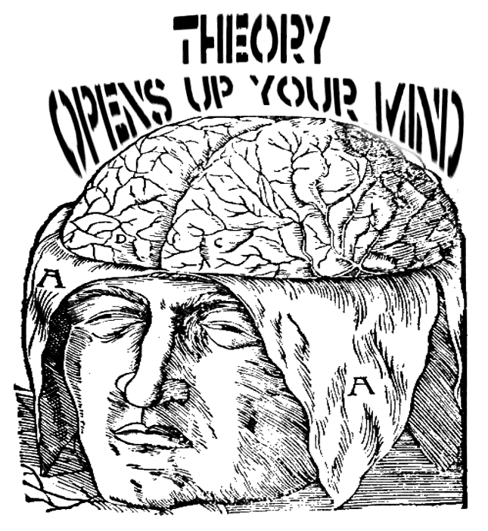
Three Perspectives/Theories
We will focus on three major perspectives/theories within the discipline of sociology.
Perspective – a particular attitude or point of view
Theory– A broad system or approach used to understand phenomena in the world. Must be supported by EVIDENCE.

Slide 3

You can view any single issue through multiple perspectives.
Which perspective you are seeing the issue from will greatly alter how you perceive it
The major difference between each perspective is the LEVEL OF ANALYSIS & THEMATIC FOCUS

Slide 4

Levels of Analysis
Macro Theory – An approach that examines large scale social structures in order to see how they effect individual’s lives (top-down)
Micro Theory – An approach that examines interactions between individuals and the ways those interactions reflect larger patterns within a society (bottom-up)

Slide 5
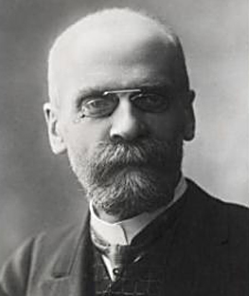
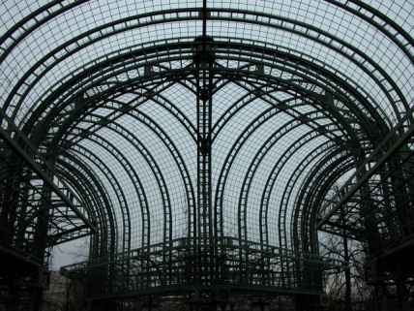
Functionalism
A perspective based on the ideas of Herbert Spencer and Emile Durkheim.
Emile Durkheim – wanted to look at society from a macro(large scale) perspective by studying social institutions, groups, and social facts.
Social Fact – Values, cultural norms, and social structures that transcend the individual and have effects on most people in a society.

Slide 6
Functionalism
Level of Analysis: Macro Theory
Definition: Studying society as a system of interconnected parts that work together in harmony to maintain a state of balance and social order.
Thematic Focus: Society as a “system,” Social order, Social stability

Slide 7
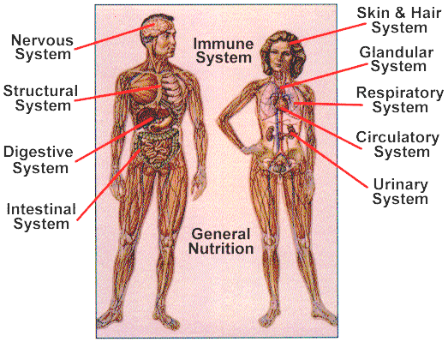
Social Structure
What are the “parts” of society that make up the whole?
How do these “parts” work together to form a working society?
Example: Human body

Slide 8



Social Function
Manifest Function – the intended purpose of something
Latent Function – the unintended affects of something
Examples: Newspaper, Schools,
Notes:
VIDEO EXAMPLE:

Slide 9
Functionalism
VIDEO EXAMPLE: All societies have the function: Raising children
How is that function similar in different societies? How is it the same?

Slide 10
Symbolic Interactonism
Level of Analysis: Micro Theory
Definition: A view of social behavior that emphasizes verbal and non-verbal communication, socialization, and transmission of culture.
Thematic Focus: Language, Culture, Interaction between individuals

Slide 11
Symbolic Interactionism
How are these people communicating verbally?
How are they communicating non-verbally?
Are they sending mixed signals?

Slide 12
Conflict Theory
Level of Analysis: Meso AND Macro Theory
Definition: An approach to studying society that emphasizes social, political, and economic power.
Thematic Focus: Social conflict, power, distribution and access of resources

Slide 13
Conflict Theory
Video Example: Look for examples of social power, political power, economic power, and inequality.

Slide 14
By the end of this course you should…
Be able to define and give numerous examples of each sociological perspective
Be able to analyze and discuss various issues from each perspective…
  Put on your _____________ hat!

