Slide 1
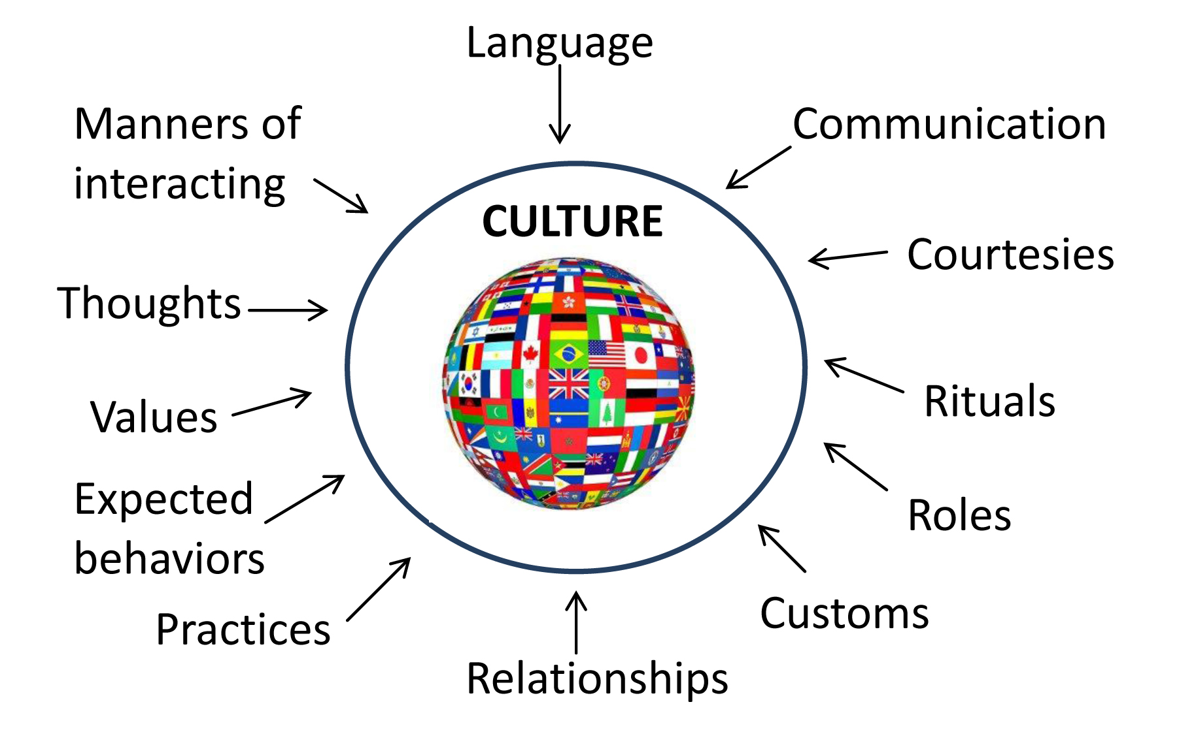
Perspectives on Culture
Functionalism, Symbolic Interactionism, and Conflict Theory

Slide 2

What would a functionalist say?
Culture is an essential part of evolution
    All societies change over time
    Culture is NECESSARY:
      It provides a blueprint for people to follow / Culture guides behavior
      The Blueprint consists of: Norms, Values, Customs, Mores, Folkways, & Taboos

Slide 3
Functionalism & Culture:
Members of a society form a collective conscious, shared moral values and beliefs.
Society cannot exist without culture!
Culture is passed on through SOCIAL INSTITUTIONS

Slide 4
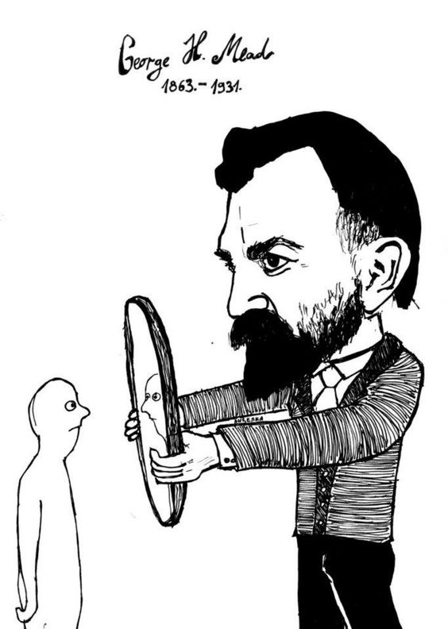
What would a symbolic interactionist say about culture?
Culture is never static… It does not merely exist… it is in a constant state of change because WE are constantly creating it.
Culture is learned… Individuals learn about their culture through socialization (social learning) which they receive from other individuals.

Slide 5
Symbolic Interactionism & Culture
People are usually socialized by their:
Families – Parent(s), Sibling(s), Extended family
Peer Groups – Friends
Out groups – People you don’t normally associate yourself… you learn more about yourself by comparing yourself to them

Slide 6
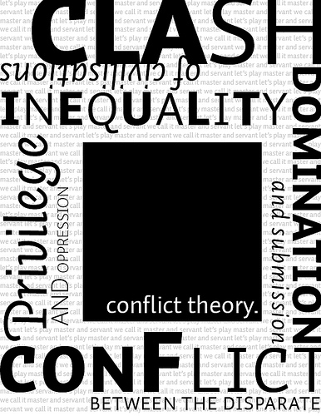
What would a conflict theorist say?
Culture takes place in the context of “THE FIELD”
“The Field” is the site of struggle between individuals within the same culture as well as between mainstream culture and counter-culture.
The field can be….
    School
    The home
    Work
    Public places

Slide 7
Conflict Theory & Culture
How do people compete in “the field?”
Capital – Access to financial resources (Money is power)
Cultural Capital – Access to non-financial resources that can promote social mobility (It’s who you know…)

Slide 8
For your Seminar:
-Make sure you understand the concept of “The Field.”
-Make sure you can CULTURE from all three perspectives.

