Slide 1

Mr. Sterchi’s Slide Show!
Check out some of the places I’ve been and people I’ve met!

Slide 2

I would like to share with you some of my life experiences!
I believe I am a good person to teach US History because of some of these experiences. What do you think?

Slide 3
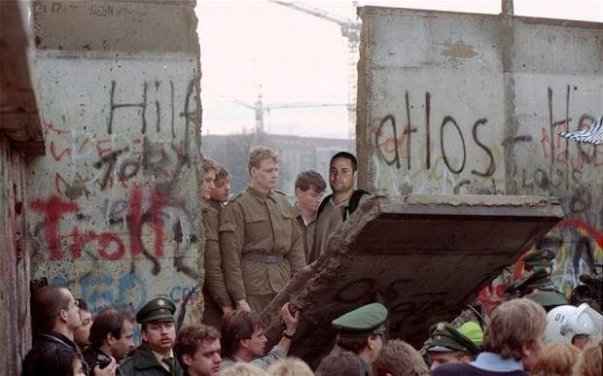

Slide 4
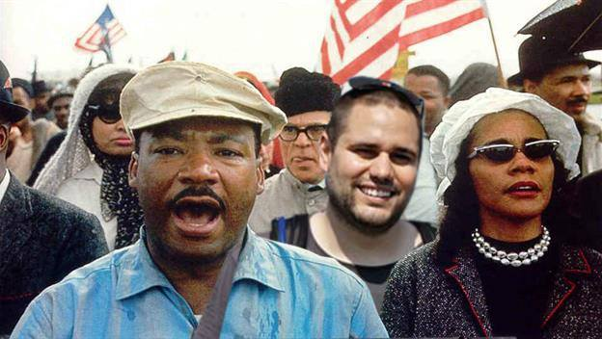

Slide 5
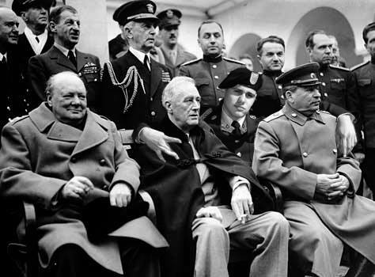

Slide 6
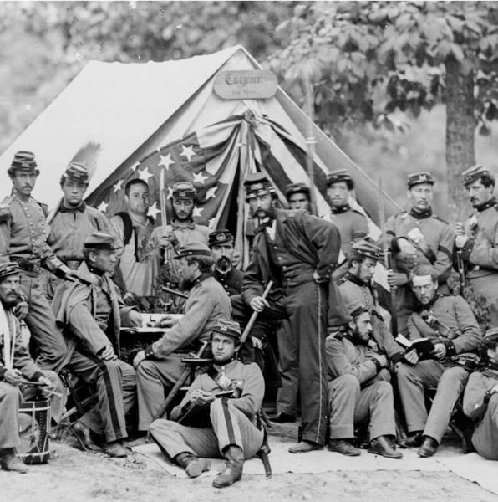

Slide 7

Skepticism:
Skepticism – an attitude of doubt, a disposition (way of thinking) that critically examines the truth of a particular concept or idea
Do you see why having a default stance of skepticism is important in the modern world??

Slide 8
Skepticism
Being skeptical doesn’t mean that you ALWAYS claim things are false… it just means that you think critically about new information.
When we study history (or ANYTHING) we should always approach new information with an open mind and some degree of skepticism!

