Slide 1
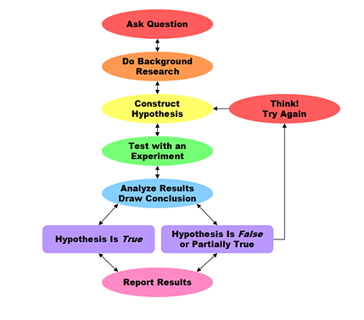
Qualitative Methods
Recording, Analyzing, and Interpreting non-numerical data

Slide 2
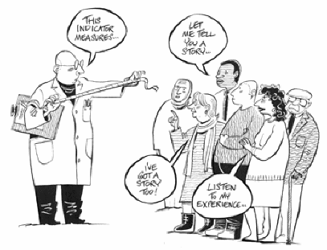
Types of Qualitative Research
Surveys
Observation / Participant Observation
Document Analysis
Interviews

Slide 3
How to: Surveys
Come up with a list of items/questions beforehand
Prepare the responses in advance… leave nothing to chance! (Yes/No, Likert Scale)
Likert Scale: How much do you agree with… ?
1 – Strongly Agree 2- Moderately Agree 3- Neutral
4-Moderately Disagree 5- Strongly Disagree

Slide 4
How to: Observation
Try your hardest to blend in and not be noticed doing your research!
Take DETAILED notes on anything and everything you think might potentially be relevant to your topic.
For participant observation: Be careful… don’t “Go Native.”

Slide 5
Document Analysis
Use “Text Coding” to record data.
Coding:
1. Use different colors to highlight specific topics and themes from the document(s)… “codes”
2. Afterward, make a list of your themes.
3. Simplify and unify codes: How can you lump your numerous themes into unified categories?
4. Interpret and make inferences using your codes

Slide 6
How to: Interview
Create your interview schedule BEFORE the actual interview
Think hard about what you want to ask.
Be polite and respectful.
DO NOT JUDGE: If your participant thinks you are judging them they will disengage from the interview

Slide 7
One more thing about coding…
Coding is also a great note taking strategy. After you take your regular notes in a class or while reading something – generate “codes” and follow the same process.
You will find that this process gives you a very deep understanding of the material!

