Slide 1
Norms and Values
What is common to all societies?

Slide 2
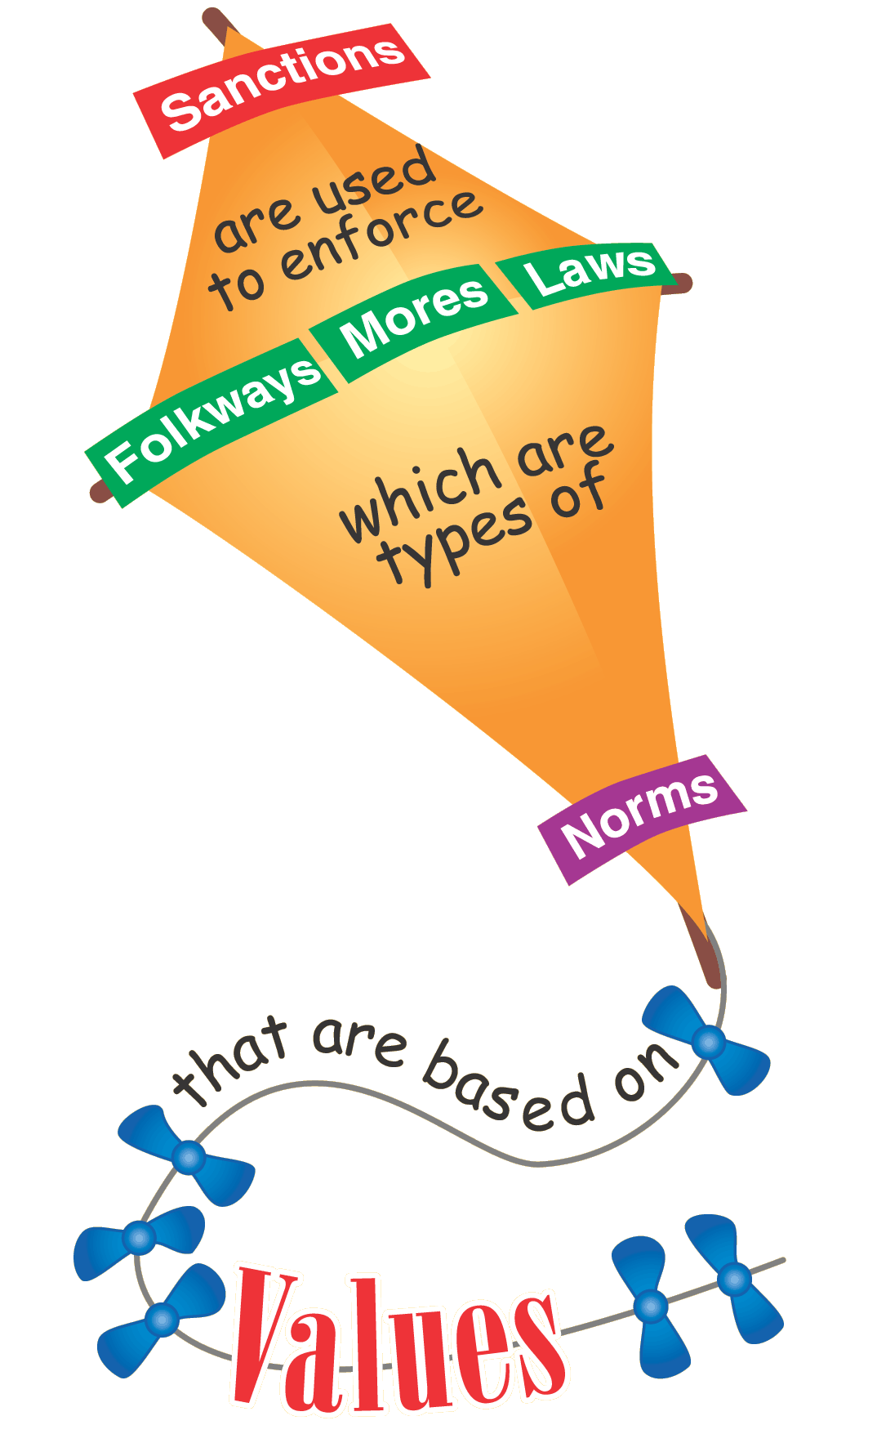

Slide 3
Values – The Basis of Norms
Values are broad ideas about what is good or desirable shared by people in a society
They are so general that they do not dictate precise ways of thinking, feeling, and behaving but instead serve as guidelines

Slide 4
For example…
Remember Robin Williams study of American Values
Americans value…
  Achievement & Success
  Activity & Work
  Humanitarianism
  Progress
  Material Comfort
  Individualism… and more

Slide 5


Slide 6
Why are values important?
They influence human behavior.
Values are…
  Emotion-laden
  Relative (they vary according to time and place)
  The basis for NORMS

Slide 7
NORMS – The Rules We Live By
Norms are the rules defining appropriate and inappropriate behavior
They are LEARNED behavior used to guide social success
Norms are NOT universal
Most people are not consciously aware of a norm until it is violated
    Minor: Cutting in line Extreme: Laws like stealing, murder

Slide 8
There are 3 Types of Norms…
1. Folkways – Rules that cover customary ways of thinking, feeling, and behaving but lack a moral aspect to them
  Examples: Talking loud in a quiet place, offensive language in public, covering mouth while sneezing, knocking before entering

Slide 9
Three types of norms cont’d
2. Mores – Norms that have moral dimensions that when broken produce anger, disgust, and other forms of severe disapproval
      Not standing for national anthem
      Women pregnant out of wedlock
      Serious mores are TABOO…a norm so strong that its violation demands punishment from the group
          Incest
          Eating a dog

Slide 10
Three types of norms cont’d
3. Laws – Norms that are formally defined and enforced by officials and social institutions
    They are consciously created
    Recent changes: Smoking in a public place
    --------------------------------------------------------------------
    BLUE LAWS – Laws that are outdated or no longer applicable but still exist
    http://gemsong.hubpages.com/hub/Blue-Laws-of-the-USA

Slide 11
Video examples:
In the following video examples decide if they are Folkways, Mores, or Laws:

Slide 12
How are norms enforced?
Sanctions are rewards or punishments used to encourage conformity to norms
Two types of sanctions:
1. Formal Sanctions – Social rewards/punishments imposed by people given special authority to do so
2. Informal Sanctions – Social rewards/punishments imposed by ordinary people to encourage conformity
      People conform because to avoid feelings of guilt or social disapproval

