Slide 1

I See Dead People!:
History of Sociology & Classical Sociological Theorists

Slide 2
Sociology is…
A Social Science, which is a study of the human/social world.
Using evidence-based research to explain the social world.
Unlike sociologists, most people rely on common sense.

Slide 3

The European Period
For the first half of the history of sociology, the field was dominated entirely by European intellectuals.

Slide 4
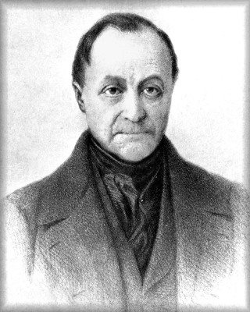
Auguste Comte (1798-1857)
-French
-Father of Sociology
Key Concepts:
Positivism – Everything can be explained through scientific observation and reason
Social Statics – The study of social stability and order
Social Dynamics – The study of social change

Slide 5
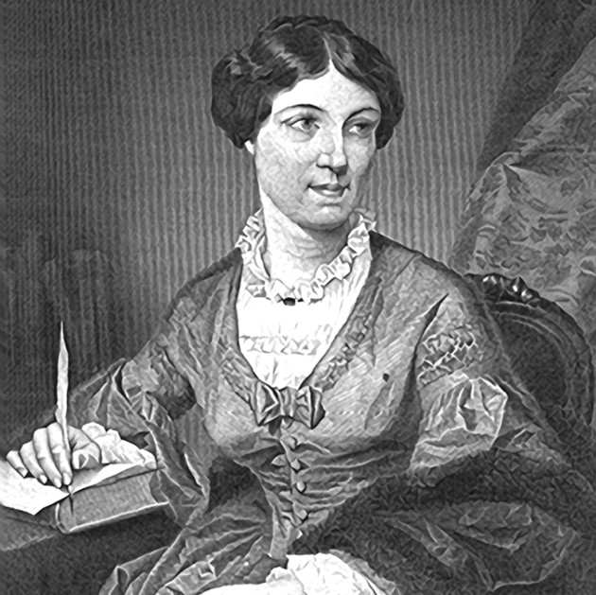
Harriet Martineau
(1802-1876)
-English
Key Contribution:
-Translated Auguste Comte’s work into English
Pioneered Feminism

Slide 6
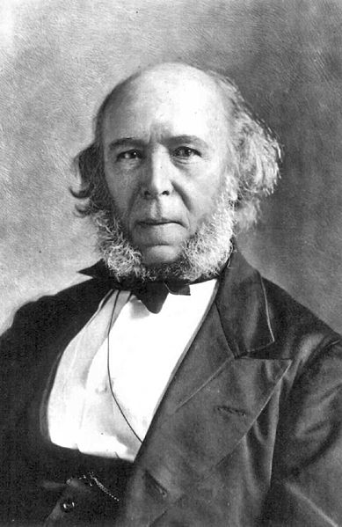
Herbert Spencer(1820-1903), English
Key Concepts:
Functionalism: Society is a system – like the human body.
Social Darwinism – Progress in society comes from a natural process that should be left alone
“The poor deserve to be poor, the rich deserve to be rich.”

Slide 7
Functionalism
“Things are the way they are because they are supposed to be.”
“Survival of the fittest.”

Slide 8


Who likes Spencer’s ideas?
Big business, Republicans, Capitalists

Slide 9
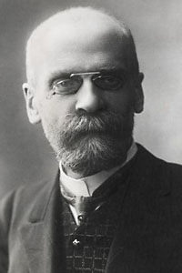
Emile Durkheim (1858-1917), French
Key Concepts:
-Established sociology as an academic discipline
-Associated with Functionalism
-Helped to explain what makes societies and their individuals successful

Slide 10
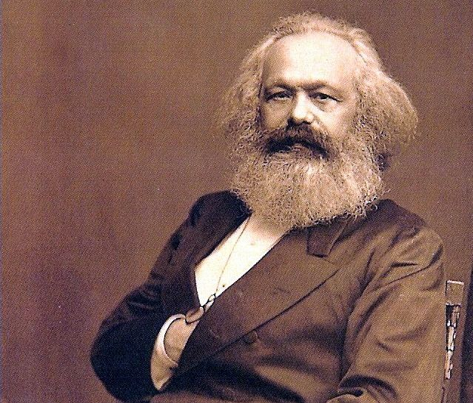
Karl Marx (1818-1883)
German
Key Concepts:
-Believed that social scientists should CHANGE the world and not merely study it
-Predicted that all industrial societies will contain two social classes…

Slide 11
Karl Marx
Bourgeoisie – Owners of the means of production (wealth creation)… 1%
Proletariat – working class that sells their labor to survive (everyone else)… 99%
Class conflict – tension between the bourgeoisie and proletariat

Slide 12

Communism
Karl Marx’s idea for a “perfect utopian society” where there would be no class, no centralized government, and democratic rule.
Karl Marx is associated with
***CONFLICT THEORY***

Slide 13
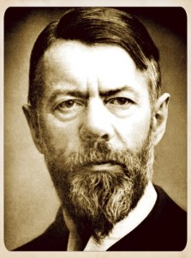
Max Weber(1864-1920)
German
Key Concepts:
Verstehen – Understanding social behavior by putting yourself in the place of others [empathy].
Rationalization – emphasizing reason, logic, and planning and rejection of mysticism
Example: Farming

Slide 14
Max Weber
Pioneered research techniques that tried to eliminate bias

Slide 15

Sociology in the US
The field of Sociology changed dramatically in the early twentieth century…
American sociology became established and began to dominate the field – most notably the Chicago School.

Slide 16
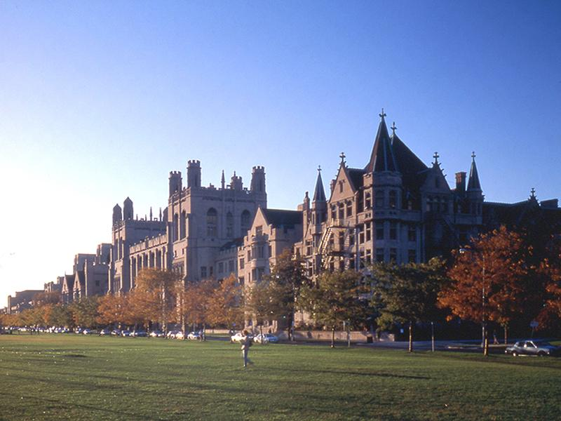
The Chicago School
The sociology department at the University of Chicago and their new methods became known as the “Chicago School”

Slide 17
Old Sociology vs New Sociology
Old European methods: Comparing societies historically at the macro level
New methods: Studying society as it is NOW using…
Interviews, surveys, ethnographies, and observational methods.

Slide 18
Chicago School Sociologists
George Herbert Mead – Father of Symbolic Interactionism… emphasized the importance of language
Herbert Blumer – Student of Mead, gave SI it’s name.
Jane Addams – Founded Hull House
Notes:
*Not a professor or student at the University of Chicago but she was loosely affiliated with them and worked with them to conduct research in the city

Slide 19
W.E.B. DuBois
Pioneered the study of race relations at Atlanta University
First African-American to earn a PhD
Forefather of Civil Rights movement
Founder of NAACP

