Slide 1
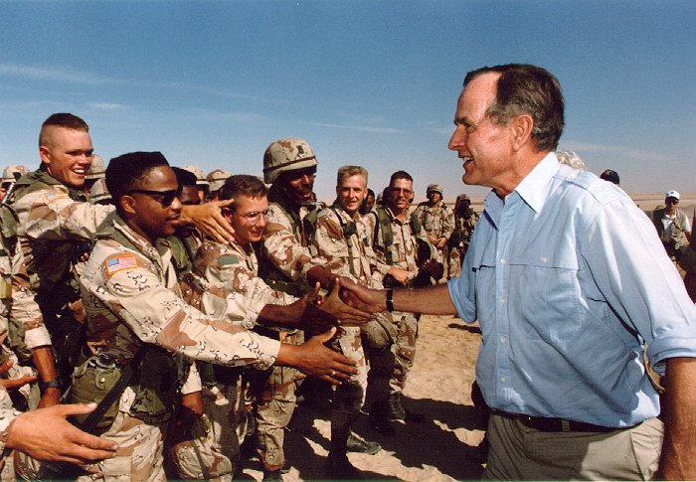
The Persian Gulf War
Chapter 33.5

Slide 2
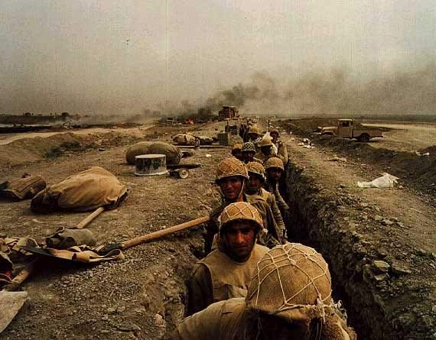
The background…
Iran and Iraq fought a war during the 1980s.
It was a long, expensive war for both countries
Saddam Hussein, the leader of Iraq wanted to pay off his country’s war debts by seizing the oil-rich nation of Kuwait

Slide 3
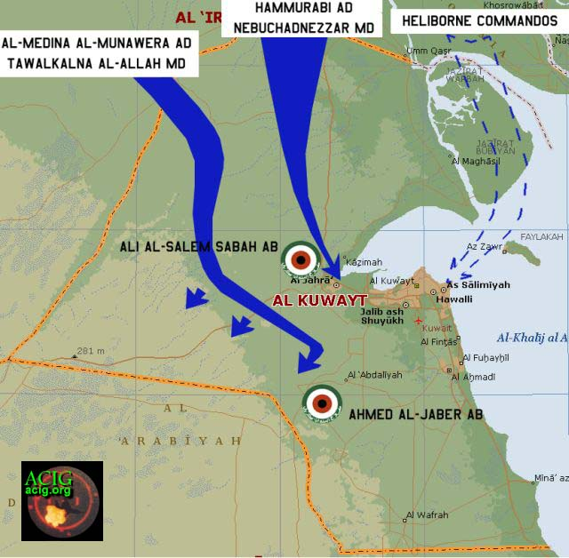
Iraq invades Kuwait
On August 2, 1990 Iraqi troops invaded Kuwait.
Saddam Hussein insisted that Kuwait belonged to Iraq historically…but really he just wanted the oil.
After seizing Kuwait, the Iraqi army turned toward Saudi Arabia.
If Saddam succeeded, he would control half of the nations oil.

Slide 4
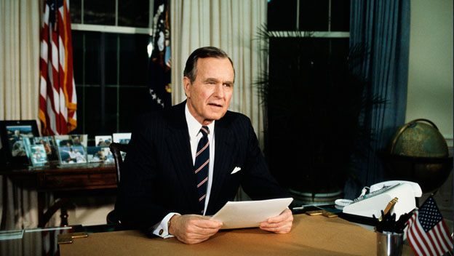
President Bush responds
President George H.W. Bush organized an international coalition against Iraq.
This U.N. operation was known as Operation Desert Storm

Slide 5
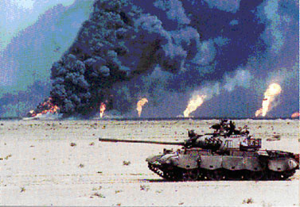
Desert Storm
Starting on January 16, 1991 the United States and its allies launched a massive air assault against Iraq.
On February 23, ground troops moved in to attack the already crippled Iraq.
The war ended on February 28th, 1991 and people in the U.S. celebrated – the war had been won with fewer than 400 casualties for U.N. forces.

Slide 6
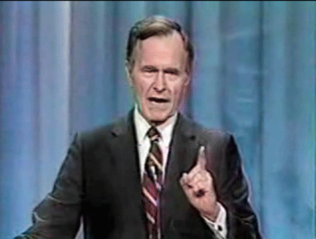
Bush at home:
Although the war was very successful, Bush struggled at home.
“Read my lips, no…new…taxes!”
-George HW. Bush
Due to another recession from 1990-1992, Bush had to raise taxes going back on his campaign promise.

Slide 7
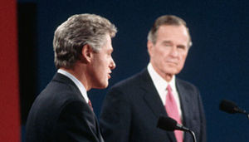
The Election of 1992
Bush’s popularity plummeted as a result of the issues at home.
Bill Clinton would defeat him due to his “middle of the road” appeal to many Americans, as well as the popularity of a third candidate.
Clinton: 43%
Bush: 38%
Ross Perot: 19%

