Slide 1
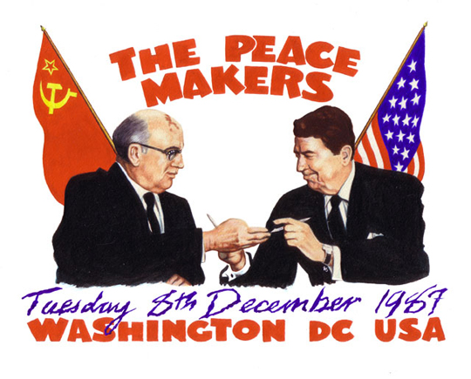
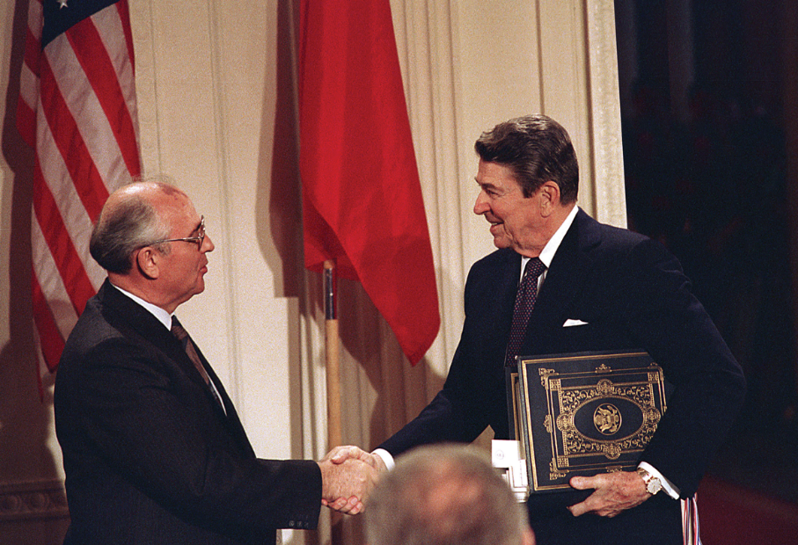
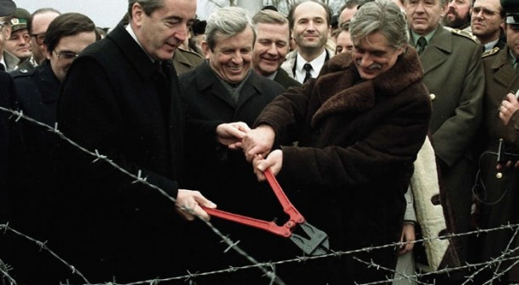
Foreign Policy After the Cold War
Chapter 33 – Section 4

Slide 2
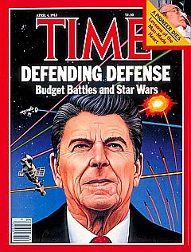
In 1980…
During his campaign Reagan talked very sternly about how he would toughen the United States’ attitude toward the Soviet Union and “Communism.”
When he took office in 1981, tensions between the U.S. and Soviet Union escalated dramatically and would continue until 1991.

Slide 3
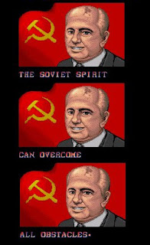
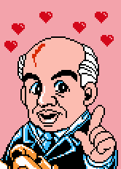
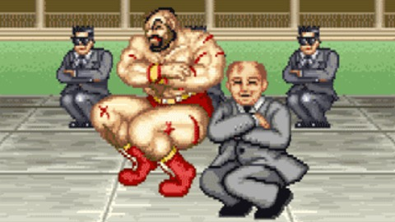
A New Era for the Soviet Union
In 1985, Mikhail Gorbachev became the general secretary of the Communist Party in the Soviet Union.
The Soviet Union was dealing with its own crippling recession in the 1980s – and Gorbachev inherited the mess.

Slide 4
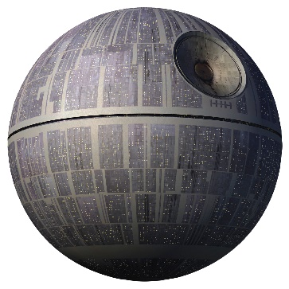
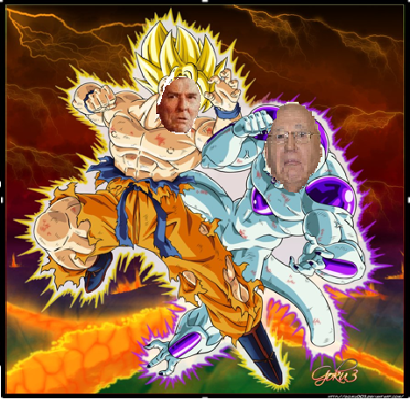
Increased Tension and an Arms Race
Reagan added pressure to the Soviets by increasing U.S. military spending (“Star Wars,” and more nuclear weapons)
The Soviets attempted to keep up…and an arms race ensued.
Gorbachev made some positive social changes in the country by taking steps toward freedom of the press and allowing citizens to criticize the government openly.

Slide 5
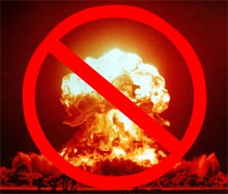
Gorbachev Tries to Reduce Arms
Gorbachev knew that a decrease in Cold War tension would mean that the Soviet Union could decrease defense spending.
He initiated the INF Treaty (Intermediate-Range Nuclear Forces Treaty) which encouraged European nations to make open on-site inspections of one another and to get rid of two types of nuclear missiles.
It would all be for nothing…

Slide 6
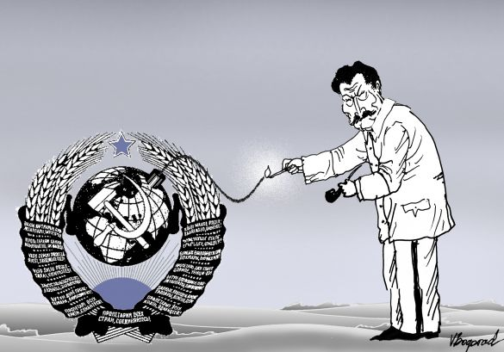
The Decline of the Soviet Union
In 1989, Problems in East Germany led to the tearing down of the Berlin Wall – a wall that had divided the country since the end of World War II. In 1990 the country finally reunited as the result of free-elections.
In 1991, 14 non-Russian countries declares their independence from the Soviet Union – Gorbachev was forced to resign.

Slide 7
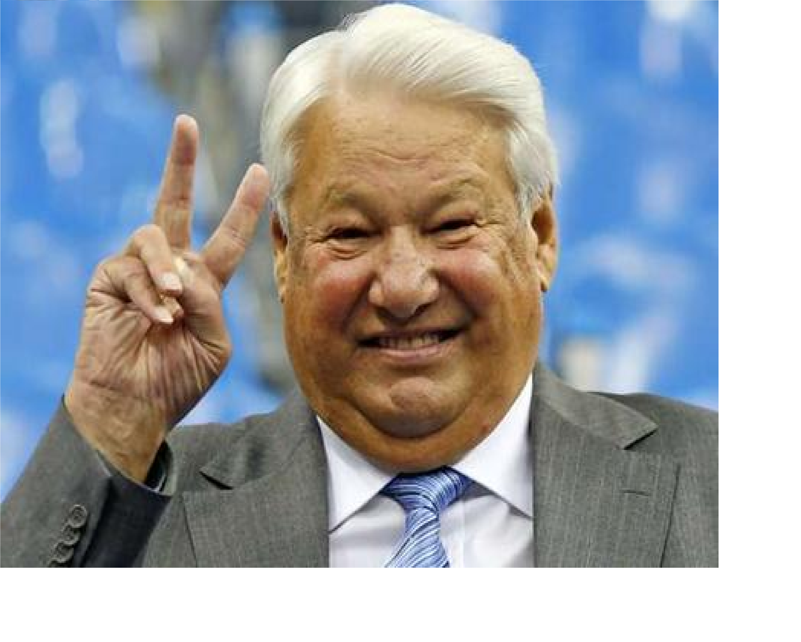
The End of the Cold War
After the dissolution of the Soviet Union, an interim government was formed in Russia led by Boris Yeltsin.
In 1993, George Bush and Yeltsin announced the end of the Cold War which had been going on since 1945.
Both countries agreed to cut their nuclear arsenals by 2/3

Slide 8
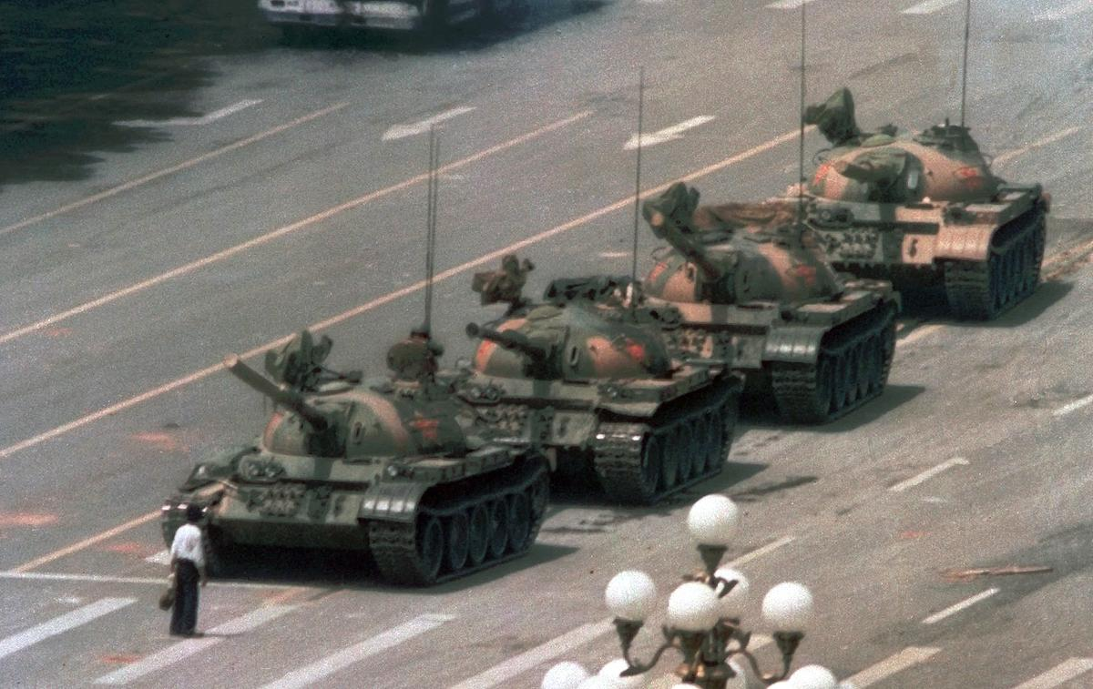
Communism Continues in China
In 1989, Chinese students began to protest their government in large numbers and held marches.
The marches quickly grew into a massive demonstration in Tiananmen Square.
In response, the Chinese military rolled into Tiananmen Square slaughtering the protesters. The Pro-democracy movement crumbled.

Slide 9
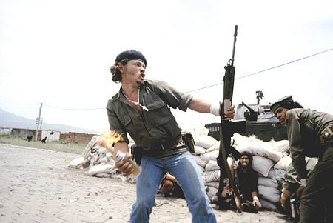
Nicaragua
In 1912, the U.S. government invaded Nicaragua to protect American investments and put Anastasio Somoza into power.
His family held power for 42 years by rigging elections and assassinating political rivals.
In 1979, a Civil War broke out because Nicaraguans wanted an end to the dictatorship.

Slide 10
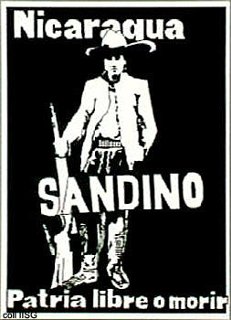
The Sandinistas
The rebels were called the Sandinistas (named for a famous rebel killed in 1934, Sandino).
The rebels toppled the government and took power in 1979. President Carter recognized the new government and send $83 million to help them rebuild – as did many other countries.
However, in 1981 Reagan began to fund and sponsor a new group of rebels called the Contras.

Slide 11
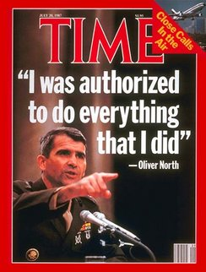
Reagan and the Contras
Reagan sent CIA officials to Nicaragua to help the Contras with their war.
The American people were not happy – and eventually congress banned the U.S. from helping the Contras.
Reagan continued to do so anyway – and eventually the issue was resolved by an election in 1990. However, the result was a very unstable country.

Slide 12
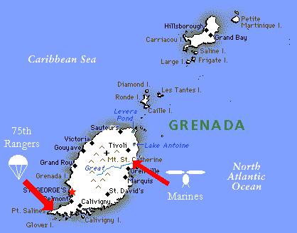
Grenada
Reagan sent 2,000 marines to the tiny Island of Grenada to overthrow the government that was becoming too friendly with Cuba.
He replaced the government with one friendlier to the U.S.

Slide 13
Panama
In Panama, the U.S. government had been giving money to the leader of Panama, Noriega – since the 1960s.
However, it came to light that he was involved in the international drug trade.
As a result, Reagan sent 20,000 troops to Panama and overthrew the government, brought Noriega back and sentenced him to 40 years in prison.
This made the people of Panama resent the United States for its “Imperialism.”

Slide 14
The Iran-Contra Sandal
In 1983, terrorist groups loyal to Iran took Americans hostage in Lebanon.
Reagan denounced Iran, who was at with Iraq, and announced that the US and its allies would not sell arms to Iran.
He said, famously, “America will never make concessions to terrorists!”
Americans were shocked to learn in 1986 that Reagan sold arms to Iran in exchange for the Iranian government’s help in getting hostages released.

Slide 15
The Scandal Gets Deeper
Profits from the Iran Deal were sent to the Nicaraguan rebels known as Contras in direct violation of the Boland Amendment – which prohibited the U.S. to be involved with the Contras.
A government investigation followed and found many Reagan officials guilty. However, Bush would later pardon them.

