Slide 1



Social Concerns in the 1980s
Chapter 33 – Section 3

Slide 2
Moral questions of the 1980s:
Should evolution be taught in schools?
Should prayer be allowed in schools? In what capacity?
Should schools teach sex education?
Should abortion be legal?
What should the government do about the HIV/AIDS crisis?
Should drugs be illegal? How severely should we punish offenders?

Slide 3
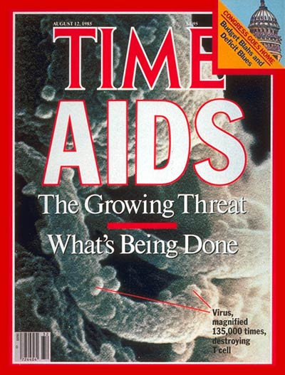
The AIDS Crisis:
HIV/AIDS (Human Immunodeficiency Virus infection & Acquired Immune Deficiency Syndrome) is a virus that attacks the immune system slowly causing those with it to be more susceptible to sickness and other health problems.
Although it had been around since the early 1900s, HIV/AIDS was not clinically discovered until 1981.
Panic over the new virus spread throughout the U.S.

Slide 4

Where did HIV/AIDS come from?
The virus originated in primates and was transferred to humans in the early 20th in West Africa.
There is evidence that suggests that a group of hunters/bush-meat preparers became infected with the virus while handling chimpanzee meat.
Source: The Origin of Aids by Jacques Pepin

Slide 5
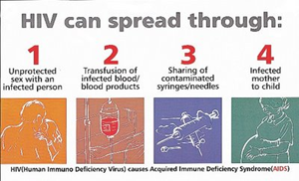
Historically, AIDS was spread throughout the world through colonial-medical campaigns intended to eradicate tropical diseases, urbanization, prostitution, and syringe sharing. (Pepin, 2011).

Slide 6
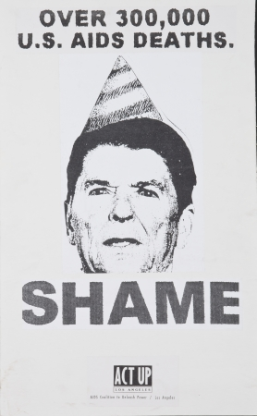
The U.S. Government responds to the crisis:
Massive aids education campaigns began in the 1980s because the disease was spreading so quickly.
Due to the conservative culture of the 1980s, the homosexual community was unfairly blamed and attributed with the cause and spread of the disease.
A major criticism of Reagan is that he did not do enough to educate society about aids.

Slide 7
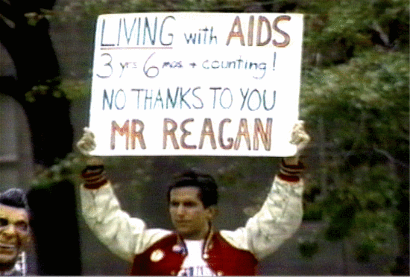

Slide 8
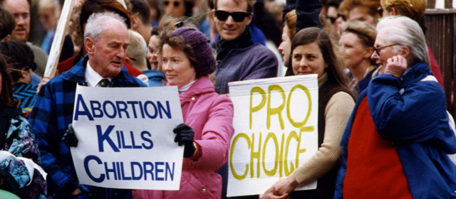
Abortion
Abortion had been legal in the U.S. since 1973, but with the new conservative nature of the Supreme Court many Americans who disagreed with Roe v. Wade saw an opportunity to challenge the law.
In July 1989, the Supreme Court ruled in Webster v. Reproductive Health Care Services that states had the right to impose new restrictions on abortion.
As a result, the practices methods varied from state to state, sometimes leading to dangerous results for patients.

Slide 9
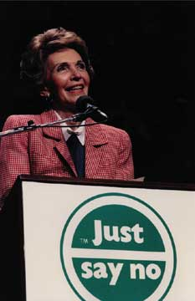
Drug Abuse
Americans saw the rise of drug use as an important social program.
Starting with Ronald Reagan, the conservative “War on Drugs” began to pass harsher penalties for drug trafficking and drug use.
This resulted in soaring incarnation rates that disproportionally affected poorer communities and people of color.

Slide 10
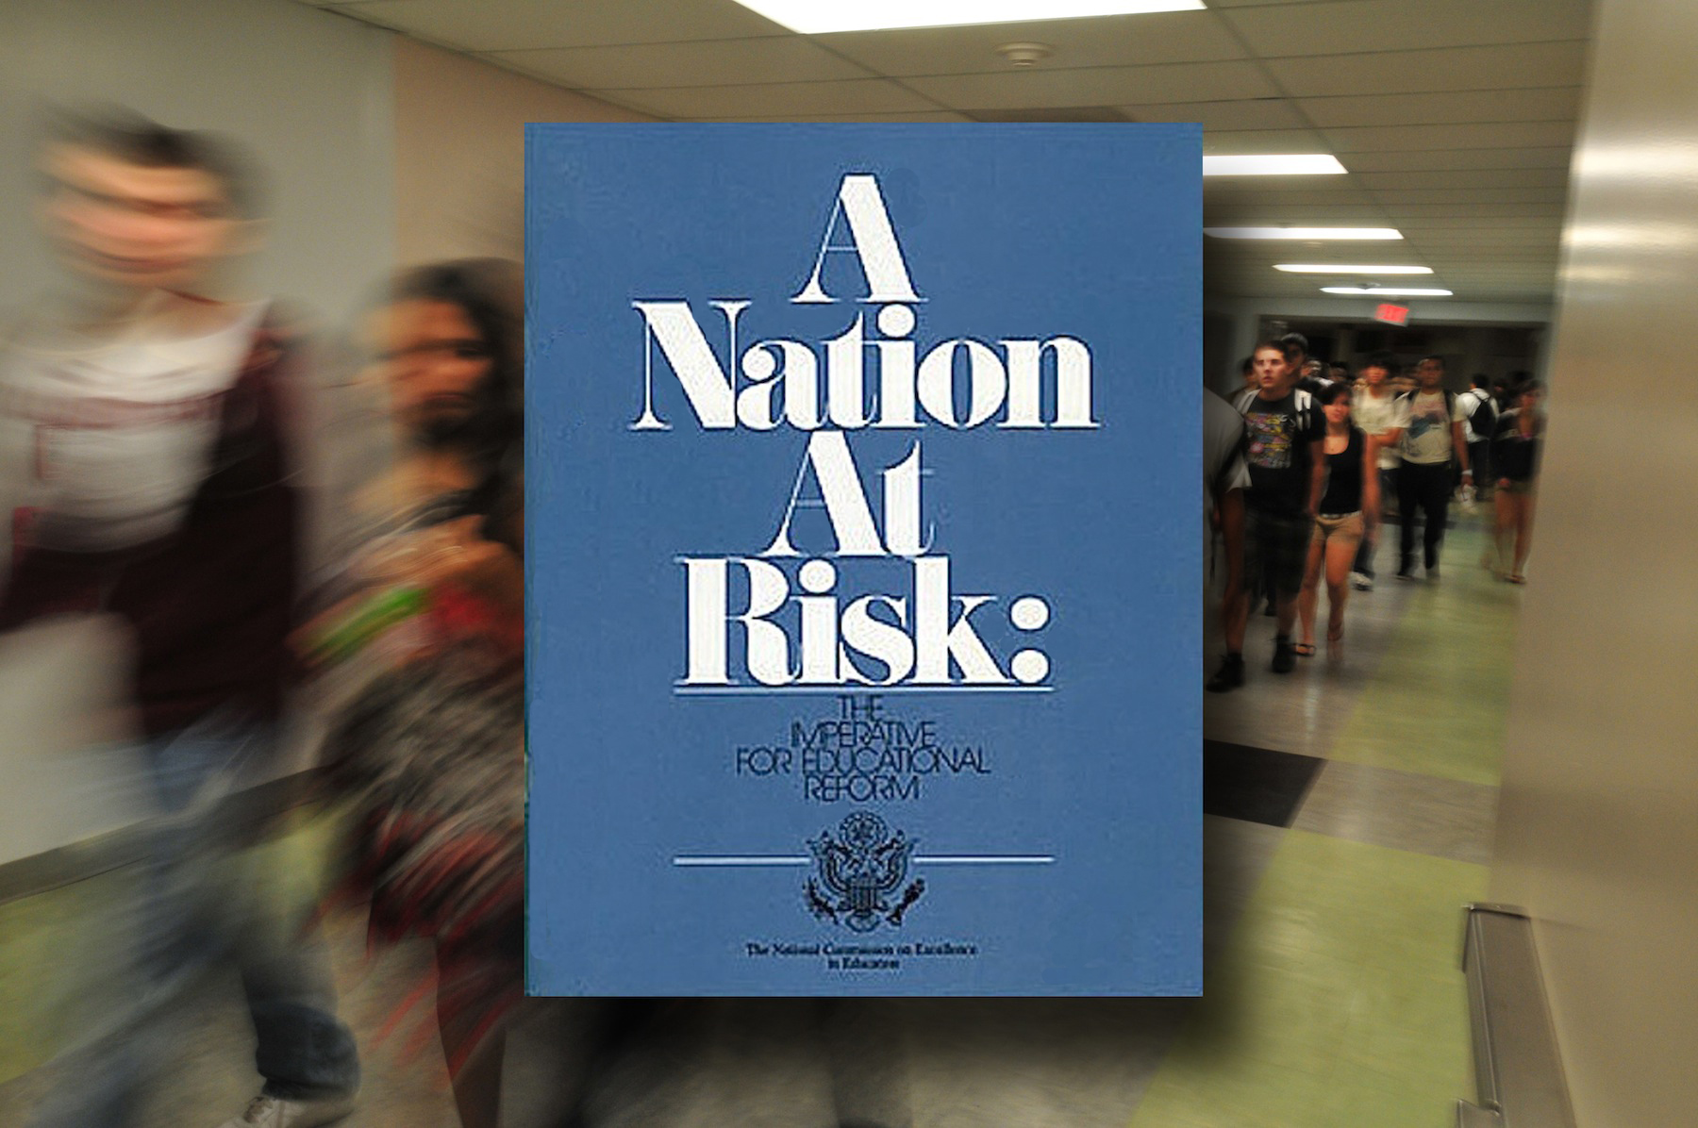
Education
In 1983, a now very famous federal report entitled A Nation at Risk was issued.
The report revealed that American students lagged behind the rest of the industrialized world.
This shocked people who thought that the American education system was the best in the world.
The report recommended: more homework, longer school days, and a longer school year.

Slide 11
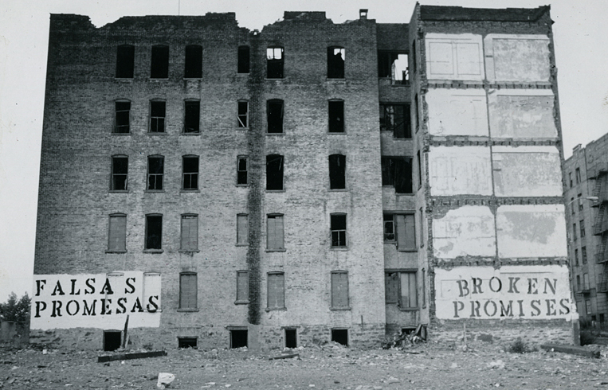
Urban Crisis
American cities struggled with high levels of poverty and unemployment, worse schools, crumbling infrastructures, and inadequate sanitation programs.
Remember “White flight?” The problems were getting worse…

Slide 12
The ERA is Defeated
The Equal Rights Amendment was finally defeated in 1982 when it failed to be ratified by enough states.
According to the Bureau of Labor Statistics in 1992, women were earning 75-cents for every dollar men made doing the exact same work.
More women began to run for public office than ever before.

Slide 13
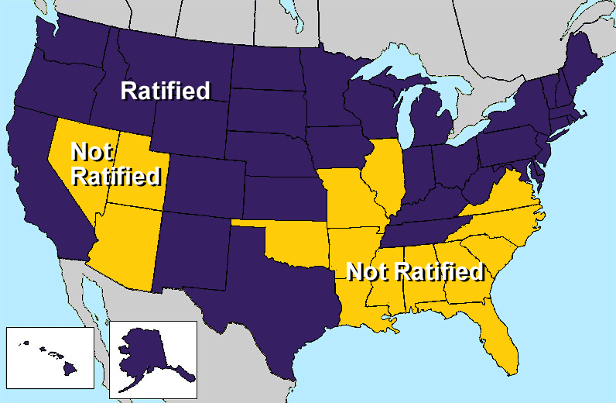

Slide 14
Gains for Minority Groups
Latinos and Native Americans saw many Civil Rights victories in the 70s and 80s.
Women’s rights were advanced in some ways, but took some steps back in others due to rising conservatism.
The Gay Rights Movement began to fight for their own Civil Rights in the 1970s and 1980s. Homosexuals have historically been victims of violence, oppression, and pseudo-science and often were powerless to fight back legally – society often “looked the other way.”

