Slide 1
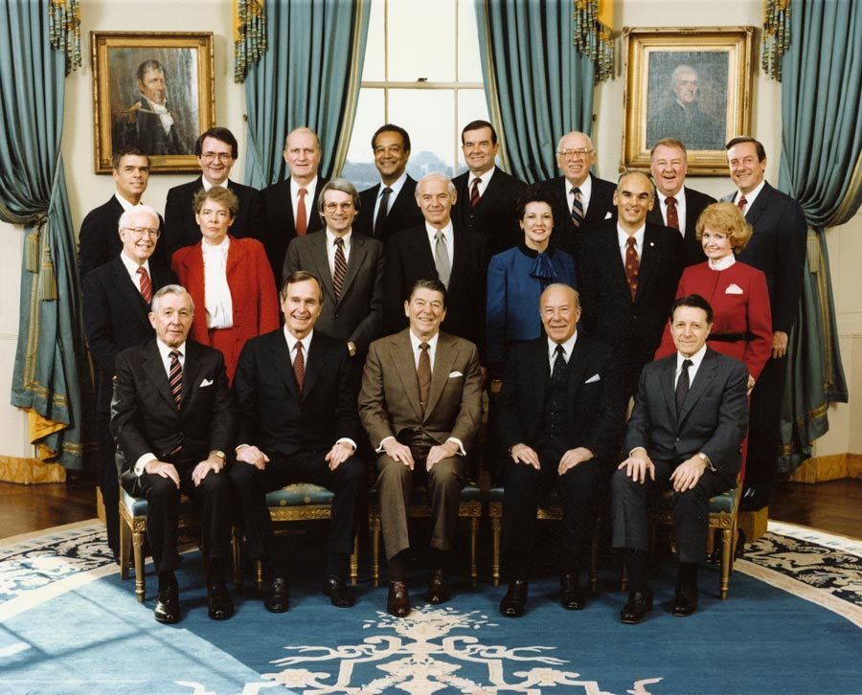
Conservative Policies Under Reagan and Bush
Chapter 33 – Section 2

Slide 2

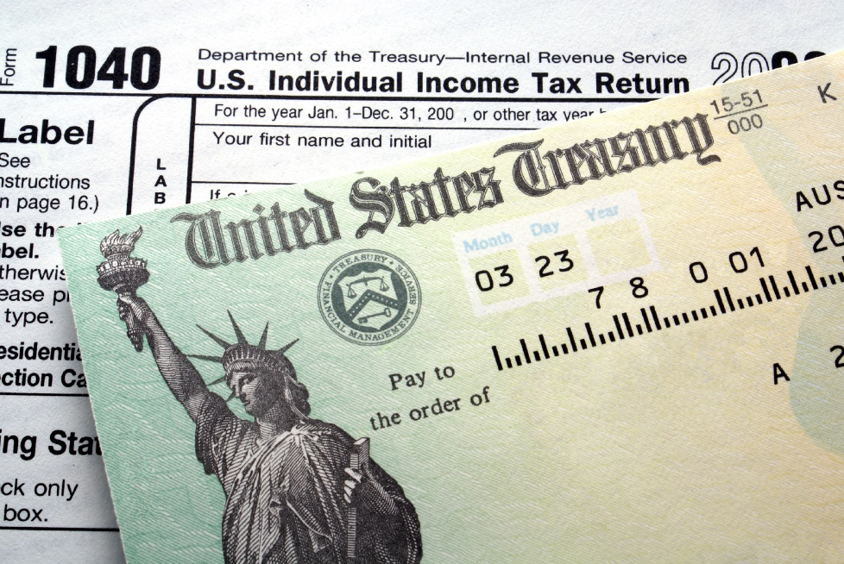

Reagan takes office on January 20, 1981
Once in office, Reagan reduced income tax rates and government spending massively.
Income Tax – A tax placed on people based on the amount of money they make

Slide 3
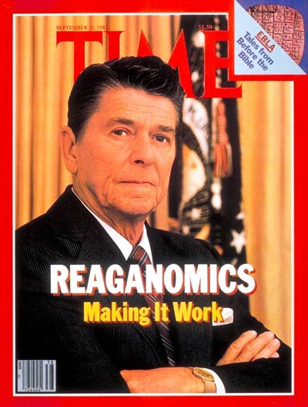
“Reaganomics”
Ronald Reagan and his economic advisers put forth policies that were very similar to 1920s Republicans:
“Reaganomics” Consisted Of
Decreasing overall government budget
Massive tax cuts, especially for the wealthy
Increased defense spending (military)
**Remember Hoover’s economic policies to fight the Depression?

Slide 4
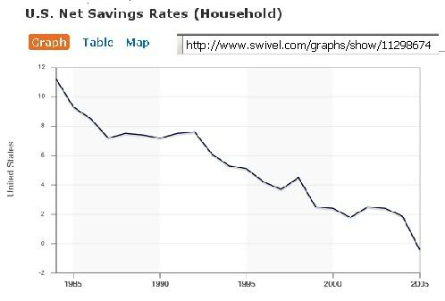
Effects on the Economy:
The wealthy thrived even more
The middle class was mostly unchanged because their entitlement programs were left alone
Lower classes of society suffered badly
Long term effect: Reagan widened the gap between “rich” and “poor” more than any other president in history.

Slide 5

The Continues:
In 1982, Reagan backed off from his massive tax cuts and began to raise the tax again when he realized the economy was getting worse.
This period is known as the “Reagan Recession” because after he was elected, the economy got even worse – though in some ways this is unfair because there were economic problems even before him.
Finally in 1983, the economy improved significantly.

Slide 6
Recovery & Re-Election
There are different arguments as to WHY the economy improved:
Some economists credit increased government spending and intervention after 1982
Conservative politicians today insist that it was the initial tax cuts that did it.
Other economists say that the recession had run its course and give little credit to politicians

Slide 7
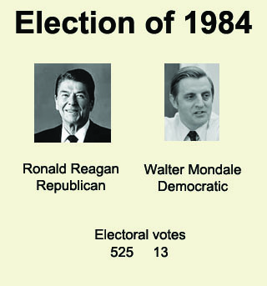
The Election of 1984
By the time re-election came around, anger towards Reagan for the recession has largely gone away.
Reagan/Bush vs Walter Mondale/Geraldine Ferraro (first woman on a major party’s presidential ticket)
Reagan/Bush won by a landslide

Slide 8
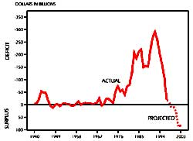
Long-term effects of Reagan’s economy:
The national debt doubled (mostly due to military spending)
Gaps between social classes grew wider
Deregulation of the economy (would lead to problems in the 90s)

Slide 9
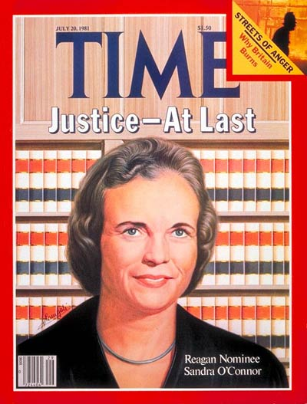
Reagan appoints Three Supreme Court Justices:
Antonin Scalia (Very conservative)
Sandra Day O’Connor (conservative, first woman)
Anthony M. Kennedy (conservative)
**Appointed William Rehnquist to Chief Justice (the most conservative justice already on the court)
The effect: The legal system dramatically shifted to the right – becoming more conservative.

Slide 10
The Election of 1988
Vice President George HW. Bush versus Michael Dukakis
Bush won because most Americans were comfortable and did not feel the need for any changes (Long-term effects not yet realized).
Bush built on Reagan’s legacy by promising, “Read my lips. No new taxes!” He also promised to continue promoting the “moral majority” and conservative morality.

Slide 11
Watch these campaign ads: Bush v Dukakis
What do the candidates accuse one another of?

