Slide 1
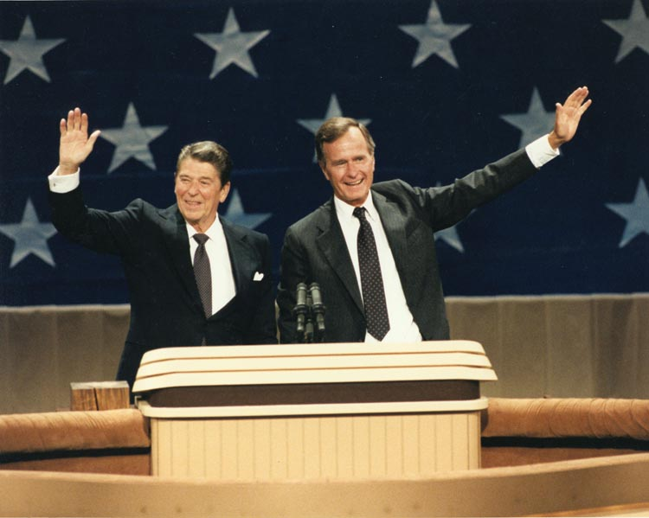
A Conservative Movement Emerges
Chapter 33 – Section 1

Slide 2
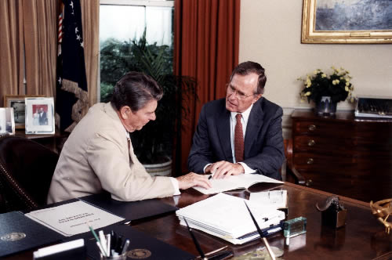
Introduction:
Since 1964, Conservatives had begun to argue that the Federal government had become too big and too powerful
They wanted to cut the size of the federal government and give the states more power (Remember Nixon’s goals?)
By 1980, government spending on entitlement programs had grown to $300 billion per year

Slide 3

Entitlement Program – A government program that guarantees social/economic benefits to a particular group or segment of society
The “New Right” versus “New Left” battled over social issues such as abortion, the Equal Rights Amendment, prayer in schools, and affirmative action.

Slide 4
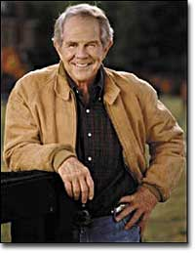
Goals of the “New Right”
Shrink the size of the federal government
Cut federal spending (programs)
Promote “family values” and patriotic ideals
Stimulate business by reducing government regulation
Lowering taxes significantly
Strengthen national defense

Slide 5
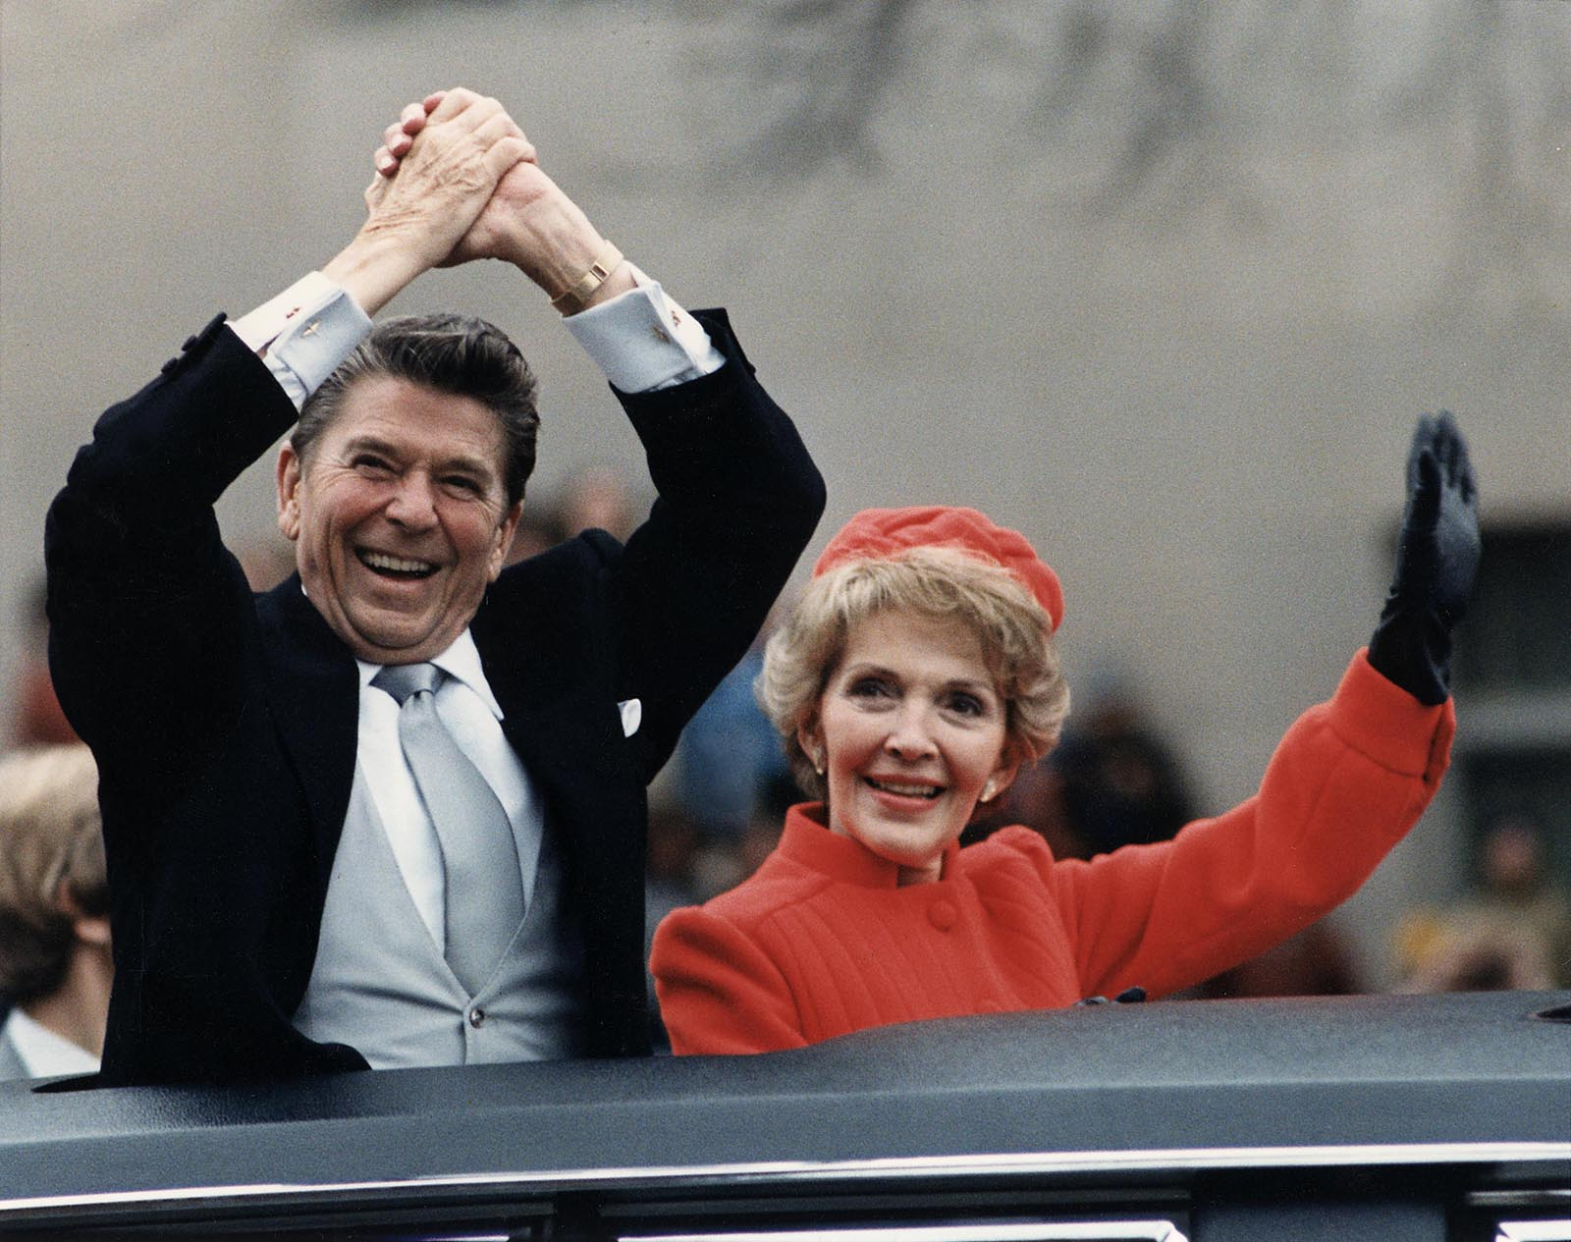
The Rise of Ronald Reagan
Although he lost to Gerald Ford for the Republican nomination in 1976, Ronald Reagan’s popularity continued to climb.
He was once a New Deal Democrat, but had switched sides during the 1950s.
“I did not leave the Democratic Party, the Democratic Party left me!”
-Ronald Regan

Slide 6
Reagan Wins the Election of 1980
Reagan won because he rallied the religiously minded “New Right” using a platform that spoke out against abortion, pornography, teaching of evolution, and the outlaw of prayer in schools.
He won by a landslide by appealing to many groups:
1. Business people who wanted the economy deregulated
2.Southerners who wanted limits on federal power
3. Westerners who resented federal controls on mining/grazing
4. Reagan Democrats who felt the Democratic Party had drifted too far to the left

Slide 7
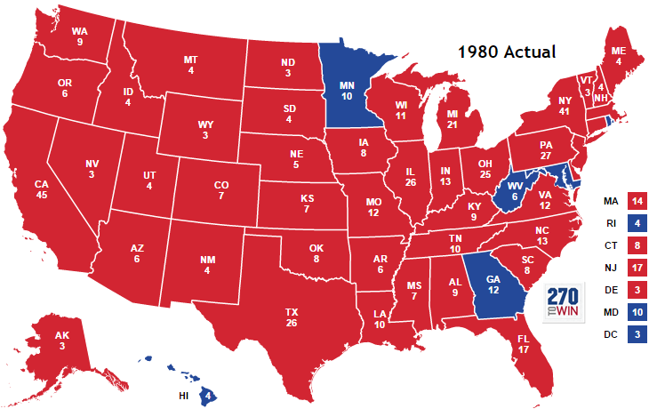

Slide 8
Assignment:
Create a campaign poster for Ronald Reagan using what you have learned about his platform and the “New Right”

